Slide 1
Biomarkers at the Interface of Delirium and Dementia
Tamara G. Fong, MD, PhD
Associate Scientist, Aging Brain Center,
Marcus Institute for Aging Research, HebrewSenior Life
Associate Professor of Neurology,
Beth Israel Deaconess Medical Center and Harvard Medical School

Slide 2
Overview
This webinar will explore mechanisms that might be common to both delirium and dementia
An overview of shared biomarkers
AD biomarkers
Neural injury biomarkers
Neuroinflammatory biomarkers
Neuroimaging biomarkers
Future directions

Slide 3
May lead to
DEMENTIA
DELIRIUM
Chronic/Insidious
Progressive
Preserved LOC
Memory
Acute
Fluctuating
Altered LOC
Inattention
vs
Increased risk

Slide 4
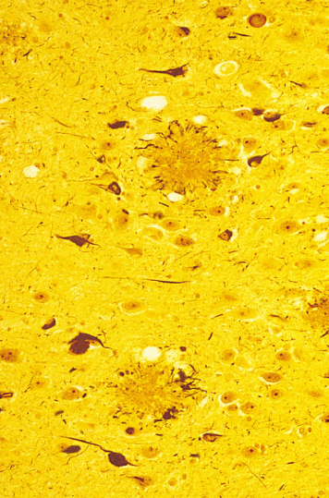
Delirium and Dementia
Neuropathological Biomarkers

Slide 5
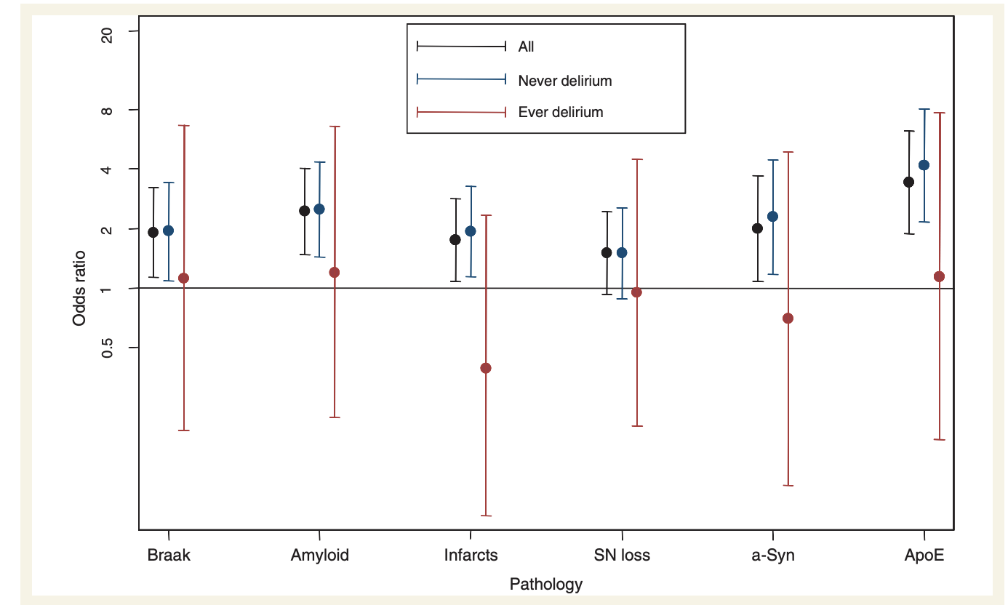
In this cohort of 553 individuals age 85 years and older, followed up to 10 years, delirium increased the risk of incident dementia (odds ratio 8.7, 95% CI 2.1-35)
delirium was associated with worsening dementia severity, new functional deficits, and accelerated decline in cognitive scores but did NOT appear to be mediated by classical neuropathologies associated with dementia

Slide 6
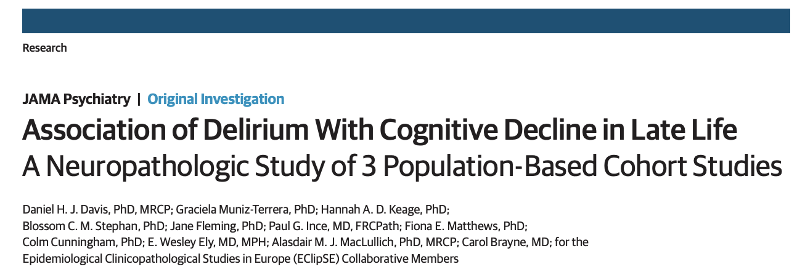
Harmonized data from 987 individual brain donors from 3 observational cohort studies with population-based sampling were used to examine whether the accelerated cognitive decline observed after delirium is independent of the pathologic processes of classic dementia
JAMA Psychiatry. 2017;74(3):244-251

Slide 7
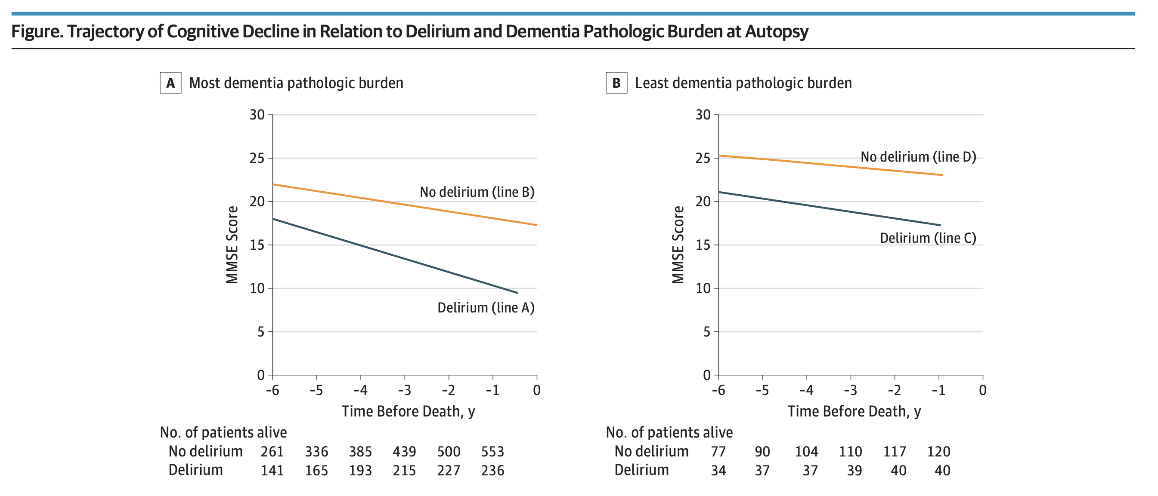
Notes:
The relationship between dementia and measures of neurofibrillary tau, amyloid burden, apolipoprotein (ApoE) ε4, vascular lesions and Lewy body pathology were strongest in the absence of a delirium historyt the acceleration of cognitive decline following delirium might result from an alternative mechanism leading to neuronal damage.

Slide 8
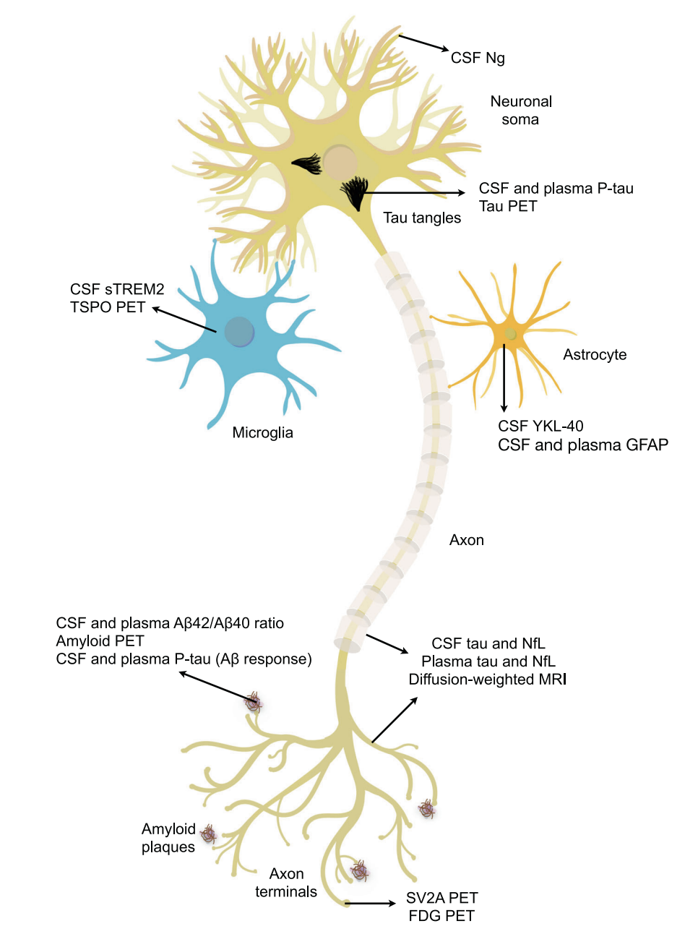
Delirium and Dementia
Fluid Biomarkers

Slide 9
Fluid biomarkers of AD
CSF
Delaby C et al. Rev Neurol (Paris). 2023
Notes:
Neural cells – Neuron, astrocyte, microglia – and AD pathology
Most specific are direct markers of Abeta and tau
Axons are rich in tau and NfL that leak into the CSF and blood during neuroaxonal degeneration
Astrocytic biomarkers – neuroinflammation and neurodegeneration
Microglial biomarkers - neroinflammation

Slide 10
Amyloid Tau Neurodegeneration (ATN) framework
Defines the biological state underpinning AD
Amyloid: Aβ40, Aβ42, Aβ42/40 ratio
Tangle: p-tau181 and others
Neurodegeneration: total tau [t-tau], neurofilament light [NfL]
Mattsson-Carlgren et al. Neurology May 2020
Notes:
define the biological state underpinning Alzheimer's disease
amyloid (Aβ40, Aβ42, Aβ42/40 ratio)
tangle (p-tau181 and others)
neurodegeneration (total tau [t-tau], neurofilament light [NfL])

Slide 11
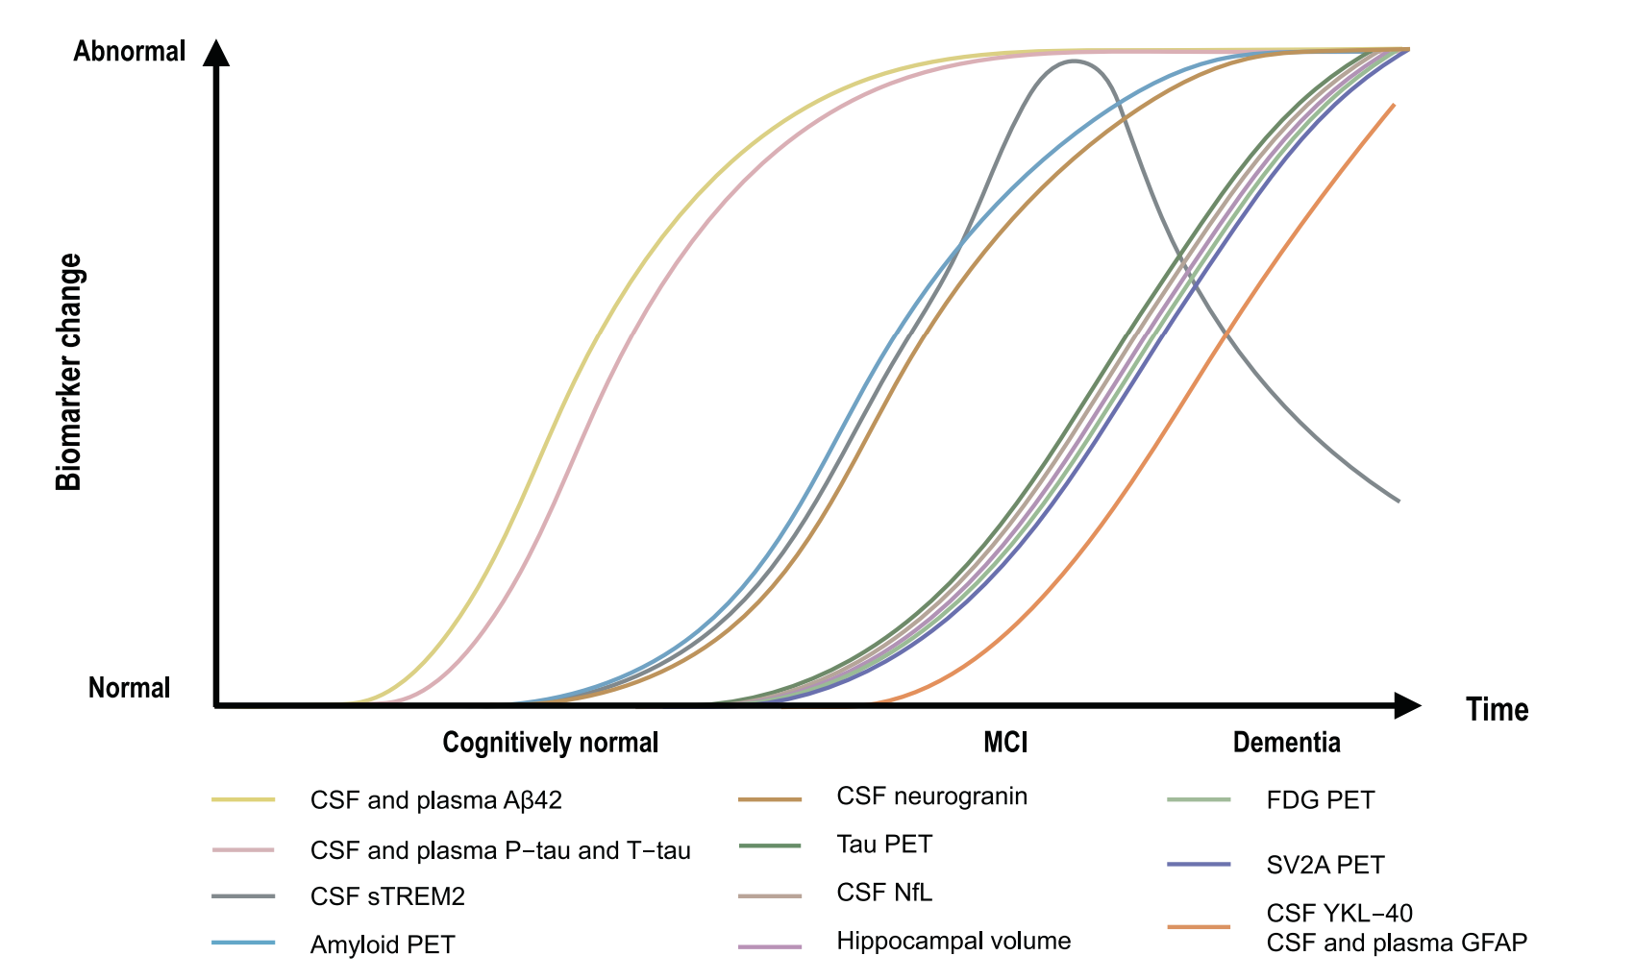
AD biomarkers change over time
Zetterberg, H Mol Psychiatry 26, 296–308 (2021)
Notes:
Which come first, the chicken or the egg? How might these biomarkers influence or be affected by delirium?

Slide 12
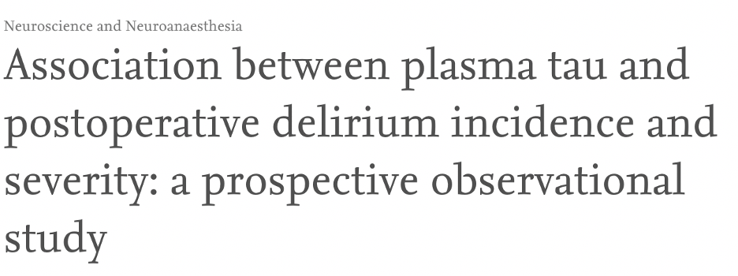
Prospective observational cohort, N=114 of older surgical patients
Change in plasma p-tau from preop to POD1 was greater in patients with delirium and (P<0.001) and correlated with delirium severity (ρ=0.39, P<0.001)
after adjusting for age, sex, preoperative cognition, and change in IL-8, tau remained significantly associated with delirium severity (P=0.026).
Using linear mixed effect models, only tau (not NfL or IL-8) predicted recovery from delirium (P<0.001).
GFAP showed no relationship with delirium

Slide 13
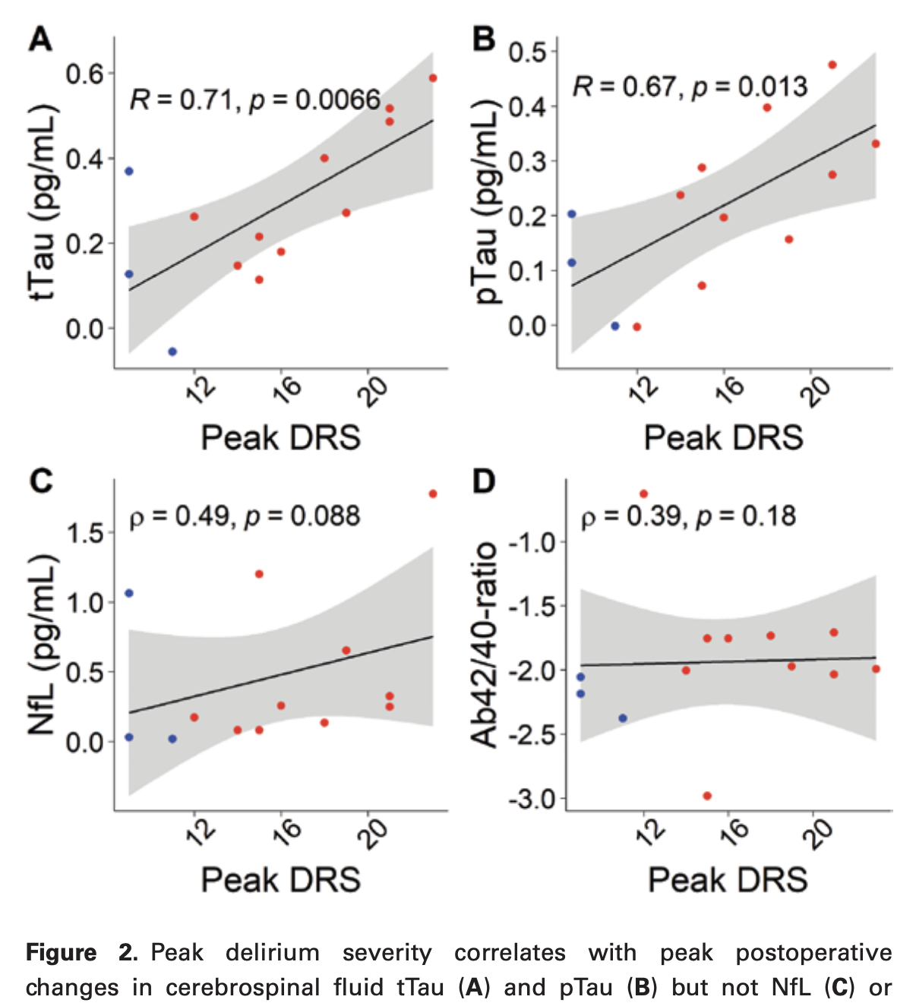
N=32 older adults undergoing thoracoabdominal aneurysm repair with anticipated placement of a spinal drain
N=31 (22 delirium, 9 no delirium) with delirium assessment
Plasma NfL, tTau, pTau, Ab42, and Ab40 (118 samples)
CSF tTau, pTau, Ab42, and Ab40 (54 samples)
All biomarkers increased postoperatively (p < .05, n = 13 paired preop– postop samples)
Delirium severity was associated with peak changes in CSF tTau and pTau but not NfL or Ab42/40-ratio No association between delirium severity and plasma ATN
Sensitivity analysis with exclusion of participants with putative spinal cord ischemia shifted the NfL result to significance (p < .001, ρ = .847).

Slide 14
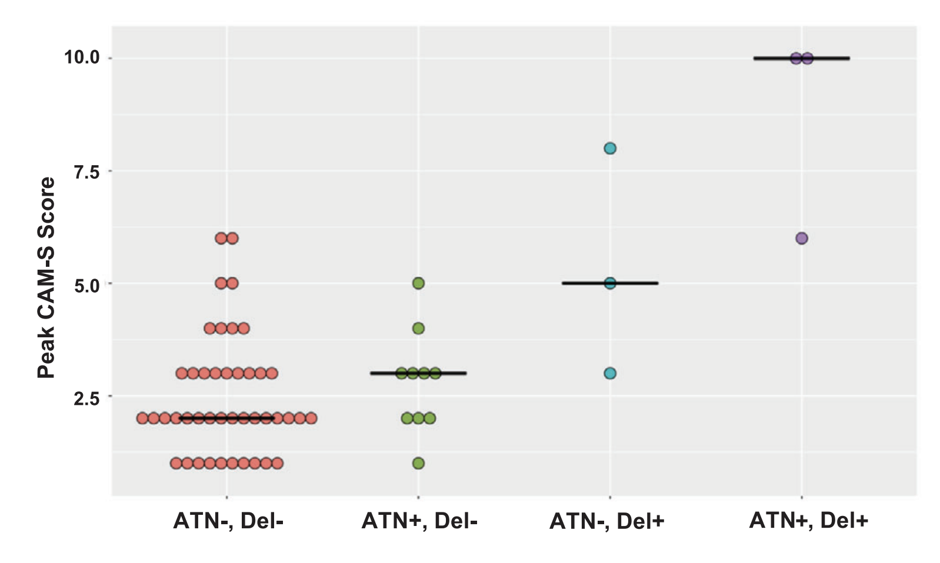
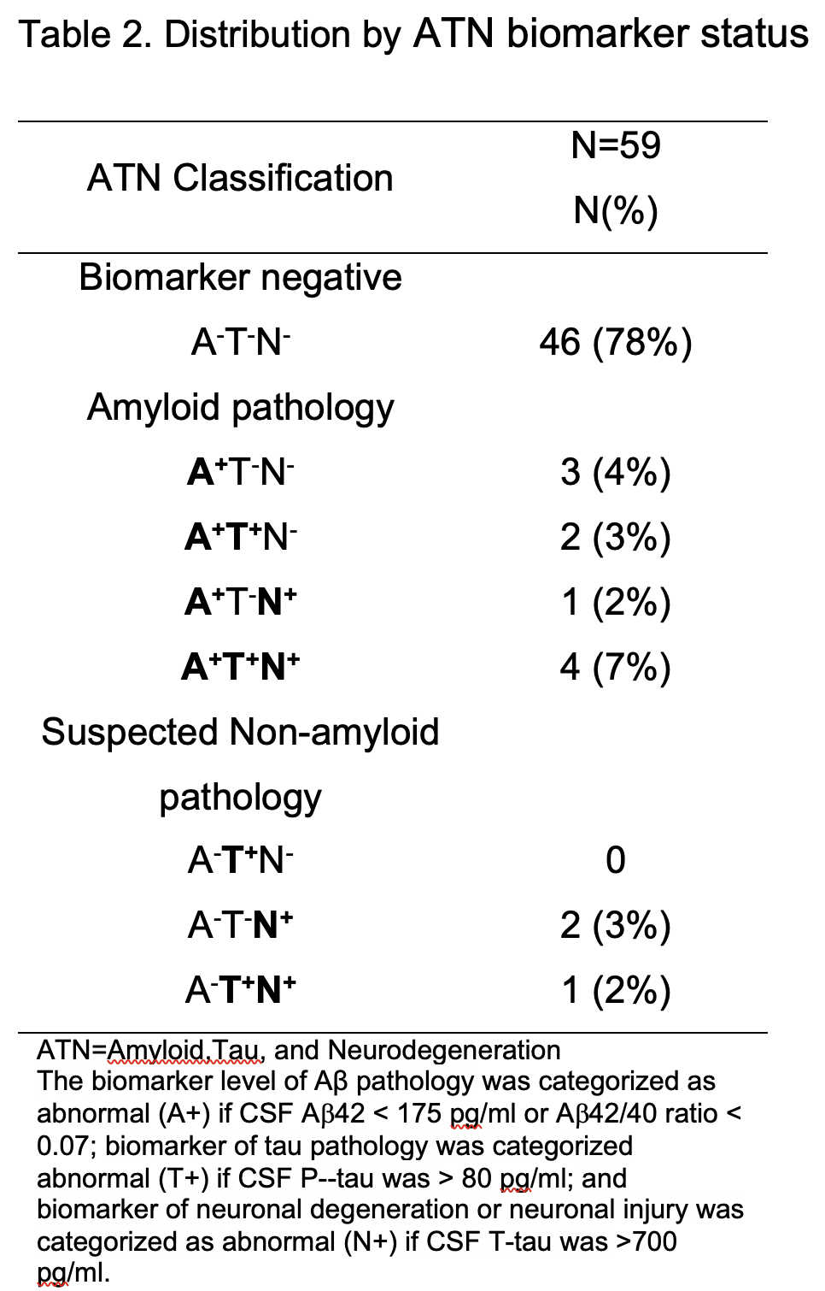

Slide 15
100 participants in the Interventions for Postoperative Delirium: Biomarker-3 (IPOD-B3) cohort study
aged >65 yr undergoing non-intracranial surgery
Outcomes: plasma amyloid beta ratio (AβR; Aβ42:Aβ40) and delirium incidence (3D-CAM) and severity (DRSR-98)
plasma Aβ42:Aβ40 increased preop to POD 1 (Wilcoxon P<0.001)
not associated with delirium incidence (Wilcoxon P=0.22)
not associated with peak severity after adjusting for confounders (log[incidence rate ratio]=0.43; P=0.14).

Slide 16
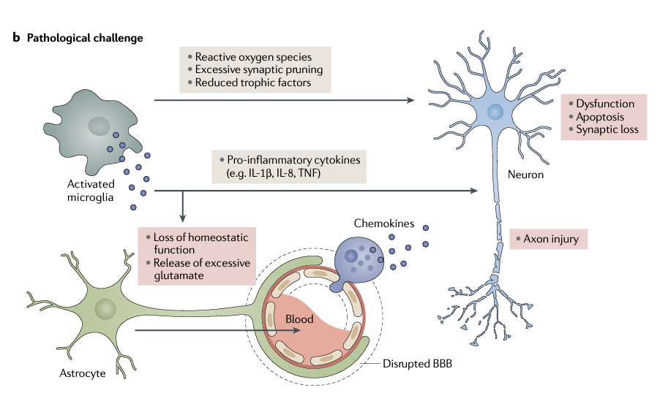
Neuroinflammation and microglial activation
Leng F and Edison P. Nat Rev Neurol. 2021

Slide 17
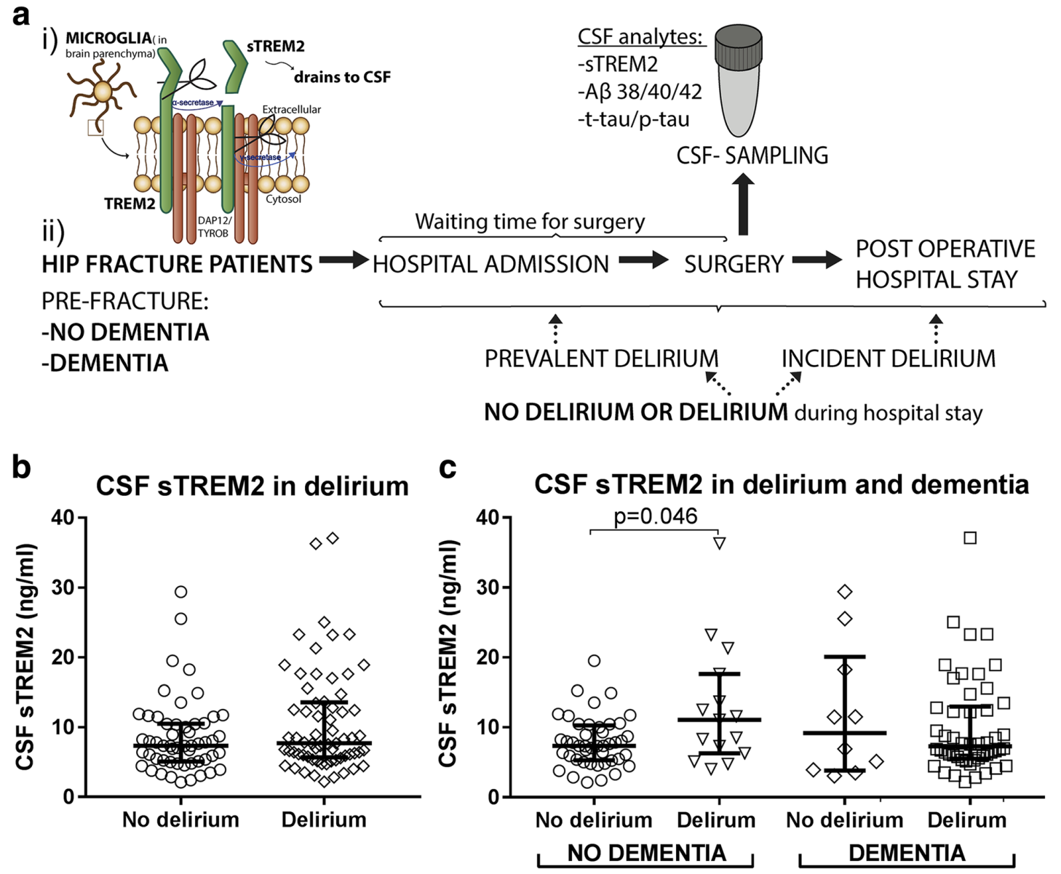
patients with or without pre-existing dementia undergoing acute hip fx surgery (n = 120)
delirium (n = 65).
Delirium was associated with a higher level of CSF sTREM2 only among those without pre-existing dementia (p = 0.046, n = 15, n = 44), particularly among patients developing delirium
CSF sTREM2 level increased with waiting time for surgery (rS = 0.39, p = 0.002, n = 60) and correlated well with the CSF Alzheimer’s disease biomarkers, Aβ42, and t-tau/p-tau
findings support the concept of primed microglia in neurodegenerative disease and central immune activation after a peripheral trauma in such patients
Notes:
people with clinical AD have constant activation of microglia by Aβ deposits and tau inclusions, and therefore the effect of delirium on microglial response is attenuated and the association is not observed

Slide 18
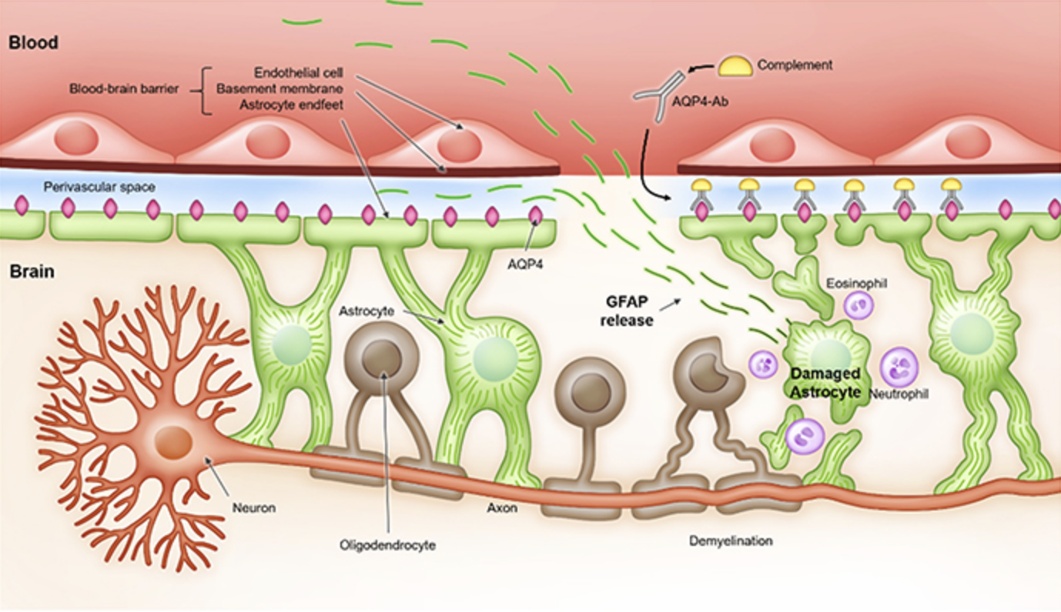
Neural Injury
GFAP
Neurofilament light chain

Slide 19
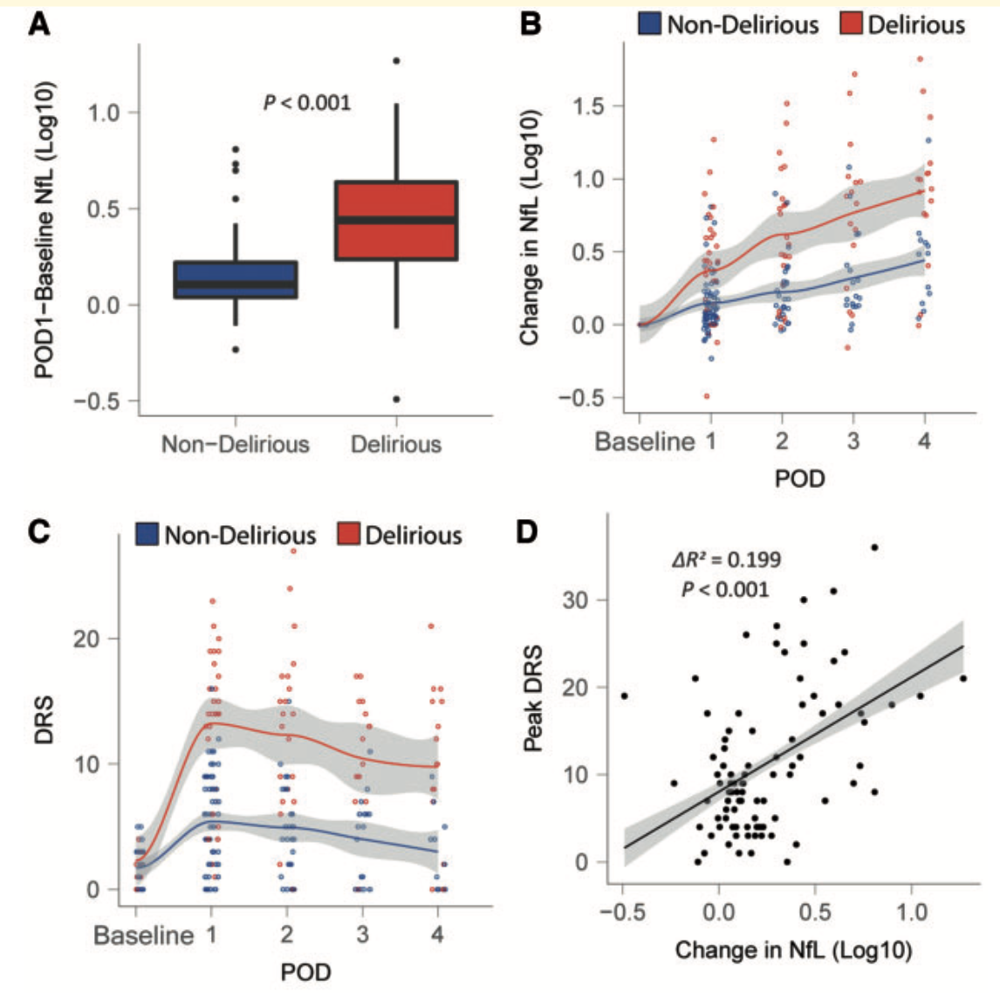
N=114 surgical patients
surgery was associated with increasing NfL levels from preoperative levels (P < 0.001 )
NfL increased more sharply in participants with delirium compared to no delirium (P < 0.001)
NfL increased proportionately to delirium severity (P<0.001)
IL-8 exhibited a strong correlation with delirium severity, however the change in NfL contributed to delirium severity independent of IL-8
These data suggest delirium is associated with exaggerated increases in NfL and that this putative neurotoxicity may contribute to the pathogenesis of delirium itself, independent of changes in inflammation.

Slide 20
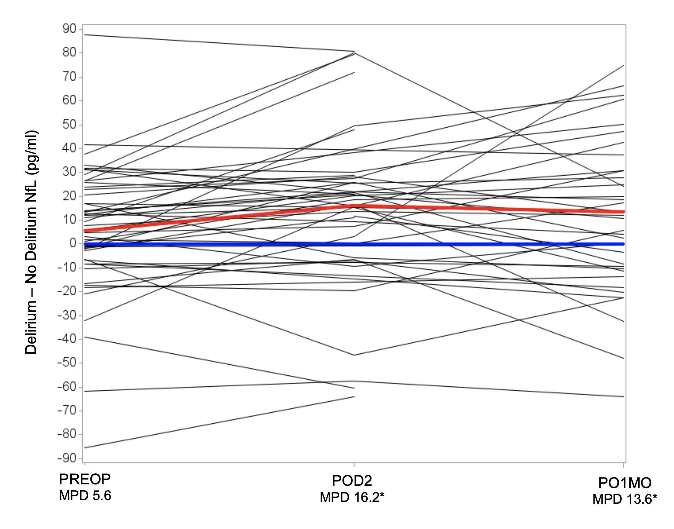
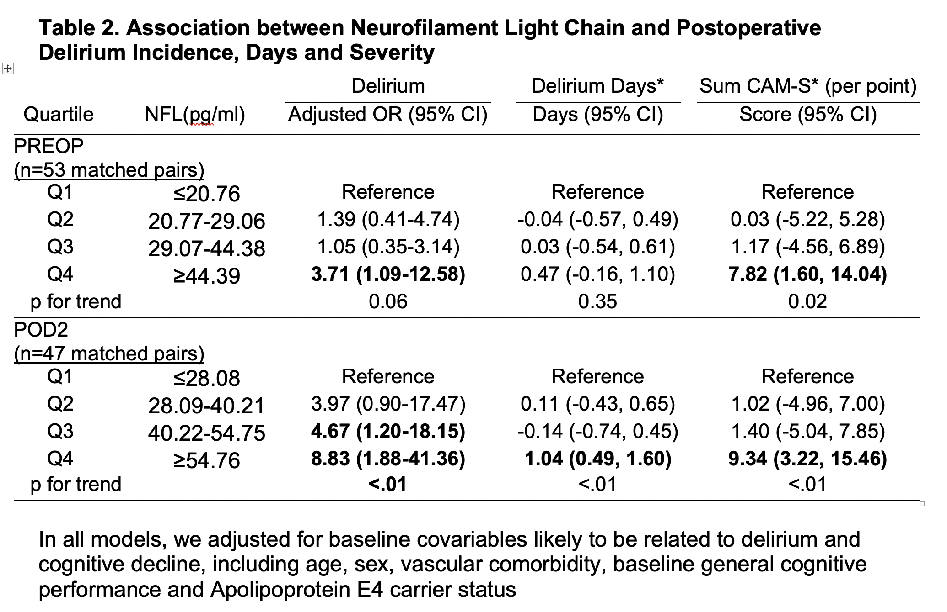

Slide 21
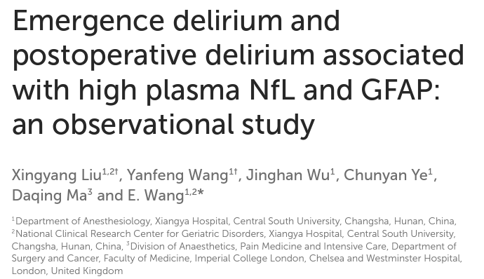
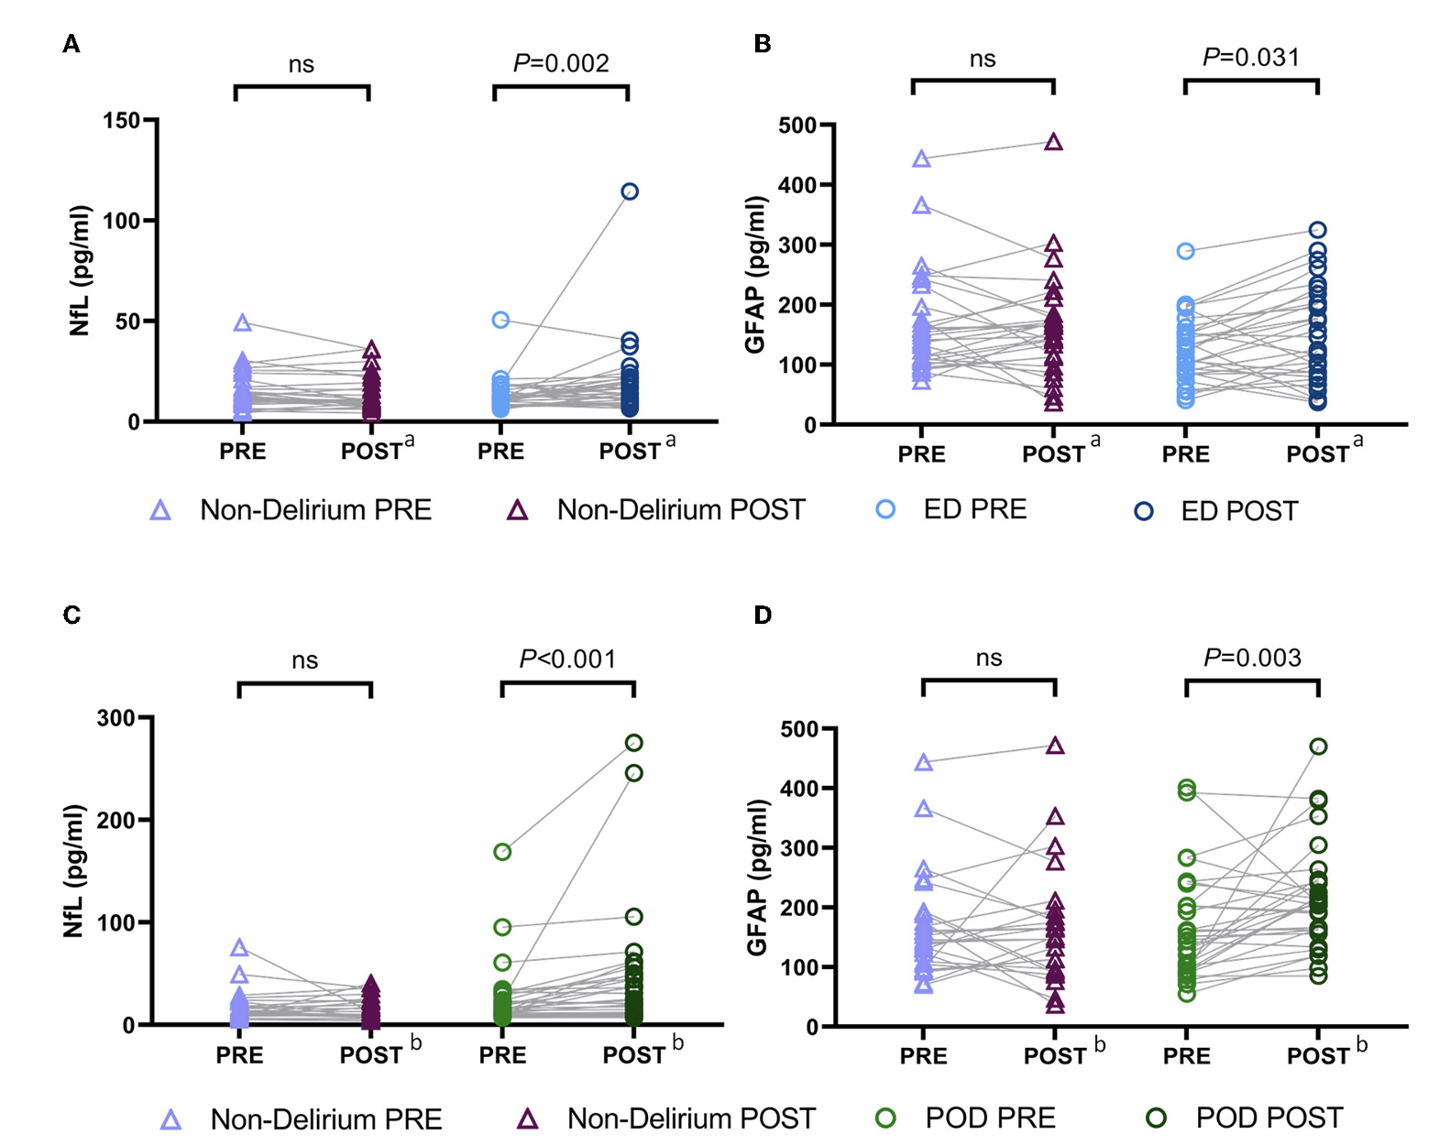
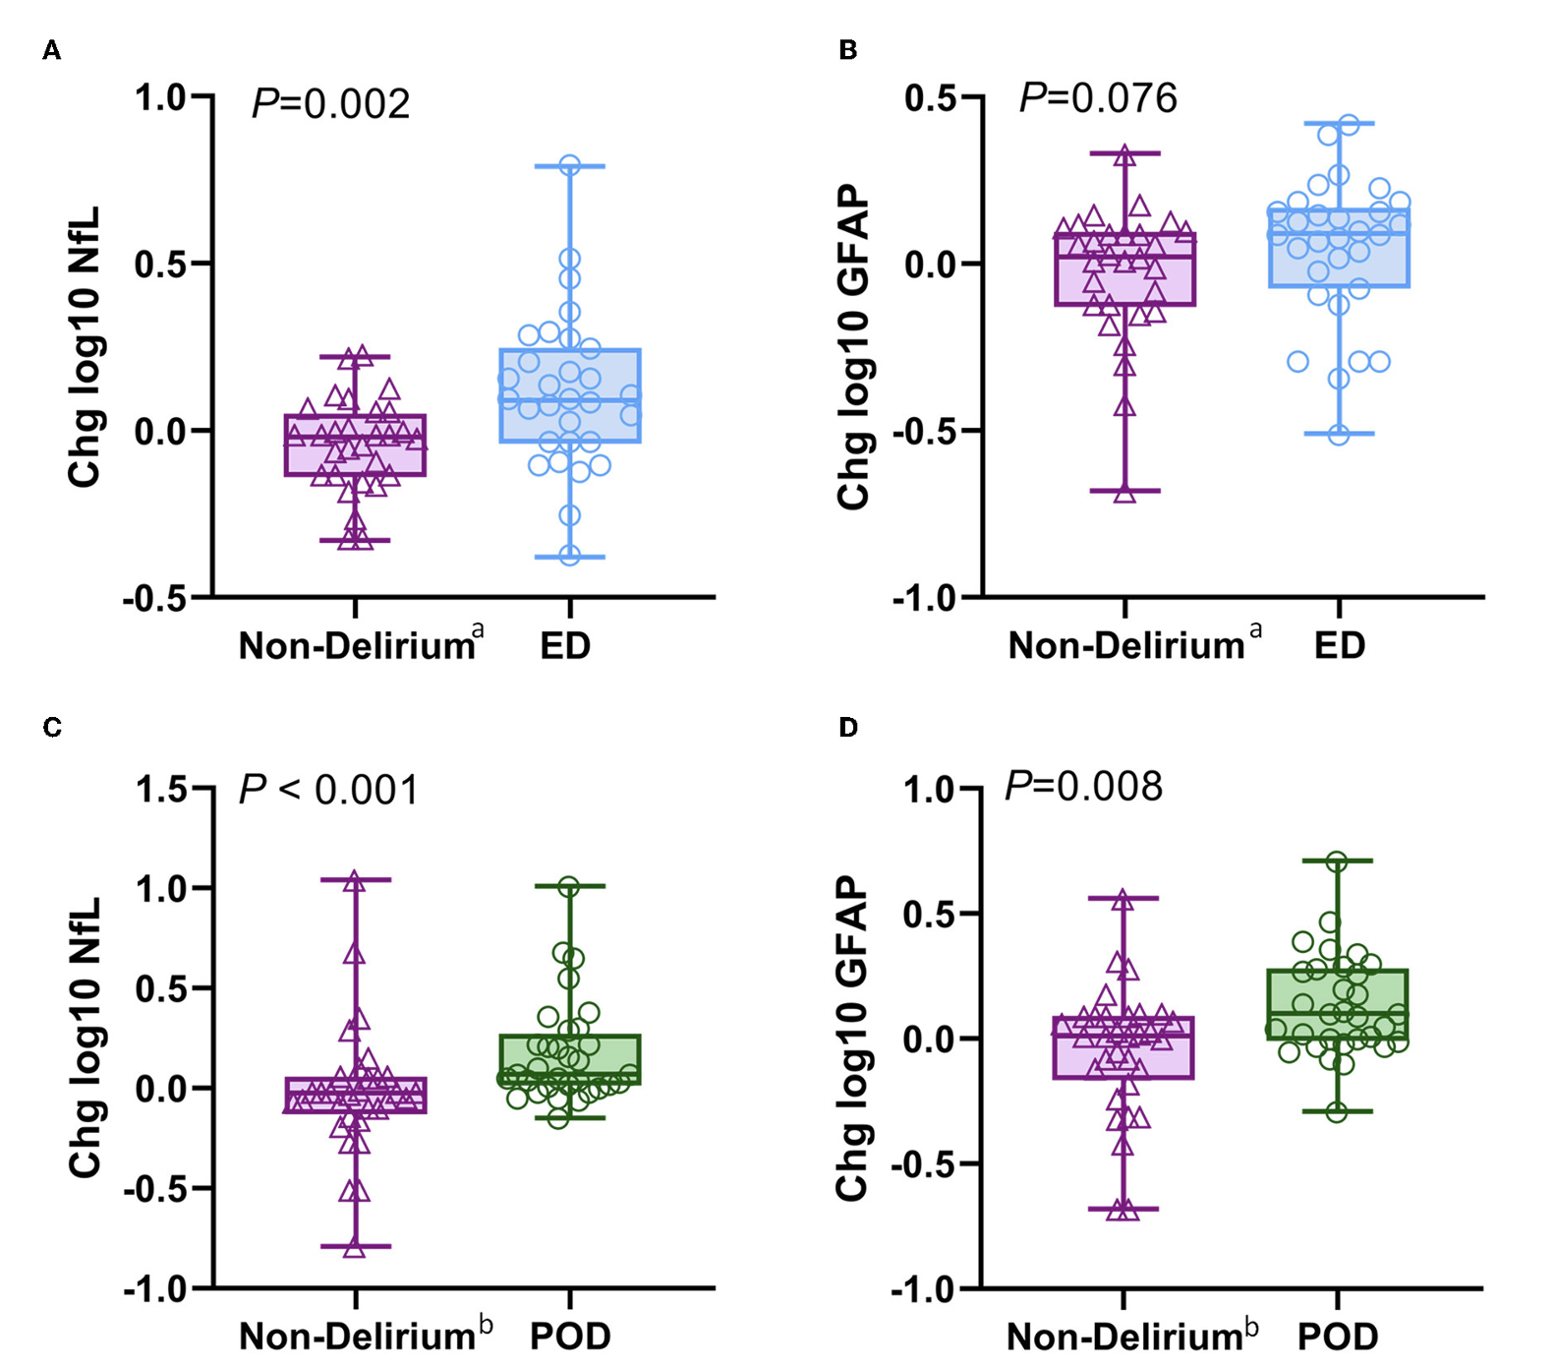
Elective surgery, age > 60
N= 30 matched emergence delirium and no-delirium; n=32 matched POD and no-delirium
Blood collected pre-op, 20 min and 24hours after surgery
Following surgery, there were significant increases in plasma NfL and GFAP in both ED and POD patients
Suggests that ED is associated with a more significant axonal injury during surgery, while POD is accompanied by activation of the astrocyte.
0→ 24hr
Emergence delirium
0→ 20min
Emergence delirium
Post-operative delirium
Post-operative delirium

Slide 22
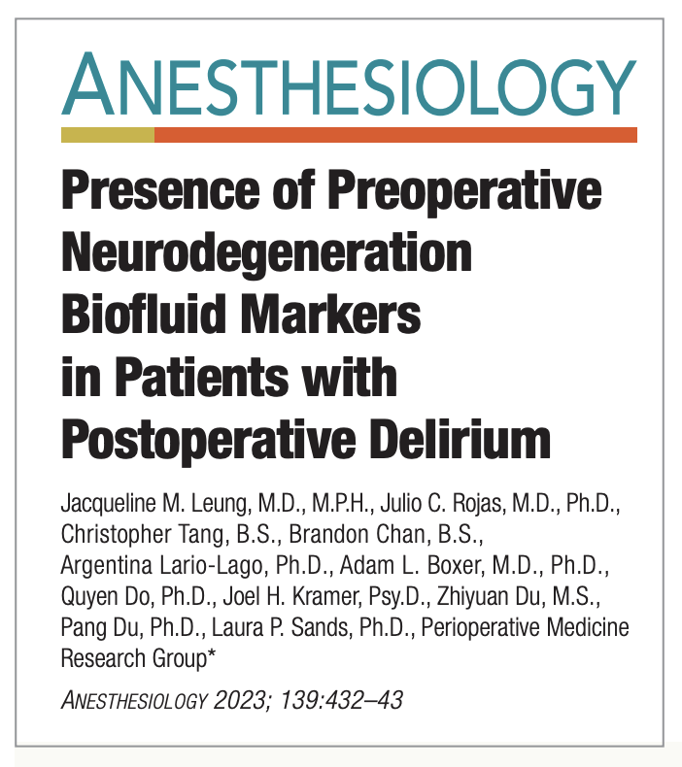
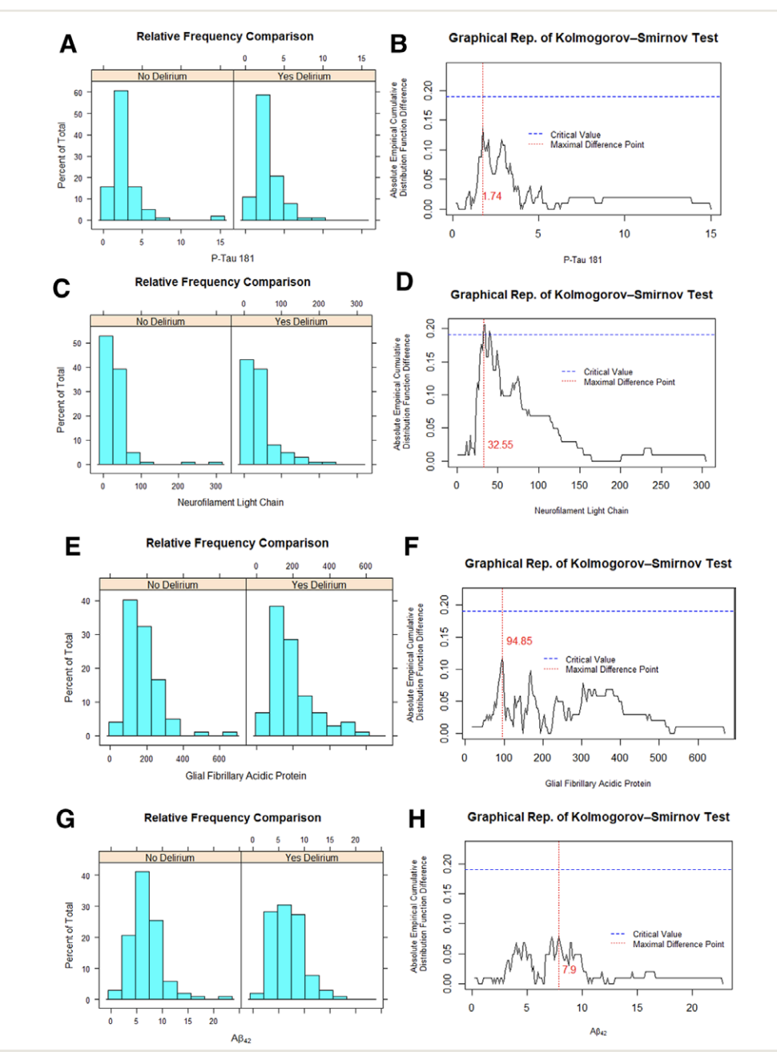
Non-normal distribution
Non-parametric statistical analysis
claims a significant difference between the distributions of the biomarker measurements for the two groups when the supreme or maximum of the absolute difference function (red) is greater than the critical value (blue) determined by the test procedure.
patients > 65, elective noncardiac surgery
n= 189 with no delirium; n= 102 patients who developed postoperative delirium → 102 matched pairs by age and sex using propensity scoring
preoperative plasma P-Tau181, NfL, (Aβ42), and GFAP

Slide 23
Summary of fluid biomarker evidence
Neuroinflammation
associated with both dementia and delirium, separately
the influence of neuroinflammation on delirium in the presence of dementia pathology seems to be variable
AD
most but not all studies support an association between the presence of AD biomarkers and delirium incidence
gene–protein interactions may modify other processes (i.e. neuroinflammation) to promote delirium
Neural injury markers
neuronal, astrocytic and glial biomarkers are mixed
delirium itself might promote additional injury and further release of injury markers
multiple injury pathways (via AD, neuroinflammation, etc.) may be involved in the relationship between delirium and dementia

Slide 24
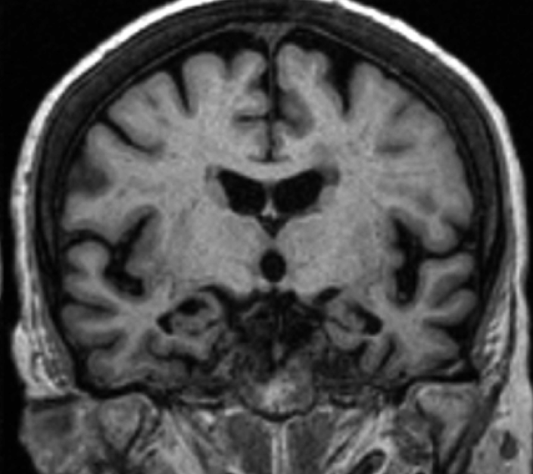
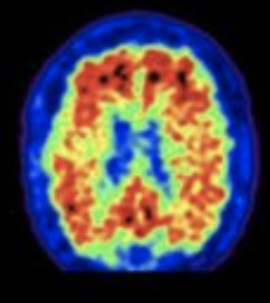
Delirium and Dementia
Neuroimaging Biomarkers

Slide 25
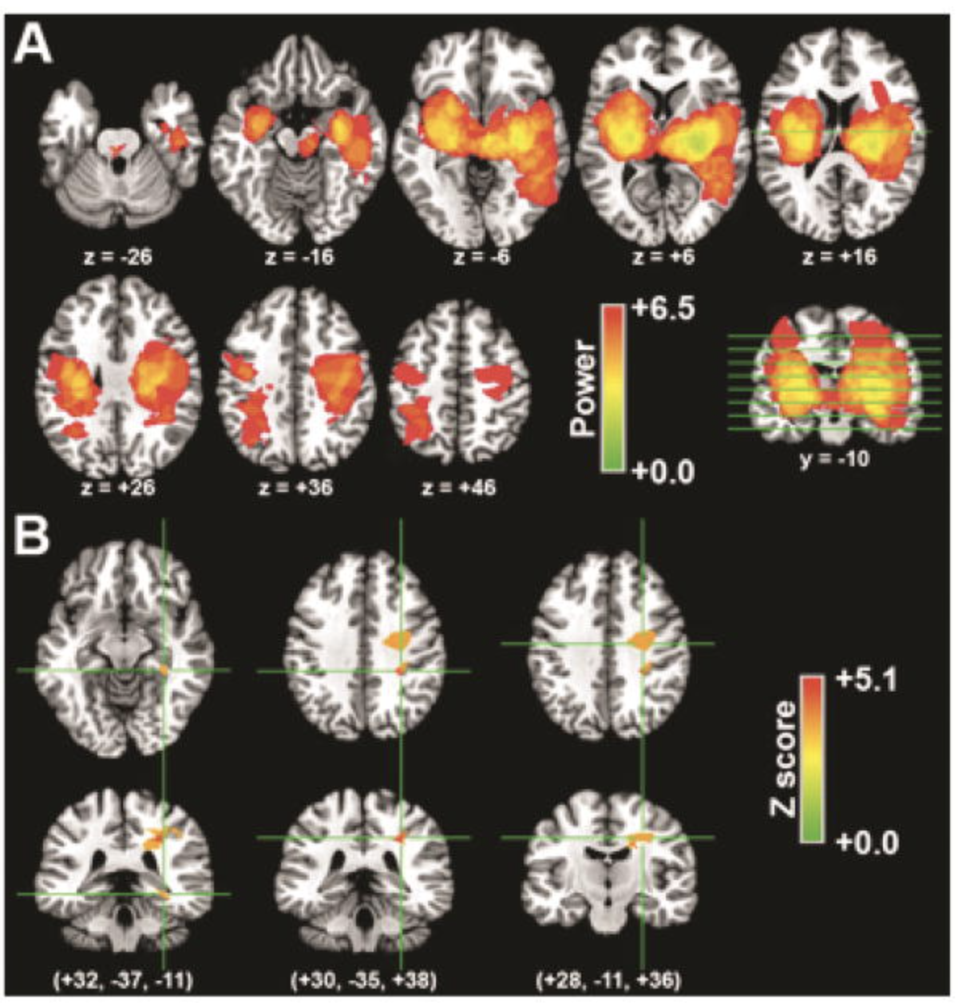
Neuroanatomic basis for delirium symptoms
Prospective cohort, spontaneous ICH (n=89)
Delirium assessed twice daily using CAM-ICU
25 patients developed delirium (28.1%)
Voxel-based lesion-symptom mapping (VLSM) using NCHCT
R parahippocampal gyrus (RR 7.8; p<0.009)
R posterior superior longitudinal fasciculus (RR6.9; p=0.002)
R anterior superior longitudinal fasciculus (RR6.5; p=0.01)
Size of hematoma was not significant
Right parahippocampal region and right parietal lobe are associated with acute delirium symptoms
Naidech AM et al. Neurocrit Care. 2016

Slide 26
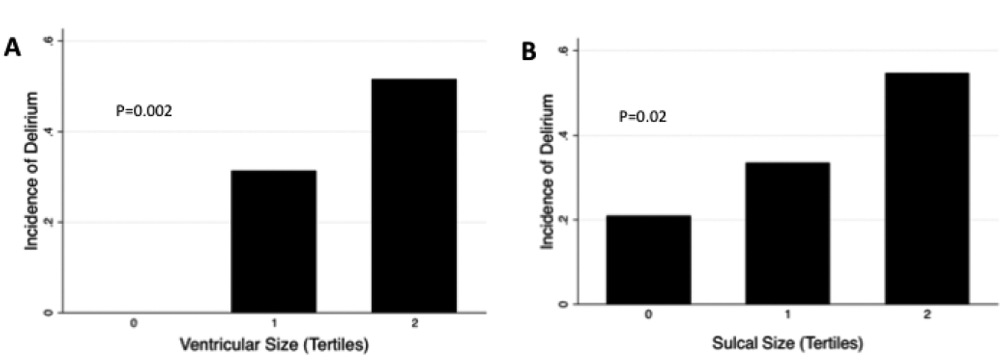
Brain volume and Cerebral Atrophy
Brown CH et al. Clin Ther. 2015
Cavallari M et al. Neurobiol Aging. 2015
Patients underwent MRI at a median of 6 days following cardiothoracic surgery (n=79)
Delirium assessed by validated chart-review
N=28 (35.4%) developed POD
Ventricular size (OR 3.59) and sulcal size (OR 2.15) were associated with POD
Prospective study of older adults undergoing elective surgery. MRI sub-study (n=146)
Delirium assessed daily post-op using CAM
32 (22%) developed POD
no differences were observed
whole brain (996.79 vs. 1018.71 cm3; p =0.334)
hippocampal volumes (3.25 vs. 3.23cm3; p =0.862
Variable findings in association of brain volume and cerebral atrophy and delirium include natural individual variations in brain volumes and differences in measurement techniques

Slide 27
Reduced Grey Matter Volume is a risk for delirium
Patients scheduled for cardiac surgery (n=119)
MRI obtained pre-surgery for atlas-based estimation of brain volume
Delirium assessed daily using DSM-IV-TR criteria
N=19 (16.4%)
Decreased GM volume in delirium group (p<0.05 after adjustment); WM volume NS
temporal lobe (p<0.05)
limbic lobe (p<0.05)
GM volume (as fraction of total volume) can predict delirium
middle temporal gyrus AUC=0.813
fusiform gyrus AUC=0.824
Decreased volume leads to vulnerability under stress?
Shioiri A et al. Am J Geriatr Psychiatry. 2016

Slide 28
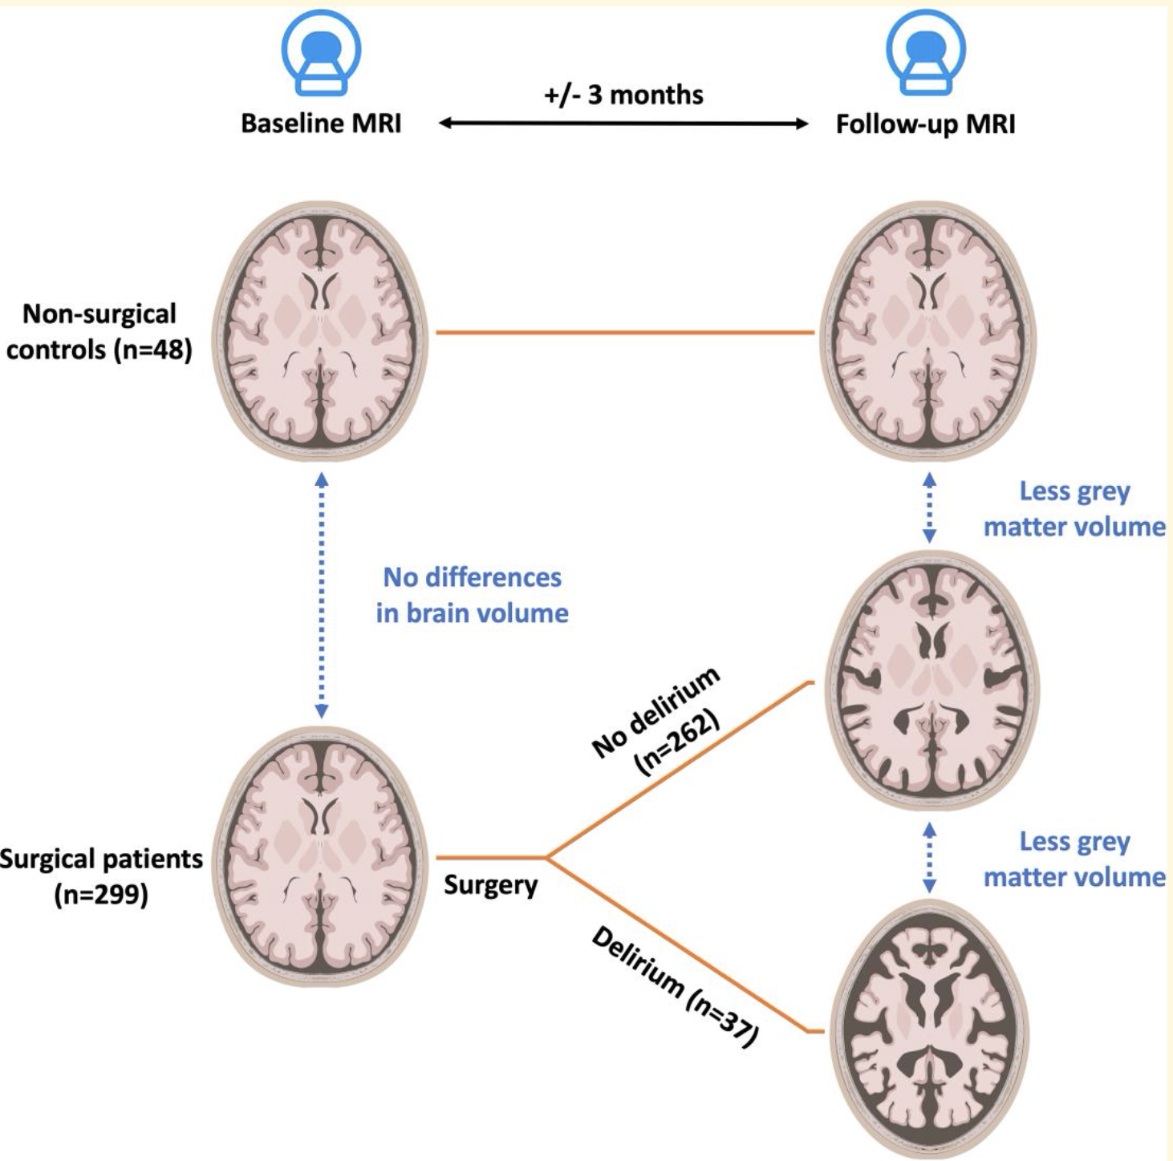
Grey matter volume loss is associated with Delirium
Observational longitudinal multi-center study
Surgical (n=299) and control (n=48) cognitively healthy (MMSE > 24) participants
MRI obtained at baseline and 3-months
Delirium by CAM-ICU, NuDESC, chart review
N=37 (12%) developed POD
Surgical vs. non-surgical patients showed greater decrease in grey matter volume [−0.65% of intracranial volume (−1.01 to −0.29, P<0.005)].
Within the surgery group, delirium was associated with a greater decrease in grey matter volume [−0.44% of intracranial volume (−0.82 to −0.06, P=0.02)]
Kant IMJ et al. Brain Commun. 2023

Slide 29
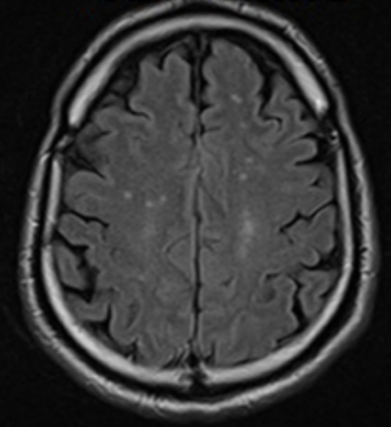
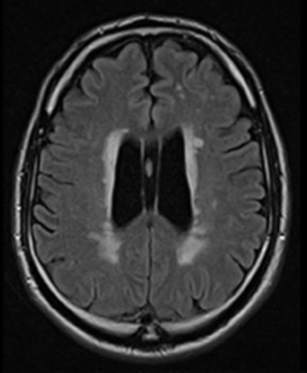
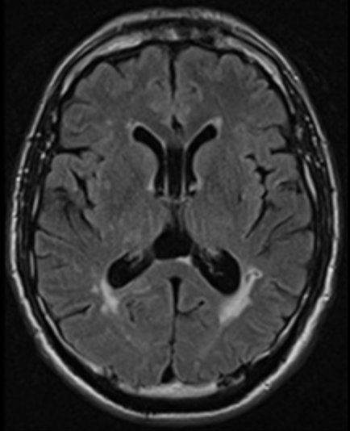
White matter hyperintensities
Hatano Y et al. Am J Geriatr Psychiatry. 2013
Patients scheduled for cardiac surgery underwent pre-operative Brain MRI (n=130)
Blinded review (modified Fazekas criteria) for DWMH and PVH
Delirium determined by retrospective chart review, DSM-IV criteria
N=18 (14%) developed POD
Severe baseline WMH more prevalent in delirium
OR 3.9, 95%CI: 1.12–12.5; p=0.02
Cavallari M et al. Neurobiol Aging. 2015
Prospective study of older adults undergoing elective surgery. MRI sub-study (n=146)
Delirium assessed daily post-op using CAM
N= 32 (22%) developed POD
A trend for association was observed
WMH volume[delirium vs .control]:10.24 vs. 11.55cm³; p=0.710
The findings from other studies of WMH and delirium are mixed, possibly due to differences in methodology. Most studies are in post-surgical populations, and the findings may not be generalizable.

Slide 30
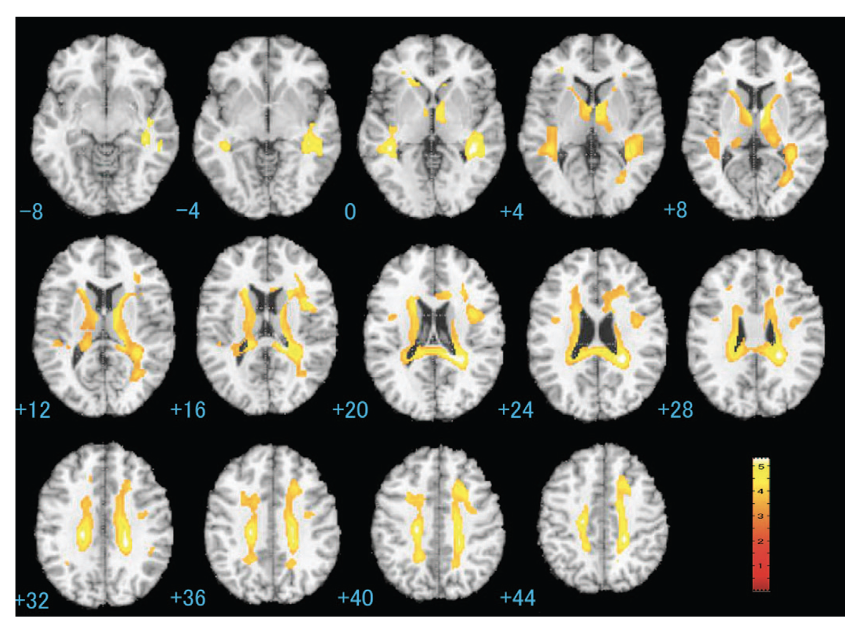
Diffusion Tensor Imaging
Patients undergoing elective cardiac surgery (n=116)
Delirium assessed daily using DSM-IV-TR criteria
delirious patients (n=19, 16.4%) demonstrated significant reduction in FA in many areas
Controlling for age - values in four clusters remain significant (p ≤ 0.01)
left subgyrus of frontal lobe
right cingulate gyrus
left ventral anterior nucleus of the thalamus
corpus callosum
Alterations in the microstructure of the WM may increase risk for delirium
Shioiri A et al. Am J Geriatr Psychiatry. 2010

Slide 31
Delirium duration is associated with white matter disruption
Prospective, convenience sample of ICU survivors (n= 47)
CAM-ICU performed twice daily up to 28 days.
N=32 (68%) with delirium
MRI Brain at discharge and 3 months later
MRI Brain found lower FA in association with longer delirium duration
genu (p = 0.04)
splenium of corpus callosum (p = 0.02)
anterior limb of the internal capsule (p = 0.01)
these associations persisted for 3 months in the genu (p = 0.02) and splenium (p = 0.04) of the corpus callosum after adjusting for age and sepsis
Lower FA values were also associated with attention and verbal fluency
Compromised white matter integrity in areas of the brain involved in interhemispheric connectivity are associated with delirium
Morandi A et al. Crit Care Med. 2012

Slide 32
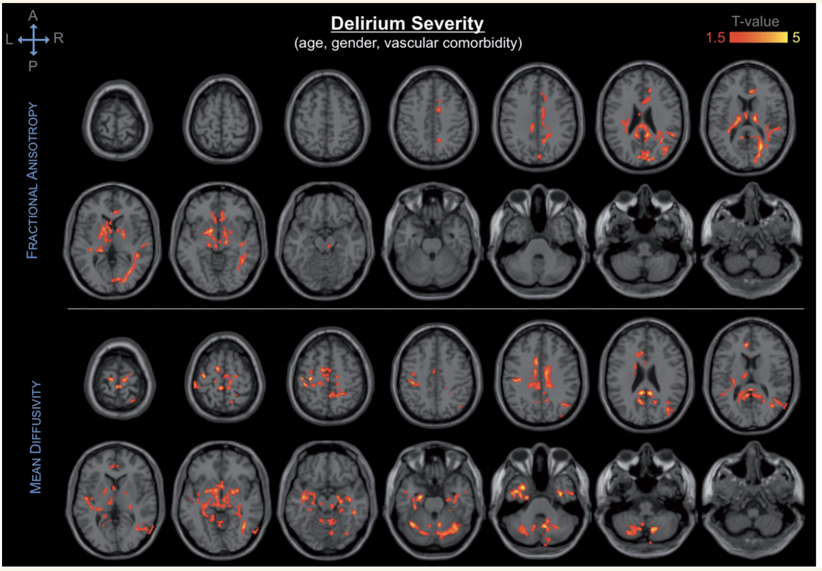
Diffusion tensor imaging identifies neural substrates of vulnerability to delirium
Prospective study of older adults undergoing elective surgery. MRI sub-study (n=146; 136 completed DTI)
Delirium assessed daily post-op using CAM
29 (21%) developed POD
DTI abnormalities were associated with delirium incidence and severity (p < 0.05)
cerebellum
cingulum
corpus callosum
internal capsule
thalamus
basal forebrain
occipital, parietal and temporal lobes (including hippocampus)
These effects persisted in the cerebellum, hippocampus, thalamus and basal forebrain after controlling for cognitive performance (p < 0.05)
Structural dysconnectivity and microstructural tissue changes can predispose to delirium under the stress of surgery
Cavallari M et al. Brain. 2016

Slide 33
MRI brain phenotypes might predict delirium
Observational longitudinal exploratory multi-centre study
Older adults scheduled for elective surgery (n=161)
MRI obtained at baseline; hierarchical clustering approach to analyze brain MRI markers (brain volumes, WMH, brain infarcts and perfusion); participants assigned to one of six phenotypes
Delirium measures: CAM, CAM-ICU, NuDESC, chart review
24 (15%) developed delirium.
Logistic regression analysis for multi-burden pathology associated with delirium (n = 15 (9%), odds ratio (95% confidence interval): 3.8 (1.1–13.0).
N=103
N=34
N=9
N=15
Kant et al. Neurobiol Aging. 2021

Slide 34
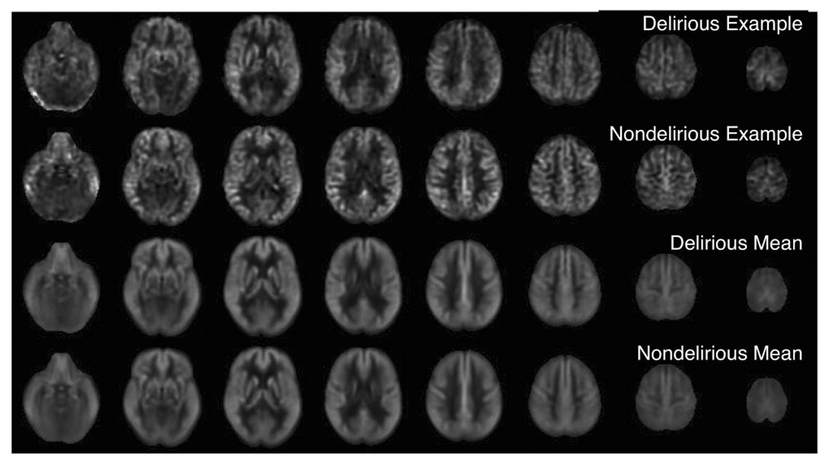
Changes in cerebral perfusion
Transcranial Doppler
ASL-perfusion MRI
MRI sub-study (n=146) , n=32 (22%) developed POD
The DSD group demonstrated lower FV compared to:
Alzheimer’s dementia (p = 0.04),
delirium alone (p = 0.009)
acute illness (p < 0.001)
Mean FV increased post-delirium resolution (p = 0.006) Caplan et al., 2014.
Other studies in ICU patients also found that reduced blood flow could predict subsequent delirium (Pierrakos et al., 2014, Schramm et al., 2012, Pfister et al., 2008)
Measurements from TCD support reduced blood flow to be associated with delirium
No association between global and voxel-wise CBF and POD incidence or severity
Hshieh TT, et al. J Cereb Blood Flow Metab. 2017

Slide 35
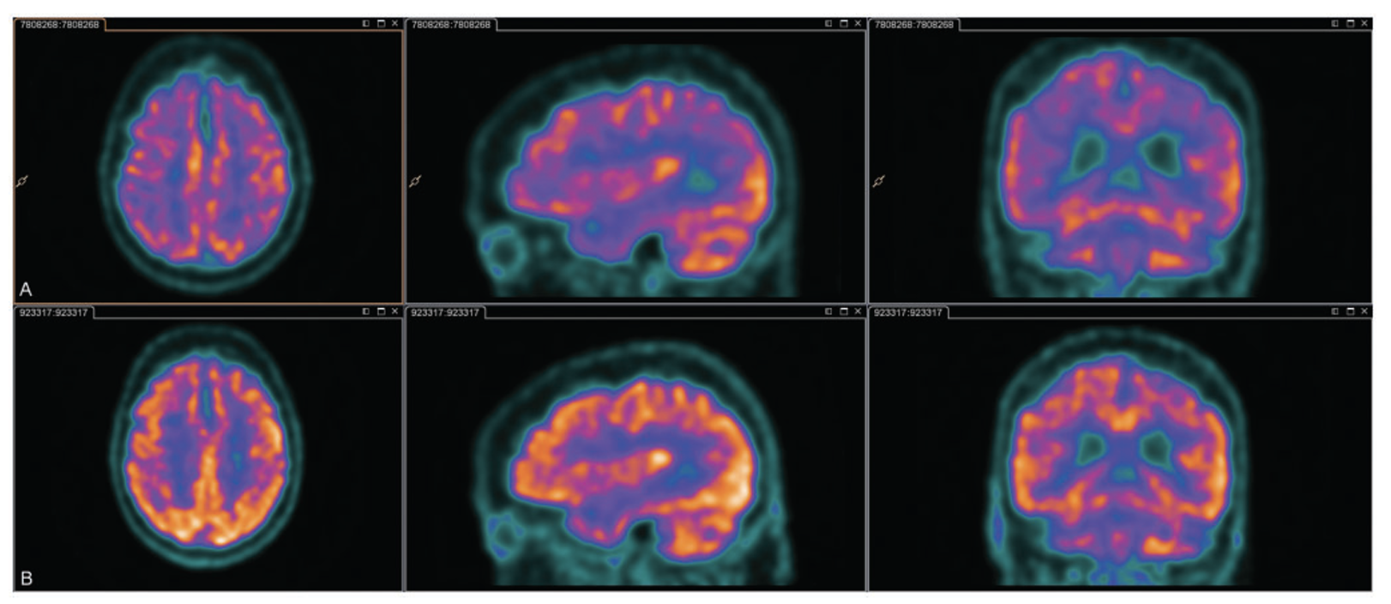
Cerebral hypometabolism
Inpatients with delirium (any cause) diagnosed by CAM underwent FDG-PET scans
13 of 15 completed initial scan during delirium
6 of 7 completed followup after delirium resolution
During delirium, all participants had cortical hypometabolism; patterns included
Global cortical hypometabolism (n=2)
Bilateral frontal (n=11)
Bilateral parietal (n=11)
Bilateral temporal (n=8)
Occipital lobe( n=2)
Left temporal lobe (n=1)
Sensorimotor cortex relatively spared/hypermetabolic (n=11)
Semi-quantitative analysis demonstrated higher glucose metabolism after delirium resolution in 5/6 patients in whole brain and PCC (p < 0.05)
Supports hypothesis that delirium results from cerebral metabolic insufficiency
Haggstrom LR et al. J Cereb Blood Flow Metab. 2017
Notes:
Did not control for illness or dementia

Slide 36
Regional hypometabolism in delirium is independent of illness and dementia
Single-center exploratory study
Acutely ill patients aged ≥ 65 years, no dementia
CAM-positive delirium (n=10) vs control (n=10)
Patients with delirium demonstrated hypometabolism in both cortical and subcortical regions
Regional hypometabolism correlated with increased delirium severity and decreased performance on neuropsychological testing
Left superior parietal cortex (A)
Right superior frontal cortex (B)
Right posterior cingulate cortex (C)
Right infero-lateral anterior temporal cortex (D)
Bilateral thalami (E)
Nitchingham et al. Alzheimer’s and Dementia 2022

Slide 37
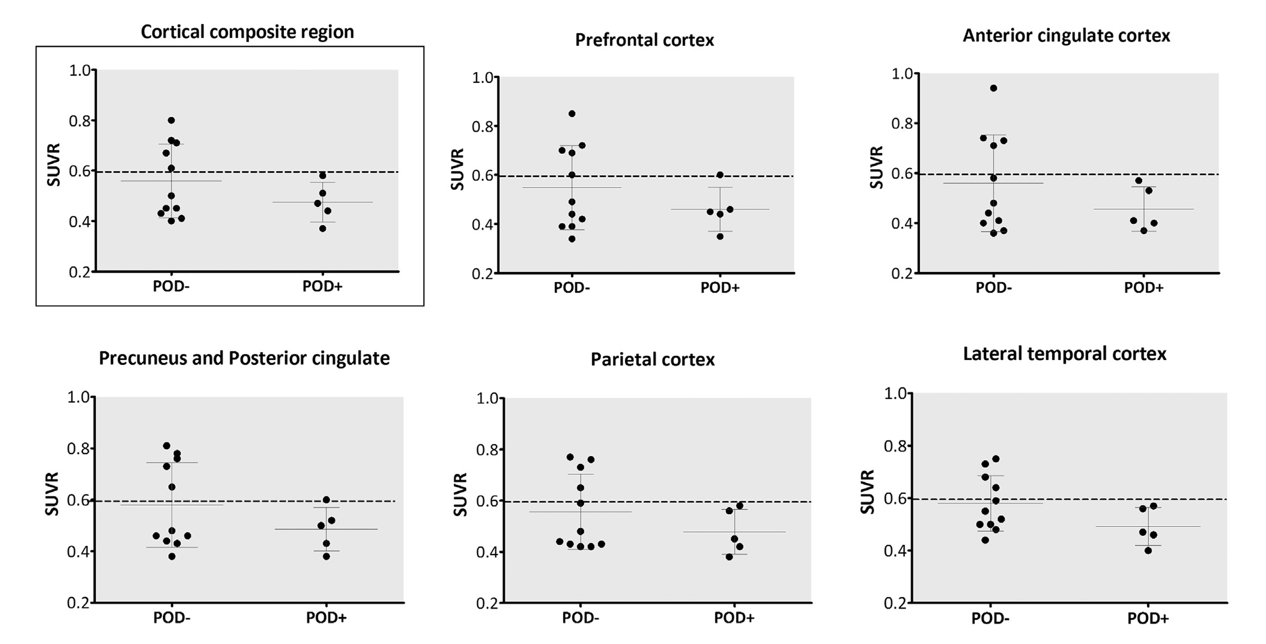
Association of postoperative delirium with markers of neurodegeneration and brain amyloidosis
Older adults, free from dementia or cognitive impairment were enrolled following hip fracture
Delirium was assessed daily by CAM and review with nursing staff x 3 days; n=5 (31%) developed delirium
¹⁸F-Flutemetamol scans were obtained 3-5 months after hip fracture (n=16)
All delirium cases (n=5) were amyloid negative, while 45% of non-delirious (n=5)were amyloid positive
Secondary outcomes for delirium cases:
Lower gray matter volumes in the amygdala (p < 0.003), middle temporal gyrus and anterior cingulate cortex (p < 0.001)
Increased diffusivity in the genu of the corpus callosum and in the anterior corona radiata (p<0.05)
Higher functional connectivity within the default mode network (p<0.001).
brain amyloidosis is unlikely to be a major cause of poor brain resiliency increasing the risk of POD after nonelective surgery
Recall that delirium pathophysiology might be independent of Alzheimer’s disease (Davis DH et al. Brain 2012)
Rolandi E, et al. Neurobiol Aging. 2018

Slide 38
Summary of Neuroimaging findings
Pre-existing brain damage (cerebral atrophy, ischemic lesions, and white matter lesions) is a strong predictor of delirium
Changes in perfusion and metabolic activity may reflect microscopic tissue damage and glial activity
Regions
Function
Fronto-thalamic
Limbic systems
Corpus Callosum
executive functioning
sensory processing
attention
emotional regulation
memory formation
orientation

Slide 39
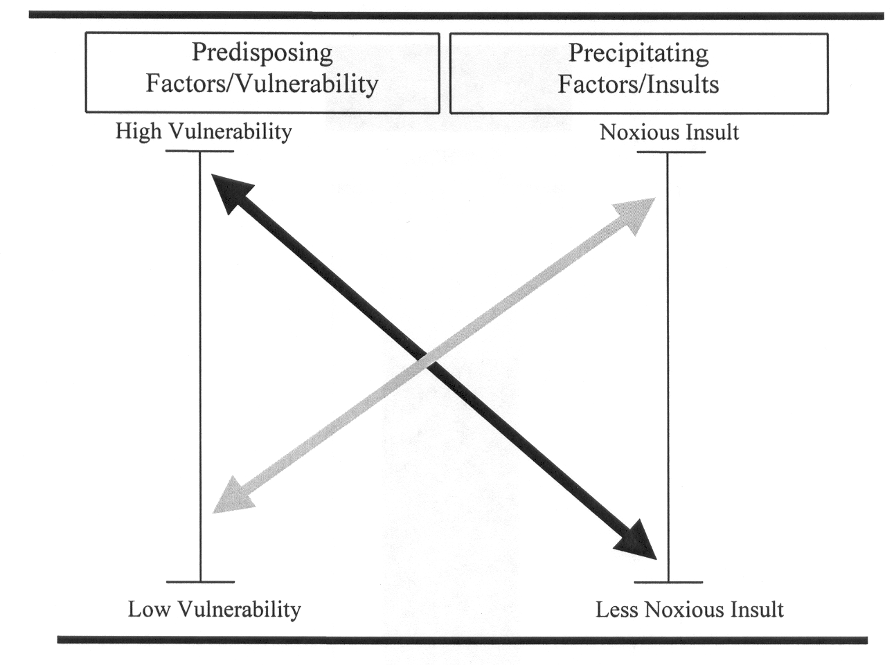
Research Challenges
Variable study designs can affect the comparability of results
Use of specific populations (i.e. elective vs. non-elective surgical, ICU) can limit generalizability
Choice of biomarker, biomarker analysis
Small sample sizes
Bias of advanced imaging (or CSF studies) - patient recruitment is restricted to those able to tolerate/participate scanning (CSF collection)
Challenges of collecting data while patient is symptomatic
Longitudinal “change over time” studies require a baseline before delirium episode
As delirium results from the interaction between predisposing vulnerabilities and precipitating insults, patient selection may influence imaging outcomes
Inouye SK et al. JAMA 1996; 275:852-857

Slide 40
Research priorities
Better matching of patient demographics could help strengthen findings
Studies examining changes over time may demonstrate stronger relationships than cross-sectional studies
Longitudinal studies may help define transient effects of delirium from pre-existing vulnerabilities (i.e., dementia), and enables investigation of long-term brain changes associated with delirium
Larger sample sizes would help confirm findings
Studies involving vulnerable patients such as those with acute illness and dementia would be more representative of the clinical population most affected by delirium

Slide 41
ACKNOWLEDGMENTS
National Institute on Aging for funding our work in delirium (Drs. Luci Roberts, Molly Wagster, Sue Zieman). Special thanks to Dr. Sharon Inouye for her inspiration and leadership in the field of delirium. We are grateful to the many patients, families, nurses, physicians who participated in these studies.
SAGES Study Group:
Richard Jones, ScD
Eva Schmitt, PhD
Steven Arnold, MD
Michele Cavallari, MD, PhD
Bradford Dickerson, MD
Edward R. Marcantonio, MD, SM
Towia Libermann, PhD
Alvaro Pascual‐Leone, MD, PhD
Mouhsin Shafi, MD, PhD
Alex Touroutoglou, PhD
Thomas Travison, PhD
ABC Working Group:
Tammy Hshieh, MD, MPH
Zachary Kunicki, PhD
Eran Metzger, MD
Patricia Tabloski, PhD, GNP‐BC, FAAN
Douglas Tommet, MS
Sarinnapha Vasunilashorn, PhD
NIDUS
Molly Mackler, MHS

Slide 42
Questions or Comments?
tfong@bidmc.harvard.edu

Slide 46
Fluid Biomarkers of AD
5. Microglial biomarkers – neuroinflammation
4. Astrocytic biomarkers – inflammation and degeneration
1. Direct markers of A$β$
3. Axons are rich in tau and neurofilament light (NfL) that leak into the CSF and blood during neuroaxonal degeneration.
2.
CSF t-tau
Neural cells and AD pathology
Zetterberg, H.. Mol Psychiatry 26, 296–308 (2021).

Slide 47
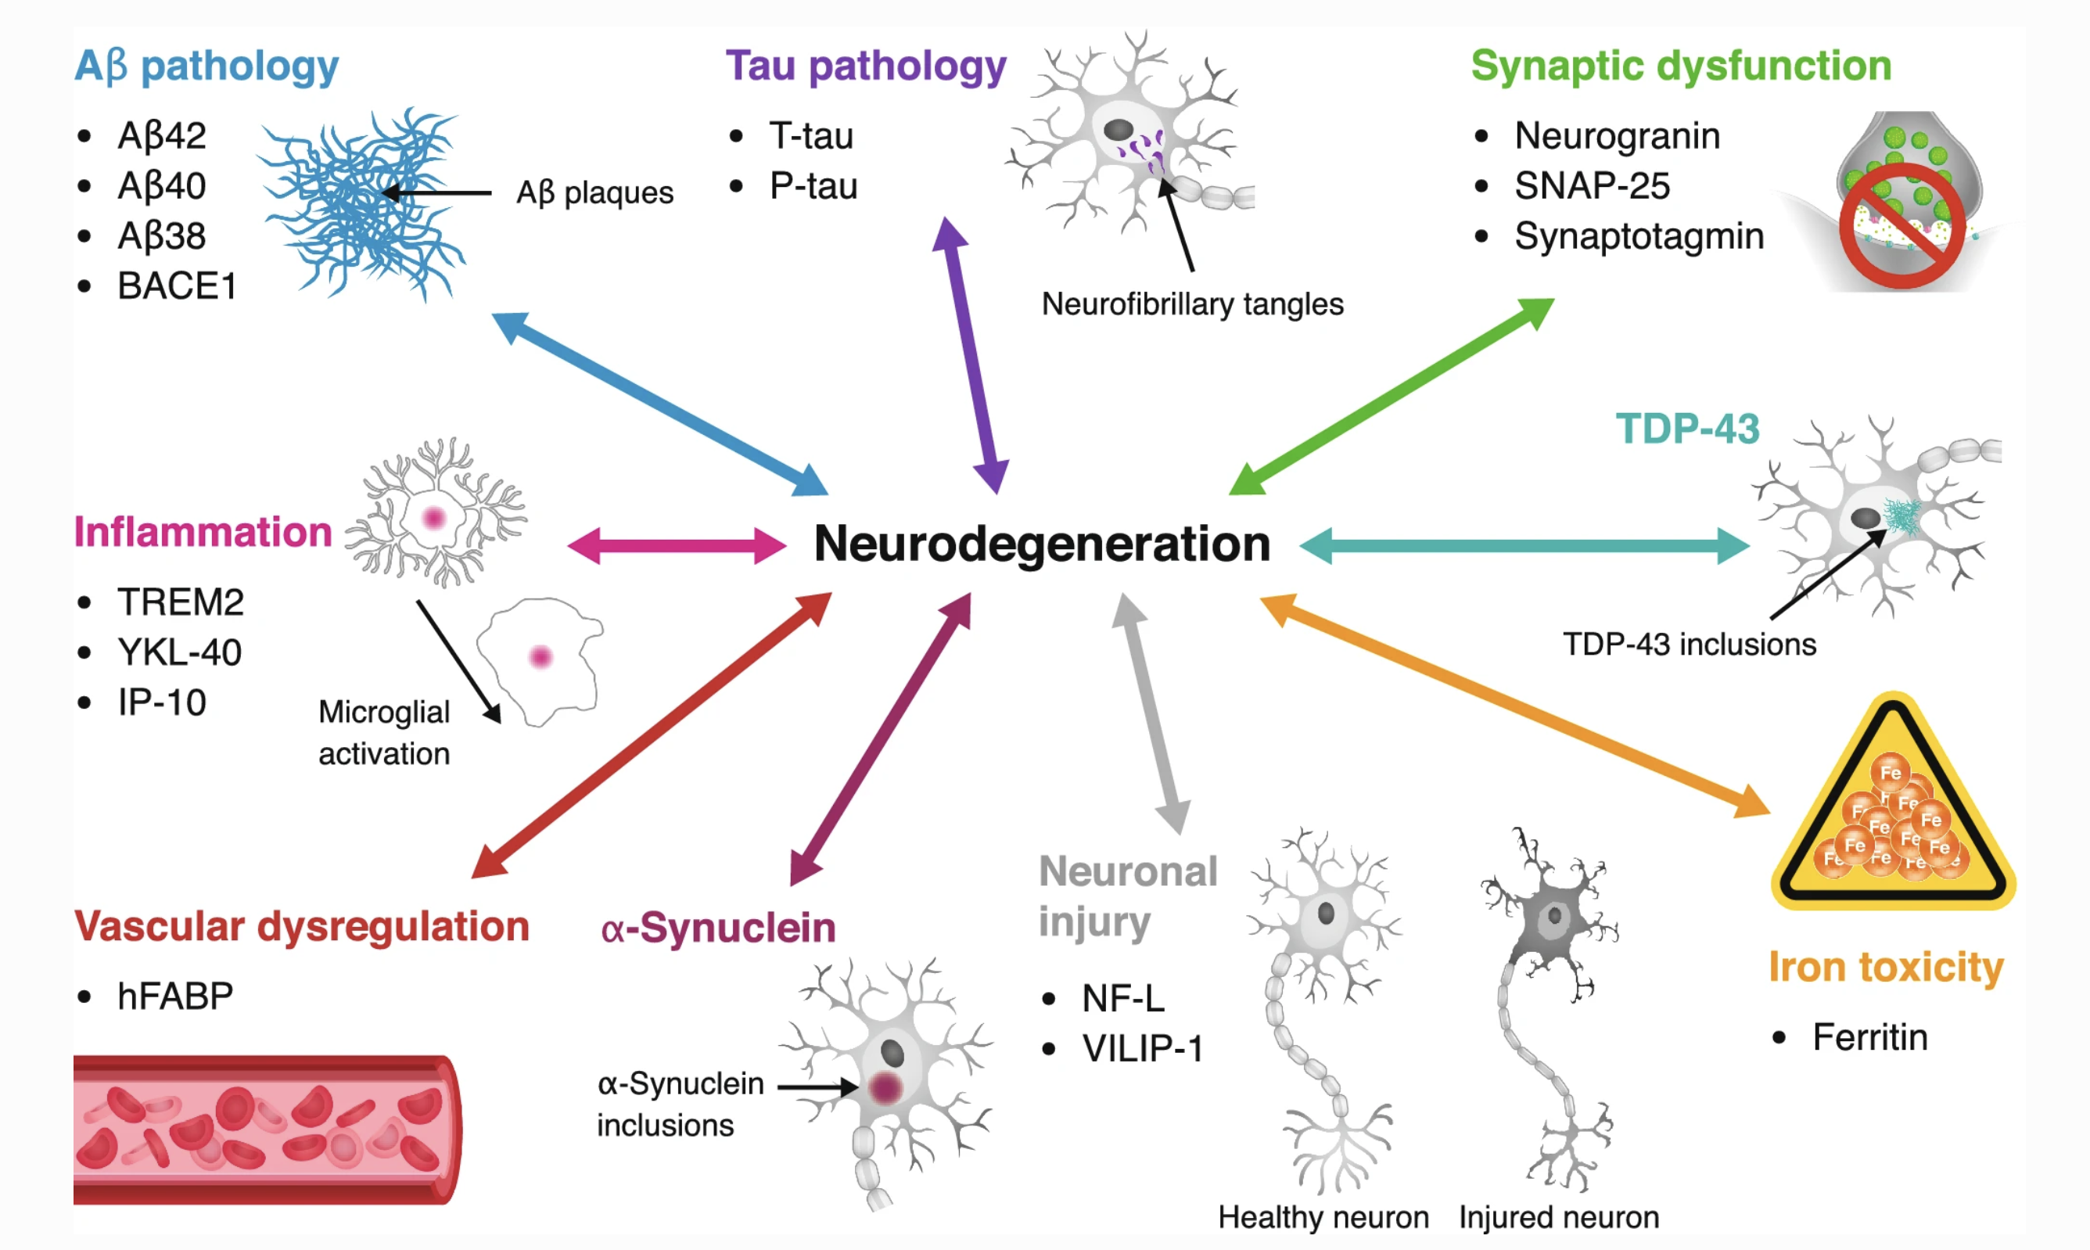
Plasma and CSF biomarkers of AD

Slide 48
Biomarkers: timing and other considerations
Baseline
Delirium
Post-delirium
Risk prediction Disease marker Consequences

Slide 49
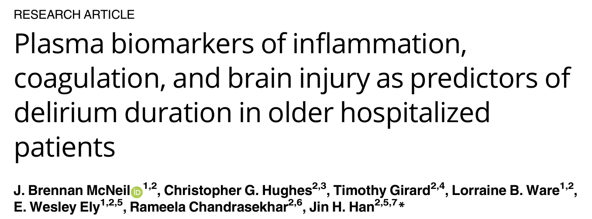
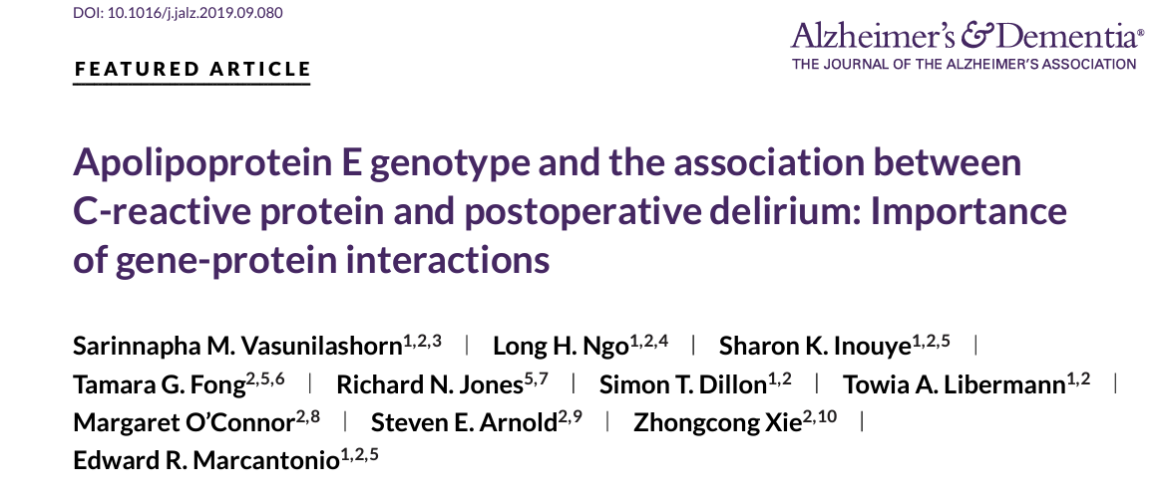
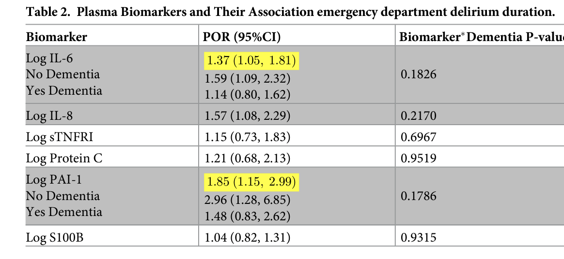
Participants age >65, seen in ED, n=156
Blood collected at time of enrollment
Primary outcome: delirium
IL-6 is independently associated with more prominent ED delirium duration in subjects without dementia
Elective non-cardiac surgery, age > 70, n=553
Blood collected on POD 2
CRP was significantly associated with delirium incidence, severity, and duration only among APOEƐ4 carriers.
APOE may function as a mediator of the relationship between CRP and dementia.
Notes:
The proportional odds regression models were adjusted for dementia, baseline functional status, comorbidity burden, severity of illness, CNS diagnosis, infection diagnosis, or use of home steroids

Slide 50
Resting state connectivity in Delirium
Delirious patients (n=22) able to tolerate MRI
N=14 underwent repeat fMRI following resolution of delirium (median 5.8 days).
Control patients (N=22) showed inverse correlation in functional connectivity between the dorsolateral prefrontal cortex and posterior cingulate cortex (PCC)
In delirious patients, the DLFPC and PCC connectivity was strongly correlated (p < 0.05) and persisted following resolution of delirium
Choi SH et al. Am J Psychiatry. 2012

Slide 51
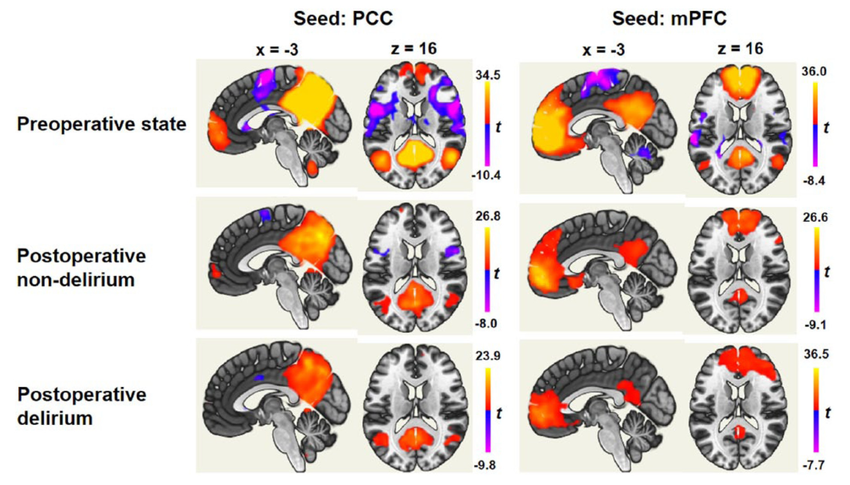
Disruption of the default mode network in delirium
Hip fracture patients > 70 years old (n=58)
Delirium dx by psychiatrist (n=25, 43%)
resting-state fMRI obtained prior to surgery and again after surgery (14 delirium, 18 control)
PCC and mPFC strongly connected to DLPFC.
PCC hyperconnectivity with IPL; mPFC with FPC; mPFC had hyperconnectivity with frontopolar cortex and hypoconnectivity with SFG
Increased connectivity of the striatum with ACC and insula
Disconnections between the lower subcortical regions and the striatum/thalamus
Oh J et al. Aust N Z J Psychiatry. 2019

