Slide 1
Cognitive Assessments Outside the Hospital
C. Adrian Austin, MD, MSCR
Clinical Instructor, Division of Pulmonology/Critical Care, Division of Geriatric Medicine
UNC
University of North Carolina at Chapel Hill, North Carolina, USA
No financial or commercial disclosures

Slide 2
Learning Objectives
Discuss importance of delirium outside the hospital setting and impact of delirium on cognitive function
Discuss ideal cognitive test for post-hospitalization setting
Review currently available cognitive assessment tools
Review currently available telemedicine delirium assessments
Discuss technology usage in older adults
Discuss dementia and telemedicine
Future directions in delirium, cognitive assessments, and telemedicine
Image © Can Stock Photo by Paha L

Slide 3
Diclosures
None

Slide 4
Delirium Outside the Hospital

Slide 5
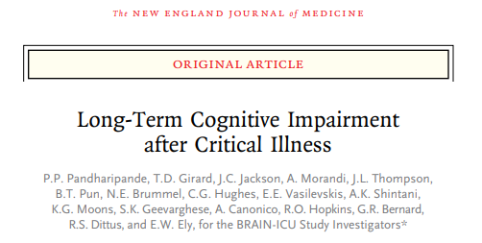
Pandharipande, NEJM 2013

Slide 6
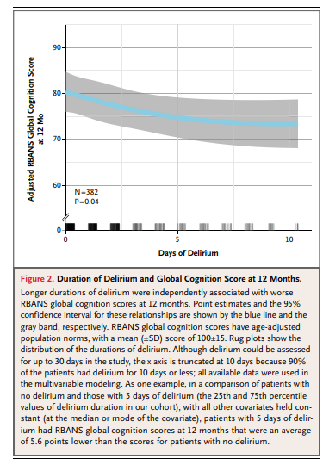
Pandharipande, NEJM 2013

Slide 7
Austin, JAMA Surgery 2019

Slide 8
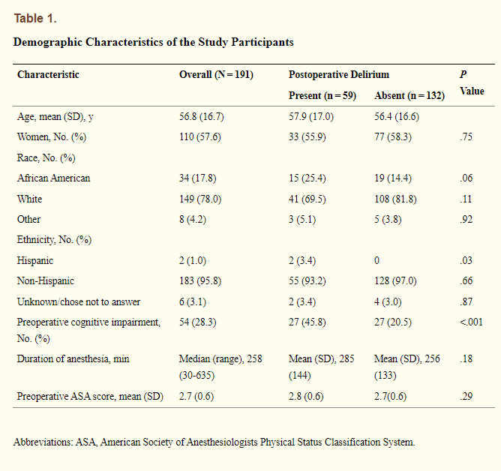
Austin, JAMA Surgery 2019

Slide 9
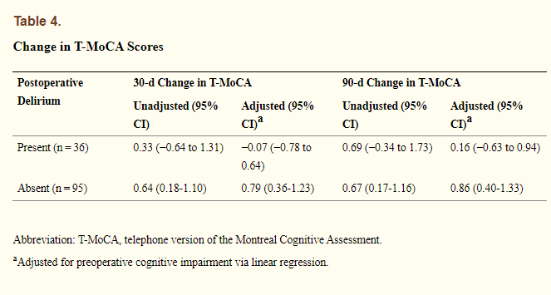
Austin, JAMA Surgery 2019

Slide 10
Discharged with Delirium
20% discharged with active delirium!
In older adults, persists in up to 50% of patients
15% of patients presenting skilled nursing facilities
If persists, associated with increased risk of mortality
Austin, JAMA Surgeyr 2019
Inouye, JAMA Internal Medicine 2007
Marcantonio, JAGS 006
Kiely, JAGS 2009

Slide 11
Questions
What happens to people who are discharged home with delirium??
How can we study this population??
Should we would be doing something differently??

Slide 12
Ideal Cognitive Test for Out-of-Hospital Setting

Slide 13
Ideal Test
Capture important cognitive domains
Accurate and reproducible
Quick (short administration time)
Easy to administer (telemedicine?)
Free or at least, inexpensive

Slide 14
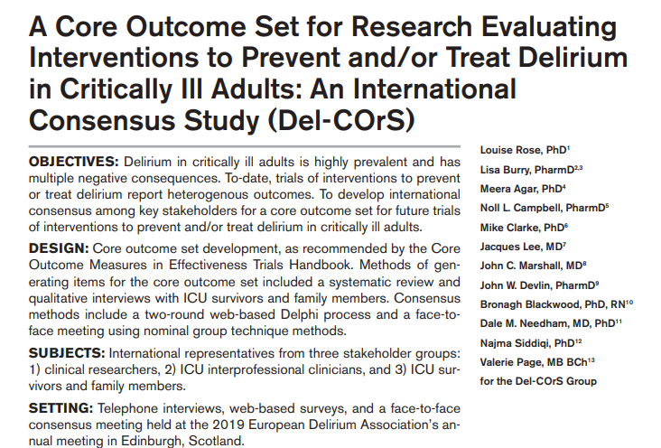
Rose, CCM 2019

Slide 15
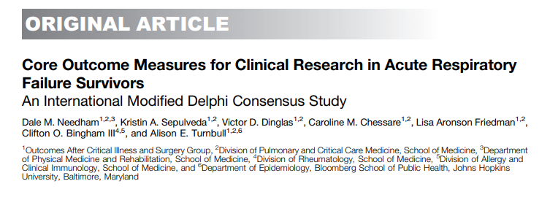
Needham, AJRCCM 2019

Slide 16
Which Cognitive Domains are Important?
Executive Function
Memory
Attention
Processing Speed
Visual-Spatial Ability
Rengel, Anesthesia & Analgesia, 2019

Slide 17
Repeatable Battery for Assessment of Neuropsychological Status (RBANS)
Immediate Memory
Delayed Memory
Attention
Language
Visual-Spatial Ability
Frreilich, Psych Reports 2007
Notes:
Misses executive function and processing speed. Takes time. Not free

Slide 18
Montreal Cognitive Assessment
Executive
Recall (Short-Term Memory)
Attention
Abstraction
Language
Visual-Spatial Ability
Naming
Orientation
Nasreddine, JAGS 2005
Notes:
Free, ?? Over phone maybe not granular enough? MOCA-BLIND vs T-MOCA

Slide 19
Other Tests
Digit Span (attention)
Months/days backwards (attention)
Trails A (processing speed)
Trails B (executive function)
Mini-Cog (memory, visual spatial, executive function)
Notes:
Free, ?? Over phone maybe not granular enough? MOCA-BLIND vs T-MOCA

Slide 20
Technology Usage in Older Adults

Slide 21
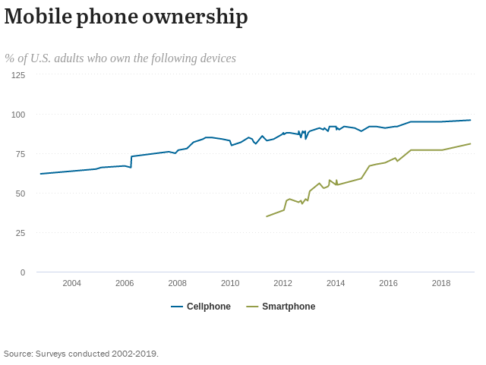
Pew Research Center. Demographics of Mobile Device Ownership and Adoption in the United States | Pew Research Center, Accessed 10.18.21

Slide 22
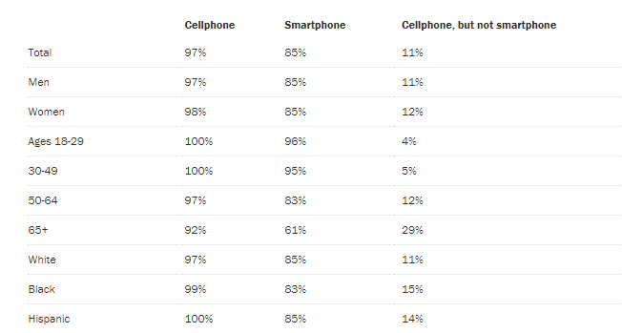
Pew Research Center. Demographics of Mobile Device Ownership and Adoption in the United States | Pew Research Center, Accessed 10.18.21

Slide 23
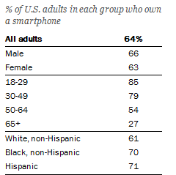
Pew Research Center., Smartphone Ownership Highest Among Young Adults, Those With High Income/Education Levels | Pew Research Center. Accessed 10.18.21

Slide 24
Dementia and Telemedicine

Slide 25
Parikh, Clini Neuropsychol 2013

Slide 26
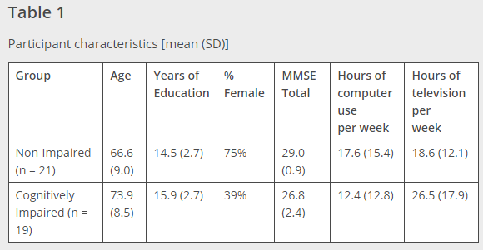
Parikh, Clini Neuropsychol 2013

Slide 27
Acceptability of Neuropsychologogical Asssessments
40 older adults, 19 with cognitive impairment
Twenty minute assessment battery performed via telemedicine and face-to face (F2F)
98% satisfaction with telemedicine overall
60% with no preference, 30% preferred F2F
Marcantonio, JGIM 1998

Slide 29
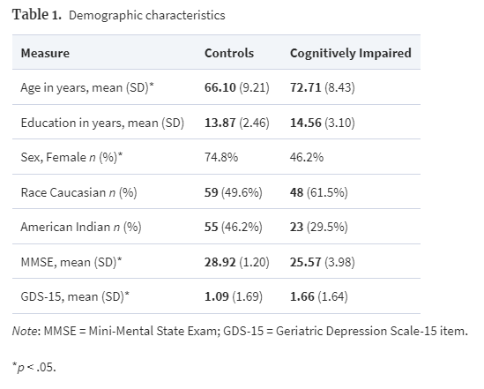
Acceptability of Neuropsychologogical Asssessments
Wadsworth, Archives of Clin Neuropsych, 2018
Notes:
197 participants, 78 with cognitive impairment

Slide 30
Acceptability of Neuropsychologogical Asssessments
MMSE, Hopkins Verbal Learning Test-Revised, letter and category fluency, Boston Naming Test-15 item, Digit span, Clock Drawing Test and GDS-15
Randomly received F2F vs telemedicine assessment first, followed by other in subsequent 2.5 hours.
Wadsworth, Archives of Clin Neuropsych, 2018

Slide 31
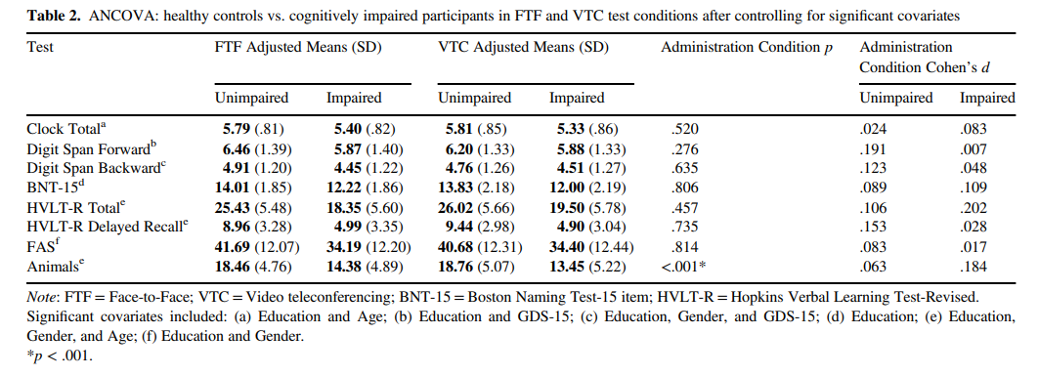
Wadsworth, Archives of Clin Neuropsych, 2018
Notes:
No differences in F2F vs VC in detecting cognitive impairment

Slide 32
Current Outpatient Delirium Telemedicine Tools

Slide 33
Marcantonio, JGIM 1998

Slide 34
Telephone Assessments
41 Subjects age 65 or older with admission for hip fracture
Interviewed 1 month after surgery
13 with pre-existing dementia
Delirium Symptom Interview via telephone
Marcantonio, JGIM 1998

Slide 35
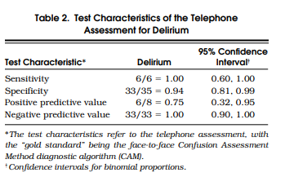
Marcantonio, JAGS 2006
Notes:
Takes over 15 minutes to perform. We can do better

Slide 36
Delirium Assessment
CAM: Confusion Evaluation Method
Based on the 4 main elements of the DSM-3 criteria for delirium:
Acute onset and fluctuating course
Inattention
Disorganized thinking
Altered level of consciousness
Must have 1 and 2 and either 3 or 4
Sensitivity 94%-100%
Positive LR 9.6
Specificity 90-95%
Negative LR 0.16
Inouye SK et al. Clarifying confusion: The confusion assessment method. A new method for detection of delirium. Ann Intern Med 1990: 113 (13): 941-948.

Slide 37
Delirium Telemedicine Assessment
Acceptable to older adults
May provide way to quickly reach patients, including rural/ underserved patients
Validation needed prior to usage in research or clinical practice

Slide 38
Telemedicine and Delirium

Slide 39
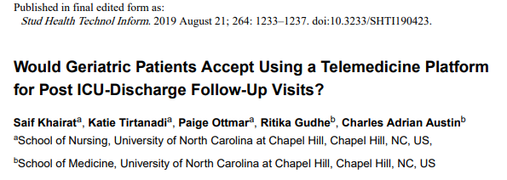

Slide 40
Telemedicine and Delirium
30 participants recruited from Geriatric Specialty Clinic at UNC
F2F delirium assessment, followed by a Telemedicine-based delirium assessment based on 3D-CAM
Assessed quantitatively and qualitatively for acceptability
Khairat, Stud Health Inf Tech, 2019
Notes:
Questionnaire for User Interface Satisfaction

Slide 41
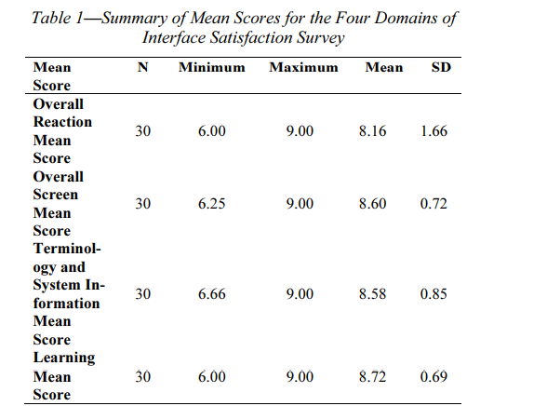
Khairat, Stud Health Inf Tech, 2019

Slide 42
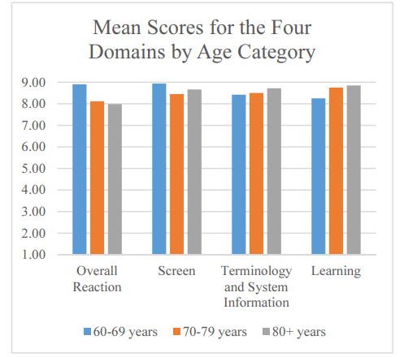
Khairat, Stud Health Inf Tech, 2019

Slide 43
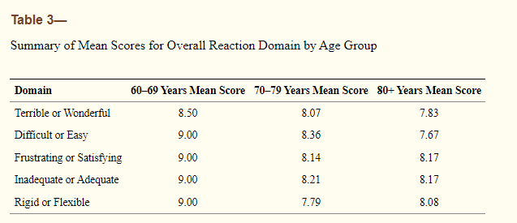
Khairat, Stud Health Inf Tech, 2019

Slide 44
Delirium Telemedicine Assessment
In feasibility study completed in Summer/ Fall 2020 (prior to pandemic)
20 participants assessed in home via telemedicine and F2F
100% congruent in detecting delirium

Slide 45
Proposed Next Steps for Trials
Delirium Assessment
MOCA
Trails A and B

Slide 46
Review
Review

Slide 47
Learning Objectives
Discuss importance of delirium outside the hospital setting and impact of delirium on cognitive function
Discuss ideal cognitive test for post-hospitalization setting
Review currently available cognitive assessment tools
Review currently available telemedicine delirium assessments
Discuss technology usage in older adults
Discuss dementia and telemedicine
Future directions in delirium, cognitive assessments, and telemedicine
Image © Can Stock Photo by Paha L

Slide 48
What Questions
Do You Have?
What Questions
Do You Have?

