Slide 1
Optimizing Translational Delirium Research Methods in Clinical Trials
Miles Berger MD PhD
Associate Professor, Duke Anesthesiology Dept.

Slide 2
Disclosures
-Private Legal Consulting Income, cases related to postop neurocognitive function
-Material Support (EEG monitor loan) from Massimo Inc, for the DREAMER study; no salary support of funding from Massimo for this study
-Member, ASA Committee on Geriatrics Task Force (Standards & Practice Parameters)
-No Corporate/pharma funding

Slide 3
Outline:
What is translational research? Why is human translational delirium research important?
Examples- MADCO-PC, INTUIT, MARBLE studies
3) Challenges & Solutions
4) Conclusions

Slide 4

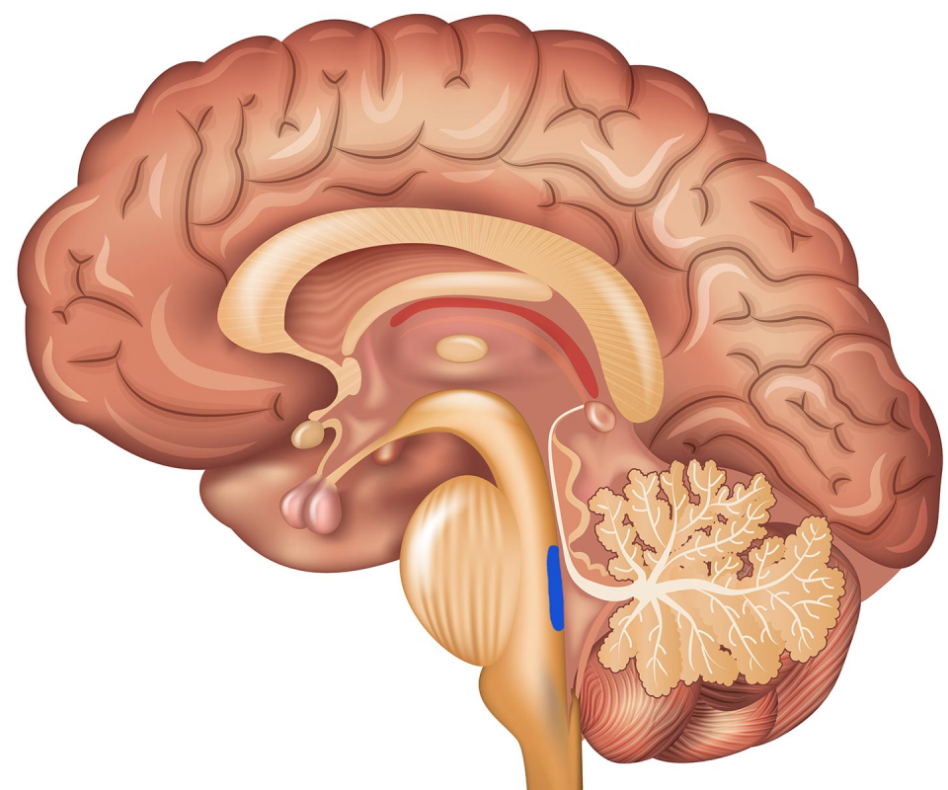
1) What is translational research?
RCTs of anti-psychotics for delirium prevention/ treatment
Mouse models- memory deficits after surgery

Slide 5
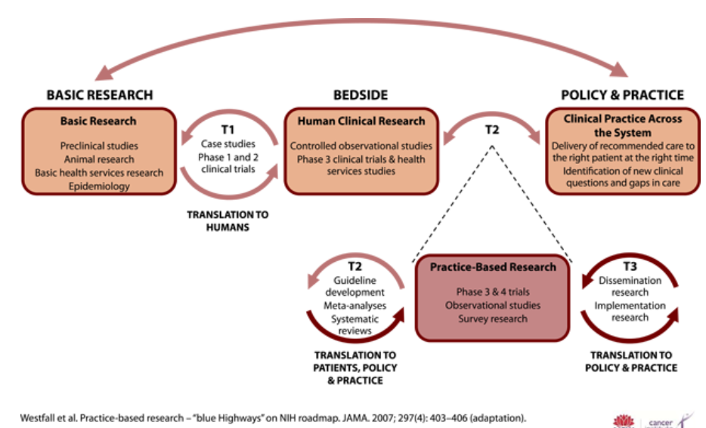
What is translational research? Why translational delirium research…?
Show picture of Cori Bargmann
Disease models (model organisms)
Cori Bargmann Quote
“If you want to understand how a 747 works and you knew nothing about airplanes or electronics or physics, it would be much easier to start with a paper airplane and try to understand how its wings provide lift- because the same basic principles of flight apply to both paper airplanes and 747s”

Slide 6
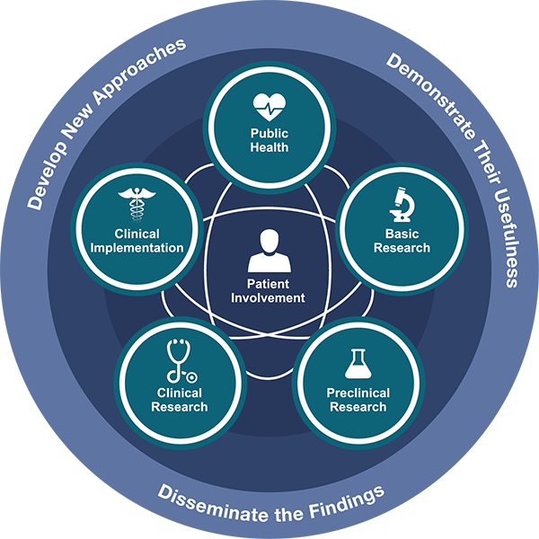
What is translational research?
5 different types of translational research
1. Mechanism Discovery (model organisms, cells & humans)
2. Drug testing in vitro, animal models
3. Mechanism validation/testing in humans
4. Phase I-3 Clinical Trials
5. Clinical Implementation, Public Health

Slide 7
Why translational delirium research…?
How can we study Delirium in animal models without knowing what a delirious brain looks like?
How can we design rational medications to prevent delirium, without understanding the molecular/cellular and brain network level etiology of delirium?

Slide 8
What is translational research? Why translational delirium research…?

Slide 9
What is translational research? Why translational delirium research…?
Translational continuum picture for delirium vs ADRD

Slide 10
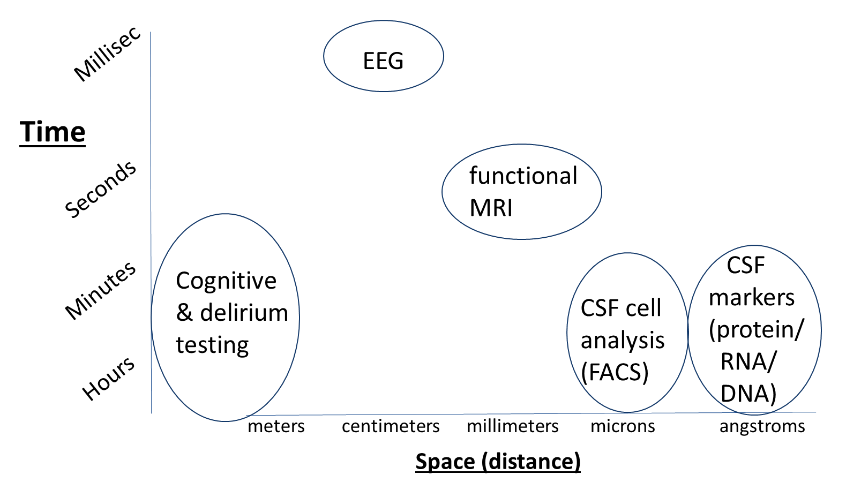
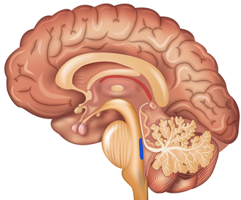



II. Tools for Translational Delirium Studies:

Slide 11
II) Translational Human Delirium Study Examples- MADCO-PC
MADCO-PC: Markers of Alzheimers Disease and neuroCognitive Outcomes after Perioperative Care
(prospective, observational cohort study)
Primary outcome: correlation between perioperative change in CSF AD biomarker (tau) and continuous cognitive change index (from preop to 6 weeks post-op)
N=108 surgical patients→ >80% power with α=0.05, to detect a Spearman correl. coefficient of ≥0.3

Slide 12
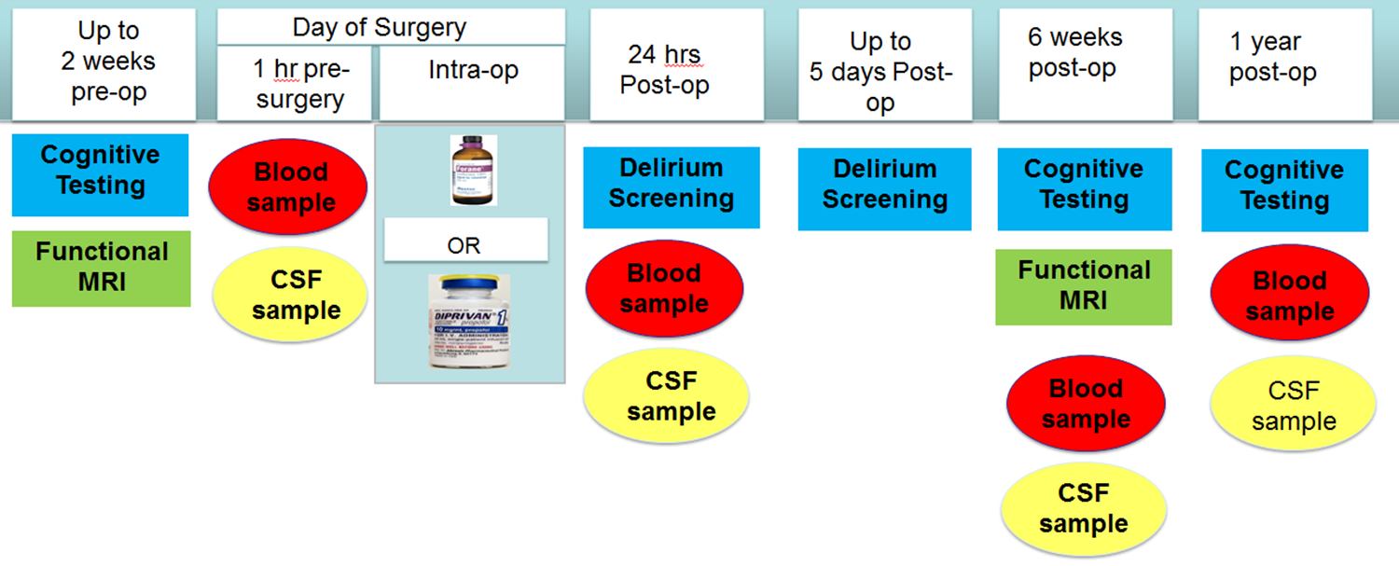
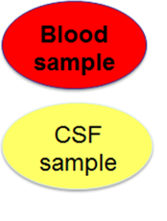
II) Translational Human Delirium Study Examples- MADCO-PC

Slide 13
II) Translational Human Delirium Study Examples- MADCO-PC
Patients scheduled for surgery
Enrollment, baseline cognitive testing
Pre-Induction CSF + blood samples
24 hr post-op CSF + blood samples, delirium screening POD 1-5
6 week post-op cognitive testing, CSF + blood samples
Correlate CSF AD biomarkers, cognitive findings

Slide 14
II) Translational Human Delirium Study Examples- MADCO-PC
(Berger M et al, Annals Clin Transl Neurology, 2022)

Slide 15
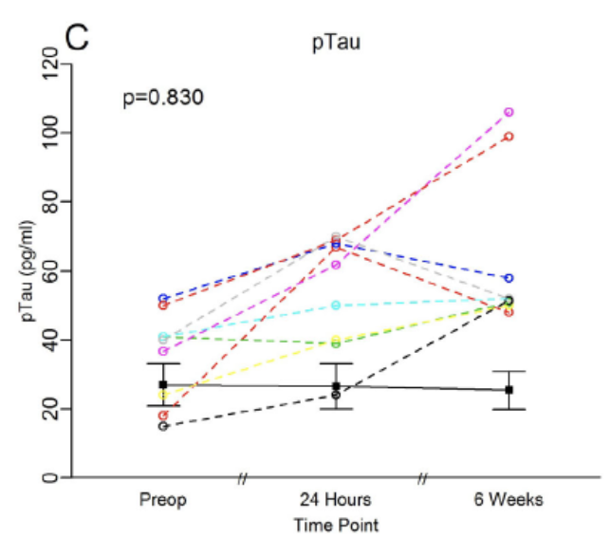
II) Translational Human Delirium Study Examples- MADCO-PC
(Berger M et al, Annals Clin Transl Neurology, 2022)

Slide 16
II) Translational Human Delirium Study Examples- MADCO-PC
(Berger M et al, Annals Clin Transl Neurology, 2022)

Slide 17
II) Translational Human Delirium Study Examples- MADCO-PC
EEG

Slide 18
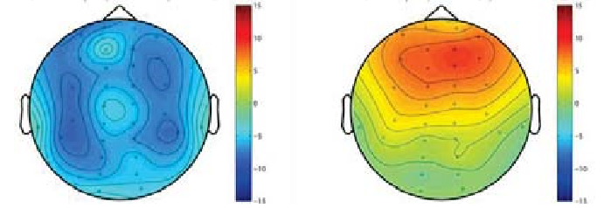
Patients don’t respond equally to Anesthetic Drugs:

Slide 19
Time (minutes)

Slide 20
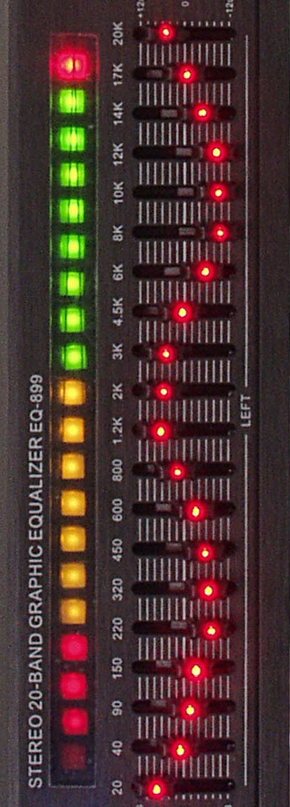
Time (minutes)

Slide 21
Brain Responses to Anesthetics Change with Age:
-Purdon et al, BJA, 2015

Slide 22
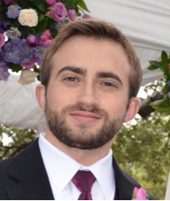

III. Using EEG to Identify Delirium, Cognitive Impairment
32 channel EEG Recordings in 15 patients;
BIS EEG recordings in 35 patients
Charlie Giattino, PhD
Marty Woldorff, PhD
-Giattino et al, Front Syst Neurosci, 2017

Slide 23
II. Can EEG Can Substitute for Preop Cognitive Testing?
Baseline Characteristics (N=15 patients)
Age 69 (5.5)
Sex 8 Male, 7 Female
Surgery Length (min) 285 (110)
ASA Status ASA 3-15
-Giattino et al, Front Syst Neurosci, 2017

Slide 24
Can EEG Can Substitute for Preop Cognitive Testing?
-Giattino et al, Front Syst Neurosci, 2017

Slide 25
EEG Alpha Power Depends on Preop Cognitive Status
Poor Preoperative Cognitive Function
Good Preoperative Cognitive Function
-Giattino et al, Front Syst Neurosci, 2017

Slide 26
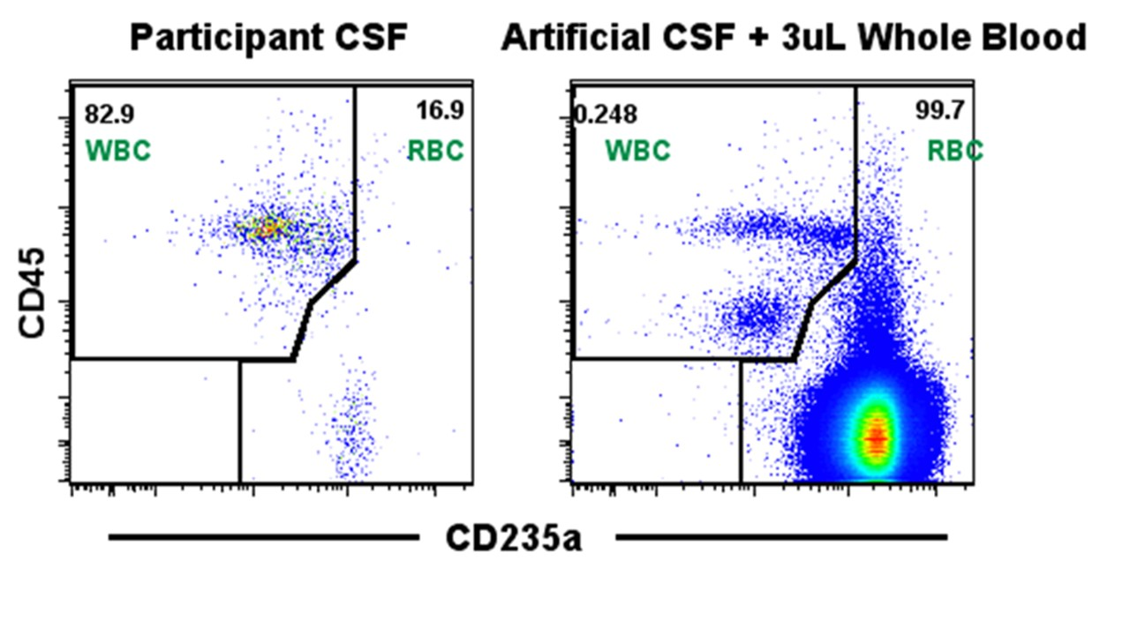
But Are there Monocytes in the Human CNS Postop?
CSF cell conc. = 12,654 +/- 1631 cells/10 ml (1.2 cells/uL)

Slide 27
INTUIT Flow Cytometry Panel Markers
Zombie | Viability, dead cell marker; live cell membranes exclude this fluorochrome
CD235a | Glycophorin A, Erythrocyte sialoglycoprotein, RBC marker
CD45 | Receptor Protein Tyrosine Phosphatase, Pan-leukocyte Marker
CD3 | Co-receptor for T Cell Receptor, T cell Marker
CD4 | Co-receptor for T Cell Receptor, binds MHC Class II, Helper T cell Marker
CD56 | Homophilic Binding Glycoprotein, NK Cell Marker
CD14 | LPS Co-receptor, a “classical” monocyte marker
CD16 | Fcγ receptor-III (low affinity IgG receptor); “non-classical” monocyte marker
CD163 | Scavenger receptor for haptoglobin-hemoglobin, expressed by monocytes/macrophages
CD192 | Monocyte chemoattractant protein-1 (MCP-1) Receptor, expressed by monocytes/macrophages
CD206 | C-type lectin receptor; expressed by monocytes/macrophages, immature dendritic cells
HLA-DR | MHC Class II receptor, expressed on B cells, monocytes/macrophages, and dendritic cells
-Berger M et al, Anesth & Analgesia, 2019

Slide 28
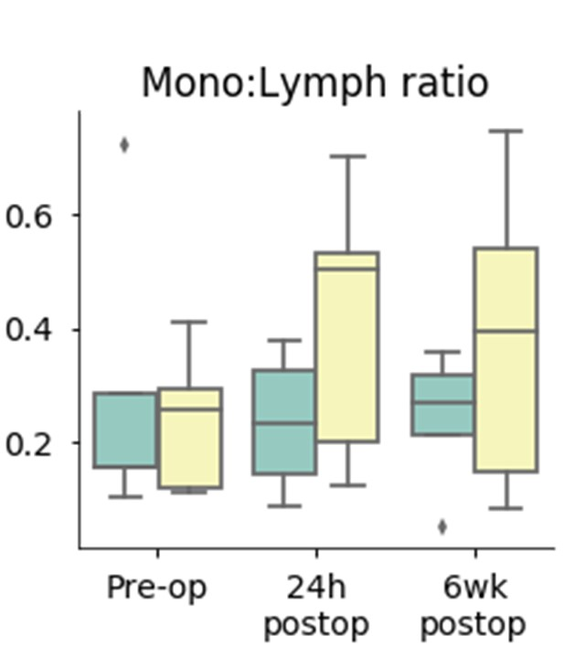


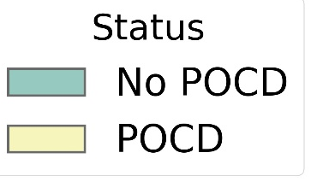

Postoperative CSF Monocyte Changes
Dr. Kent Weinhold
Dr. David Murdoch
-Berger M et al, Anesth & Analgesia, 2019

Slide 29
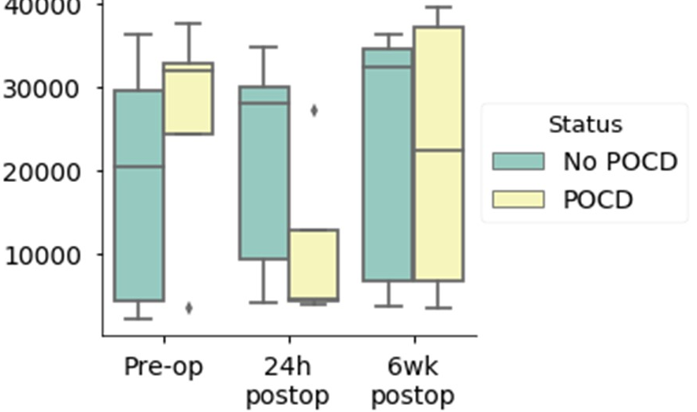
Postop CSF Monocyte MCP-1 Receptor Changes
Mean Fluorescence Intensity
(N= 5 per group)
P=0.03
-Berger M et al, Anesth & Analgesia, 2019

Slide 30
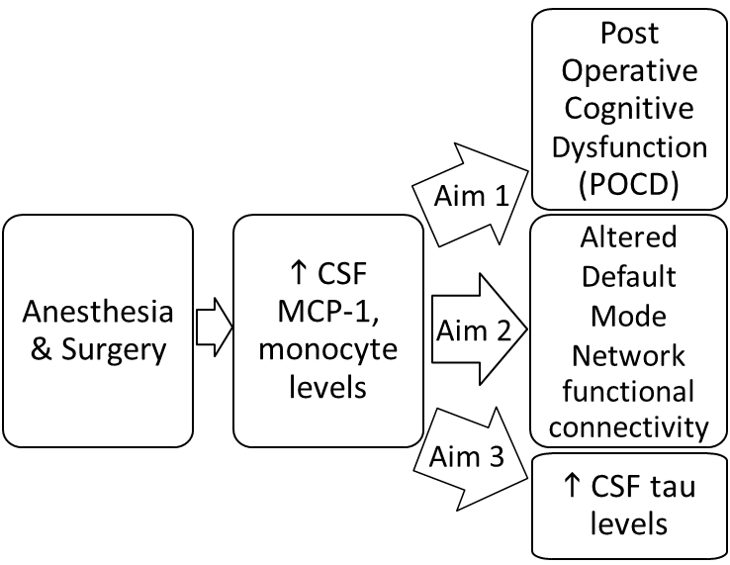
Investigating NeuroinflammaTion UnderlyIng postoperative brain connecTivity Changes, POCD, delirium in older adults (INTUIT study)
-Berger M et al, J Amer Ger Soc, 2019

Slide 31
II) Translational Human Delirium Study Examples- INTUIT

Slide 32
Overall LP Complication Rates
-Nobuhara C et al, J Neurology, 2019

Slide 33

Overall LP Complication Rates
Nobuhara C et al, J Neurology, 2020

Slide 34
MARBLE- Modulating ApoE signalling to Reduce Brain inflammation, deLirium and postopErative cognitive dysfunction
Randomized, Double-Blind, Placebo-Controlled trial in Duke surgical patients.
Primary Outcome: Safety (# of AEs)
Secondary Outcomes:
-Feasibility (# of doses given within interval)
-neuro-inflammatory measures
-Delirium, Cognitive Dysfunction
Notes:
34

Slide 35
MARBLE- Modulating ApoE signalling to Reduce Brain inflammation, deLirium and postopErative cognitive dysfunction
Inclusion Criteria
1. Age > or = 60
2. English Speaking
3. Surgery Scheduled for >2 hrs
4. Planned overnight hospital admission
Exclusion Criteria
1. Prison Inmates
2.Planned Chemotherapy prior to 6 wk postop visit
3. Unable to undergo Lumbar Punctures
4. Major Head Trauma between preop, 6 wk postop visits
Notes:
35

Slide 36
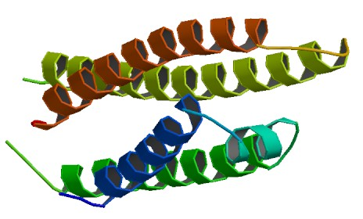
What is ApoE?
-main cholesterol transport protein in the brain, produced by astrocytes, carries cholesterol to neurons
-has 3 allelic variants, ε2, ε3, ε4
-ApoEε4 has an allele frequency of 14%
-ApoEε4 homozygotes have a 10-30x fold increase in Alzheimer’s disease risk
-ApoEε4 is the most common genetic risk factor for late onset Alzheimer’s disease
Notes:
36

Slide 37
Why study ApoE in surgical patients?
-Leading hypothesis for why ApoEε4 →Alzheimer’s is via increased neuro-inflammation
-Neuroinflammation and other pathology takes decades to develop in Alzheimer’s disease
-Yet, neuroinflammation occurs within 24 hrs after non-cardiac, non-neurologic surgery in older adults
-Berger M et al, Front Immunology, 2017
-Tang J et al, Anesthesiology, 2011
-Buvanendran et al, Anesthesiology, 2006
Notes:
37

Slide 38
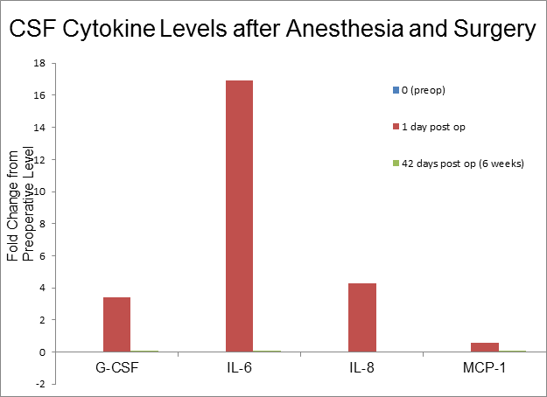
Why study ApoE in surgical patients?
-Postoperative neuroinflammation is thought to play a causal role in postoperative delirium, cognitive dysfunction
-Berger M et al, JAGS, 2019
-Berger M et al, Anesthesiology, 2018
Notes:
38

Slide 39

What is CN-105?
-A five amino acid peptide from the receptor binding region of the APOEe4 protein, which blocks the interaction between APOEe4 and its receptor (LRP)
Dr Danny Laskowitz, Duke Neurology
What is CN-105’s pharmacology, safety?
-Plasma half life = 3 hours, crosses blood-brain barrier
-Excellent safety record in phase I study at DCRU
-Guptill JT et al, J Clin Pharmacol, 2017
-Currently in a Phase II multi-center study for Sub-Arachnoid Hemorhage (SAH)
Notes:
39

Slide 40
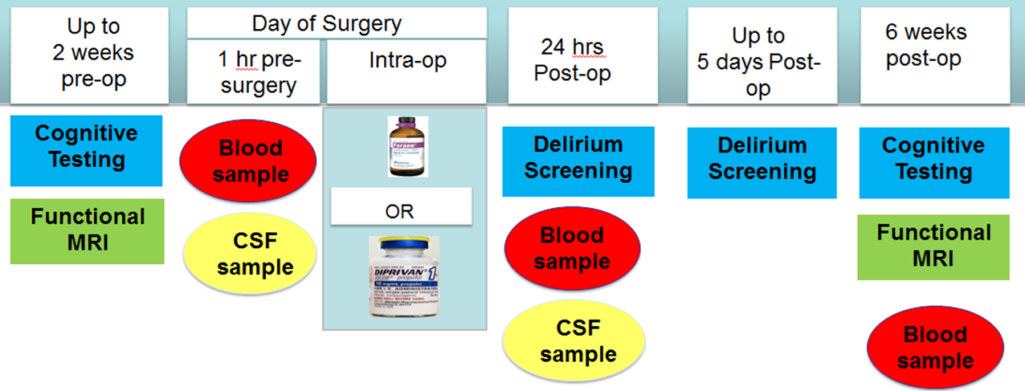
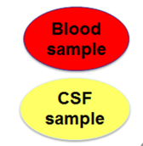
MARBLE Study Outline
-CN-105 or Placebo treatment
-Given IV, q6 hours
-Starting 1 hour before surgery, until POD-3 or hospital discharge, up to 13 doses max
Notes:
40

Slide 41
Aren’t LPs painful?
Nobuhara C et al, J Neurology, 2020

Slide 42
Overall LP Complication Rates
-Nobuhara C et al, J Neurology, 2020

Slide 43




3) Recruitment/Enrollment Obstacles & Solutions
-Patients who don’t have time for study visits before surgery
-Patients who lack transportation for study visits
-Patients whose Friends/Family talk them out of Study
-Colleagues Apprehensive About Study

Slide 44
Conclusions & Future Directions:
1. When there is a will, there is a way- creative solutions exist.
2. Importance of working in teams.
3. What is the pathophysiology of delirium?
4. How can we design studies so whether our interventions for delirium work or not, either way we learn something about delirium pathophysiology?

Slide 45
Thanks to:
Funding Sources:
-NIA K76 (Beeson award)
-FAER (Jahnigen award)
-IARS Mentored Research Award
-Duke Health Fellow Award
-SNACC (Bill Young Award)
-NIDA R01 (PI’s Murdoch, Meade)
-Transforming Duke Health Award
-Alzheimer’s Drug Discovery Foundation
PACT program grant
-NIA UH2/3 (PI’s Dr Whitson, Colon-Emeric)
-Duke/UNC ADRC
-Drs James Burke, Luke James, Danny Laskowitz,
-Duke Anesthesiology,
Drs. Joseph Mathew
-Drs. Harvey Cohen, Heather Whitson, (Duke Aging Center)
-Drs. Marty Woldorff,
Ken Roberts, Charlie Giattino,
Jeff Browndyke
-Anesthesia CRU
-Mary Cooter (statistician)
-Patients
Notes:
Make sure to say thx

Slide 46
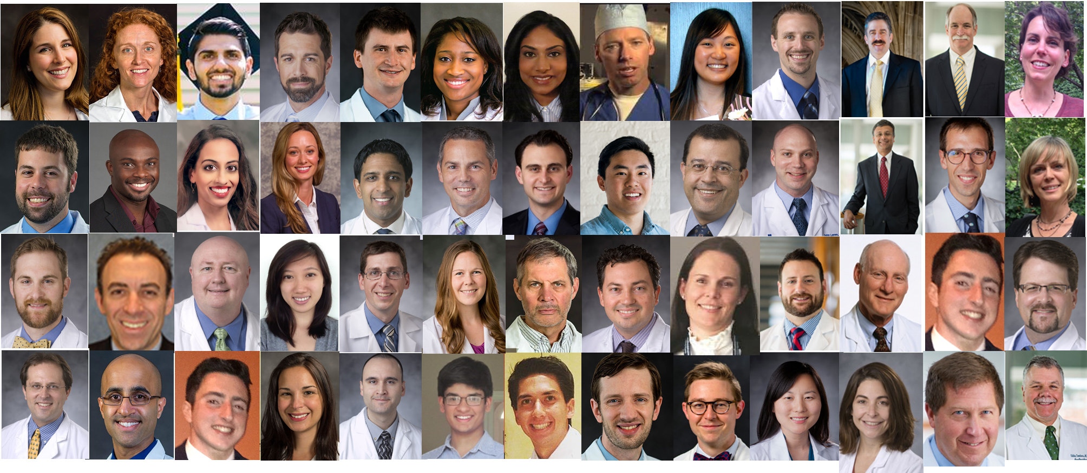
Thanks to:

