Slide 1

Delirium Assessment Practicum: CAM, 3D-CAM, UB-CAM
Edward R. Marcantonio, MD MSc
Professor of Medicine
Beth Israel Deaconess Medical Center
Harvard Medical School
NIDUS Bootcamp 2022

Slide 2
Outline
Delirium assessment: CAM
3D-CAM and UB-CAM (new)
CAM Feature quiz
3D-CAM Training Videos

Slide 3

Disclaimer
Over 40 different ways to identify delirium
Will do a “deep dive” on one approach
You need to decide best methods for your study
  Become an expert
  Train your team

Slide 4
DSM5 Delirium Definition
Disturbance in attention and awareness
Develops acutely and tends to fluctuate
Disturbance in at least one additional cognitive domain
Not better explained by a preexisting dementia
Not in face of severely reduced level of arousal or coma
Evidence of underlying organic etiology or etiologies
Used with permission. American Psychiatric Association, 2013

Slide 5
Delirium Phenomenology
Psychomotor variants:
  Hyperactive, mixed: 25%
  Hypoactive, normal: 75%
Abnormal LOC varies by setting:
  ICU, PACU > 80%
  General Medicine or Surgery <20%
Hallucinations, delusions rare (~10%)
Delirium superimposed on dementia
  Varies depending on population

Slide 6
Confusion Assessment Method (CAM)
Most widely used tool to assess delirium
  Used in >4000 original studies to date
  Translated into 20 different languages
  In literature 10X more frequently than DSM
  Recommended by 2010 JAMA Review
Wong et. al., JAMA, 2010

Slide 7
CAM Diagnostic Algorithm
(1) Acute Change or Fluctuating Course
        -and-
(2) Inattention
      -and either-
(3) Disorganized Thinking
    -or-
(4) Altered Level of Consciousness
Should be performed AFTER cognitive testing
Ref: Inouye SK, et. al. Ann Intern Med. 1990, 113: 941-8
7
Notes:
7

Slide 8
Review:
CAM Diagnostic Features

Slide 9
CAM – Acute Change
Is there evidence of an acute change in mental status from the patient’s baseline?
Positive if the patient has demonstrated or reports a change in mental status
Either new in onset or worsening in severity, usually over hours to days
Evidence may come from the interview (patient self-report), medical record, nurse/MD, comments from family or visitors.
Notes:
Acute change is defined as any change in mental status compared to baseline that occurred in the past twelve hours. This change must be for the worse. An acute change can be determined by patient self-report, nurses report, or the detection of any of the remaining eleven features of delirium which is new or worse than baseline. For example, if a patient showed moderate memory impairment at baseline but was only mildly impaired at a later interview, this would not be an acute change. An example of acute change is a patient who is alert at baseline and after surgery falls asleep during the interview. This is an acute change due to an altered level of consciousness.

Slide 10
CAM – Fluctuating Course
Did this behavior fluctuate during the interview?
Must witness fluctuation during the interview (symptom comes and goes or increases and decreases in severity)
Generally fluctuation is quite obvious
Think of splitting interview into 2 parts – was there a stark difference in a feature from the 1st half to the 2nd half?
Notes:
Each of the remaining eleven features can fluctuate in nature. However, only certain features will contribute to the overall score of fluctuation. These are inattention, disorganized thinking, altered level of consciousness, psychomotor agitation, and psychomotor retardation. Fluctuation MUST be observed during the interview. A feature can fluctuate in presence or severity. An example of fluctuating presence of a feature is a patient who at times during the interview knows she is at the hospital and at others believes she is at home. This is a fluctuating presence of disorientation. An example of fluctuating severity is a patient who at times answers questions at a normal rate and at others is very slow to respond. This is fluctuating severity of psychomotor retardation. If the feature was absent, fluctuation should be scored as n/a.

Slide 11
CAM - Inattention
Did the patient have difficulty focusing attention, for example being easily distractible, or having difficulty keeping track of what was being said?
Reduced ability to maintain attention to external stimuli and to shift attention to new stimuli.
Respondent unaware or out-of-touch with environment (e.g., dazed, fixated, or darting attention); no eye contact
Difficult to establish back and forth conversation
Errors on attention tests
Notes:
Inattention is a fairly straightforward feature to define. It is characterized by an inability to focus, being easily distractible, or having difficulty keeping track of what was being said. This feature is tested directly during the interview with various cognitive function tasks, including registering four words, reciting the days of the week backwards, months of the year backwards, and a digit span task. Inattention is determined quantitatively as two errors on these tasks or as qualitative evidence from the interview. An example of this is a patient who gazes around the room as you are speaking to him. Inattention can fluctuate in presence or in severity. When determining fluctuation of inattention, the interviewer should consider qualitative evidence as well as the degree of difficulty of the tasks. The digits backwards task is more difficult than digits forwards. Therefore if a patient correctly states three digits backwards but has difficulty with three digits forwards, this is an example of fluctuation.

Slide 12
CAM – Disorganized Thinking
Was the patient’s thinking disorganized or incoherent, such as rambling or irrelevant conversation, unclear or illogical flow of ideas, or unpredictable switching from subject to subject?
Patient speaks incoherently, rambles, irrelevant conversation, tangential or circumstantial speech, faulty reasoning
Off-target or nonsense responses
Paucity or perseveration of thought
Severe disorientation to time, place
Must be able to speak to assess this feature
Notes:
Disorganized thinking is possibly the most challenging feature of delirium to discern. This can be defined as illogical or off-target responses. Some examples are incoherent speech, rambling, irrelevant conversation, tangential or circumstantial speech, or faulty reasoning. Disorganized thought is assessed qualitatively by observing the patient throughout the interview. Disorganization can be evidenced by the patient’s speech or behavior. For example, you ask a patient to tell you the days of the week backwards, and they describe to you what they had for dinner the night before. Another example of disorganization is a patient who - instead of crossing a line through the pain scale on page 7, signs their name.
(END OF SLIDE)
The presence of some other features of delirium could contribute to the presence of disorganized thinking. Severe disorientation can be evidence for disorganized thought. For example, a patient states they are currently at their office when you ask them where we are. Another feature that can overlap disr

Slide 13
CAM – Altered level of consciousness
Overall, how would you rate this patient’s level of consciousness?
    Vigilant (Hyperalert, overly sensitive to stimuli, startles easily)
    Alert (normal)
    Lethargic (Drowsy, easily aroused)
    Stupor (Difficult to arouse)
    Coma (Unarousable)tant to note fluctuation
May need to wake patient up to start interview
  Do not count this when determining level of consciousness
Notes:
Altered level of consciousness refers to the level of arousability to a stimulus. The patient can be scored as either vigilant, alert, lethargic, stuporous, or comatose. This is determined through observation throughout the interview.

Slide 14
Additional CAM Features
(Non-diagnostic)
Disorientation
Memory Impairment
Perceptual Disturbances
Psychomotor Agitation
Psychomotor Retardation
Sleep/Wake Cycle Disturbance

Slide 15
Is CAM delirium present?
I’ve seen a dying eye
Run round and round a room
In search of something, as it seemed,
Then cloudier become;
And then, obscure with fog,
Be soldered down,
Without disclosing what it be,
T’were blessed to have seen.
Emily Dickinson

Slide 16
3D-CAM
Marcantonio et. al. Ann Int Med, 2014

Slide 17
What is 3D-CAM?
Stands for: 3 Minute Diagnostic Interview for CAM-defined Delirium
Short, structured assessment that operationalizes the CAM diagnostic algorithm

Slide 18
How was 3D-CAM created?
Started with over 160 items
  Mapped to 120 items to 4 CAM diagnostic features
Used Item Response Theory (IRT) to identify most informative items
  Reduced to 36 items
Used multivariable model selection methods to further reduce items
  Reduced to 20 items

Slide 19
Final Instrument
Patient Questions: 3 Orientation Items, 4 Attention Items, 3 Symptom Probes
10 Observational Items: Altered LOC, Fluctuation, Inattention, Disorganized Thinking
Any 1 “Positive” Item triggers the Feature
CAM algorithm: determines the presence or absence of delirium

Slide 20
Validation Study
Performed in 201 Gen Med Patients, avg. age 84, 28% with dementia
All patients received:
  Reference Standard Assessment
  3D-CAM blinded to ref standard
Results: 95% sensitivity, 94% specificity
  Retains excellent performance in patients with dementia
Marcantonio et. al., Ann Int Med, 2014 (Oct 21)

Slide 21
Delirium Ultra-brief Screens
In populations where 3 minutes is too long, ultra-brief screens may be useful:
  Best single item (MOYB): detects >80%
  Best two items (DOW, MOYB): detects >90%
  Specificity: 60-70% range
UB-2: DOW, MOYB, takes 35-40 seconds
Screens, followed in “positives” by 3D-CAM, may be efficient, effective
Fick et. al., J Hosp Med, 2015

Slide 22
UB-CAM: Ultra-brief CAM
Administer UB-2 Screen
Negative
Both items
correct
End testing
Delirium -
Positive
One or both items wrong
Interactive Testing
facilitated by an
iPad App
Administer
3D-CAM
Full 3D-CAM
Delirium + or -
3D-CAM with *Skip Pattern
Delirium + or -
*Skip Pattern: One positive
Item—skip rest of Feature

Slide 23


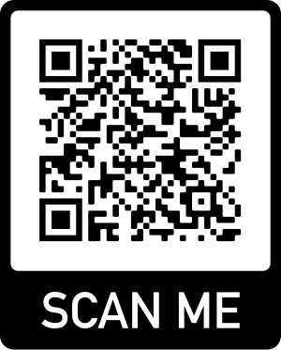
READI: Researching Efficient Approaches to Delirium Identification
>500 hospitalized older adults
  BIDMC and PA. community hospital
  Over 1/3 with dementia/AD
MDs, RNs, CNAs (UB-2 only)
vs. Ref Standard
Main findings:
  UB-CAM completed > 97%
  Avg. completion time: 1 min 15 secs
  Overall accuracy = 89%
  CNAs, RNs = MDs
  Works well—hypoactive, dementia
Marcantonio et. al, Ann Int Med, 2022
UB-CAM
Delirium
Screen App
Tested in study with over 500 older adults-Marcantonio et al., 2021,M https://www.acpjournals.org/doi/10.7326/M21-1687Annals
Available from Apple App Store

Slide 24
Delirium Severity
Delirium: spectrum phenomenon
  Not just “yes/no”
  Subsyndromal, Mild to Severe
Severity (peak and duration) confers prognostic information, ability to track status over time
CAM-S: operationalizes severity from CAM
3D-CAM-S: “Raw” Method (score 0-20):
  Simple sum # of incorrect/positive items
  Reduces subjective judgments (mild vs. marked)
  Must administer all items
Inouye et. al Ann Int Med 2014,
Vasunilashorn et. al., JAGS, 2020

Slide 25
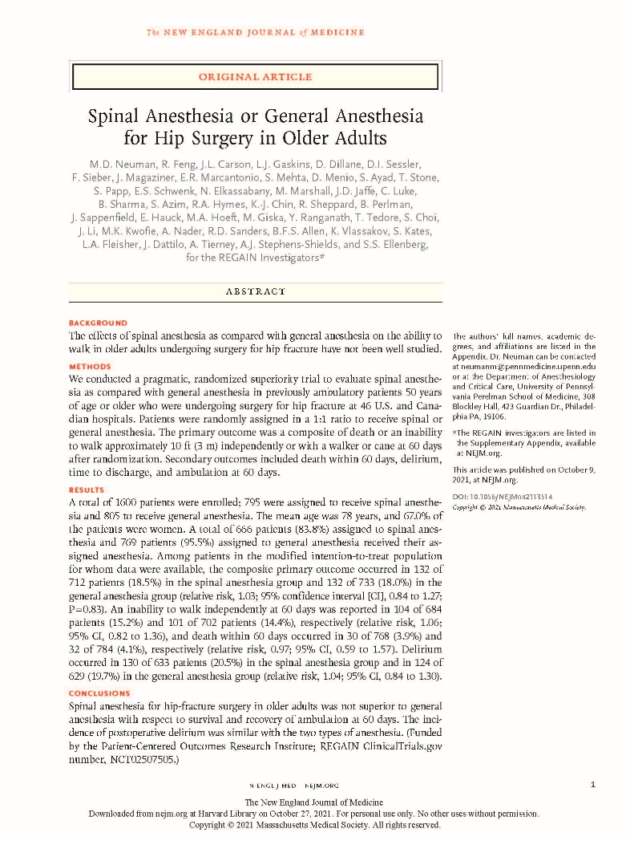
Use of 3D-CAM
REGAIN: RCT of General vs. Spinal Anesthesia for Hip Fracture
PCORI funded, 1600 patients, 50 sites
3D-CAM integrated into study protocol
Standardized delirium outcome measure
Neuman et. al., NEJM 2021

Slide 26
Administering the 3D-CAM
All materials available free of charge at:
American Delirium Society
American Geriatrics Society: help.agscocare.org

Slide 27
General Guidelines
Make sure the patient can see you and hear you
Use glasses, hearing aids, pocket talkers as needed
Ask family members to step out of room
Enunciate words clearly
Try not to deviate from phrasing on document
Give encouragement, but do not indicate correct/incorrect answer

Slide 28
3D-CAM: Item by Item
General Instructions:
Coding Instructions:
  Incorrect/Yes also includes “I don’t know” and No response or nonsense responses
  Correct/No
  Refused/Unable to assess: use sparingly
Different approaches:
  Complete Items 1-20 on all patients
  Skip pattern—discussed in UB-CAM—shortens the interview by over 1 minute (cannot measure severity)

Slide 29
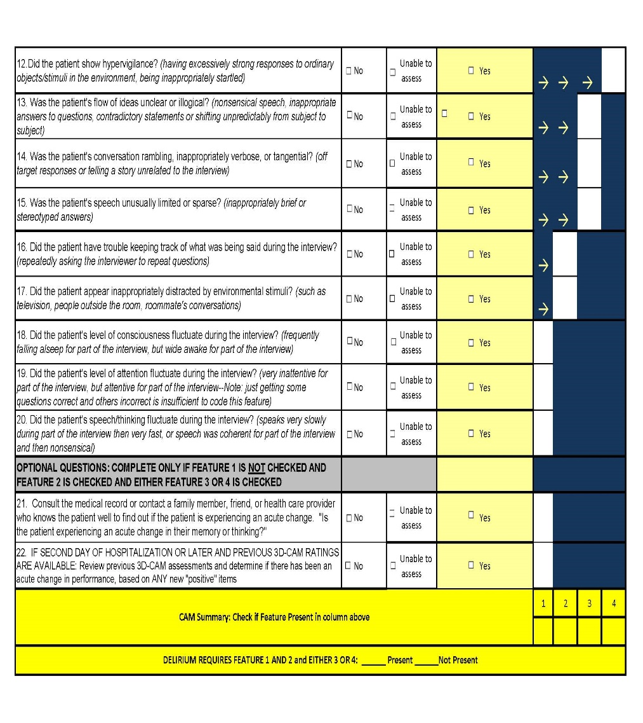
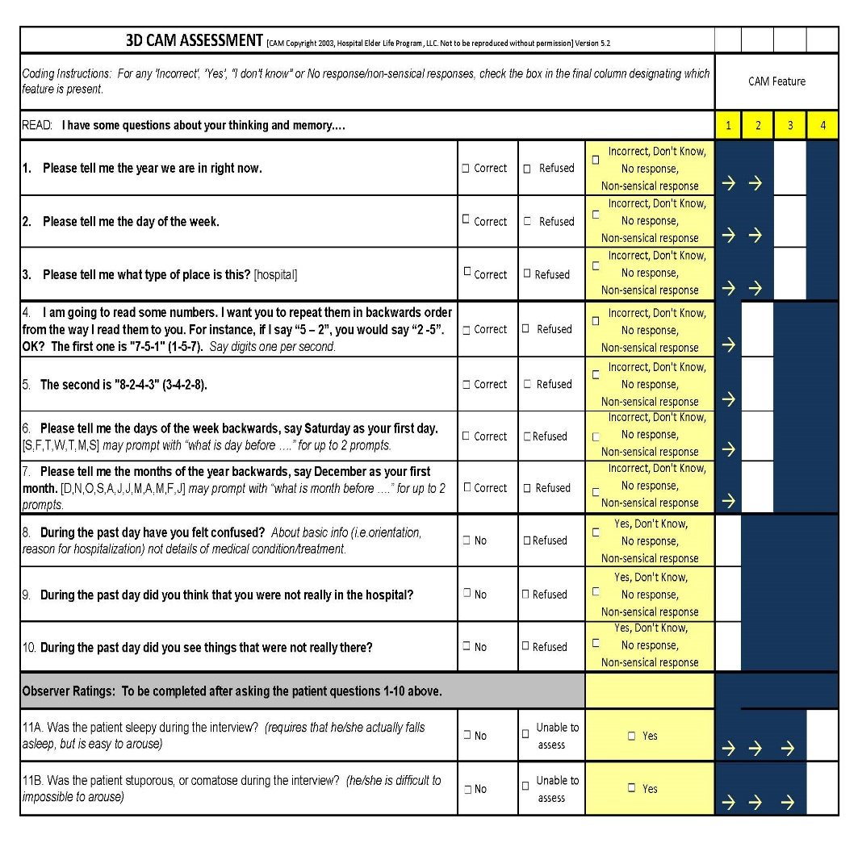
3D-CAM Form

Slide 30
Feature 3 Questions
Please tell me the year we are in right now
Please tell me what is the day of the week
Please tell me what type of place is this [hospital]
Any incorrect response triggers CAM Feature 3 (Disorganized Thinking).

Slide 31
Feature 2 Questions
Digit Span backwards: I am going to read you some numbers. I want you to repeat them in backwards order…
  The first is 7-5-1 [1-5-7]
  The second is 8-2-4-3 [3-4-2-8]
Please tell me the days of the week backwards. Say Saturday as your first day.
Please tell me the months of the year backwards. Say December as your first month.
Any incorrect response triggers CAM Feature 2 (Inattention).

Slide 32
Feature 1 Questions
During the past day have you felt confused?
During the past day did you think that you were really not in the hospital?
During the past day did you see things that were not really there?
Any “Yes” response triggers CAM Feature 1 (Acute Change).

Slide 33
Feature 4 Observations
Was the patient sleepy during the interview? (falls asleep, but easy to arouse)
Was the patient stuporous or comatose during the interview (difficult/impossible to arouse)?
Did the patient show vigilance, such as having inappropriately strong responses to ordinary objects/stimuli in the environment?
Any “Yes” response triggers CAM Feature 4 (Altered Level of Consciousness).

Slide 34
Feature 3 Observations
Was the patient’s flow of ideas unclear or illogical?
Was the patient’s conversation rambling, inappropriately verbose, or tangential?
Was the patient’s speech unusually limited or sparse (e.g. yes/no answers)?
Any “Yes” response triggers CAM Feature 3 (Disorganized Thinking).

Slide 35
Feature 2 Observations
Did the patient have trouble keeping track of what was being said during the interview?
Did the patient appear inappropriately distracted by environmental stimuli?
Any “Yes” response triggers CAM Feature 2 (Inattention).

Slide 36
Feature 1 Observations
Did the patient’s level of consciousness, attention, or speech/thinking fluctuate during the interview?
“Yes” response triggers CAM Feature 1 (Fluctuating Course).

Slide 37
Feature 1 Optional Questions
To be completed only if Feature 1 is not checked but Feature 2 and either 3 or 4 are checked
Consult medical record, healthcare provider, or family member: “Is the patient experiencing an acute change in their memory or thinking?”
After baseline: Review previous 3D-CAM’s. Are there any NEW “positive” items?
“Yes” response to either question triggers
CAM Feature 1(Acute Change)

Slide 38

CAM Feature Quiz

Slide 39
1. You ask the respondent a question. When she pauses to think about her answer, she closes her eyes and begins to snore.
Acute Change
Fluctuating Course
Inattention
Disorganized Thinking
Altered Level of Consciousness

Slide 40
2. You ask the respondent, “What is the year?” and he responds with, “Yes”.
Acute Change
Fluctuating Course
Inattention
Disorganized Thinking
Altered Level of Consciousness

Slide 41
3. The respondent startles easily at any sound or touch. His eyes are wide open.
Acute Change
Fluctuating Course
Inattention
Disorganized Thinking
Altered Level of Consciousness

Slide 42
4. As you begin the interview, the respondent’s eyes are fixed on the television. You call the respondent’s name and touch her arm. She looks at you momentarily, but does not acknowledge your presence. You repeat a question several times without response. Her eyes continue to be fixed on the TV.
Acute Change
Fluctuating Course
Inattention
Disorganized Thinking
Altered Level of Consciousness

Slide 43
5. During the interview, the respondent picks up her can of ginger ale and puts it in her flower arrangement. When you inquire as to what she’s doing she remarks, “I’m trying to water the turkey plants!”
Acute Change
Fluctuating Course
Inattention
Disorganized Thinking
Altered Level of Consciousness

Slide 44
6. You ask a family member to step out for a few minutes so that you can test the respondent’s memory and thinking. The family member says, “Oh good, she’s not herself today.”
Acute Change
Fluctuating Course
Inattention
Disorganized Thinking
Altered Level of Consciousness

Slide 45
7. Respondent repeatedly falls asleep at the beginning of the interview. Later on, she becomes wide awake and engages appropriately.
Acute Change
Fluctuating Course
Inattention
Disorganized Thinking
Altered Level of Consciousness

Slide 46

Video Time!

Slide 47
3D-CAM Training Videos
3 Sets of Videos
  3 patients, hospital days 1 and 2
Will view and score 1 set of videos today
Two more sets of videos and answer keys available for practice
Can be found at:
  American Delirium Society
  American Geriatrics Society Co-Care website—CAM assessment tools

Slide 48
DAY 1

Slide 49
FEATURE 4
Altered Level of Consciousness
11A. Sleepy?
Yes
No
11B. Stuporous/Comatose?
Yes
No
Vigilant?
Yes
No

Slide 50
FEATURE 3
Disorganized Thinking
Flow of ideas unclear or illogical?
Yes
No
Conversation rambling?
Yes
No
Speech limited or sparse?
Yes
No

Slide 51
FEATURE 2: Inattention
Trouble keeping track?
Yes
No
Inappropriately distracted?
Yes
No

Slide 52
FEATURE 1: Fluctuation
Level of consciousness fluctuate?
Yes
No
Level of attention fluctuate?
Yes
No
Speech/thinking fluctuate?
Yes
No

Slide 53
CAM Summary
Feature 1 present?
No
Feature 2 present?
No
Feature 3 present?
Yes
Feature 4 present?
No
Delirium Present?
NO

Slide 54
DAY 2

Slide 55
FEATURE 4
Altered Level of Consciousness
11A. Sleepy?
Yes
No
11B. Stuporous/Comatose?
Yes
No
Vigilant?
Yes
No

Slide 56
FEATURE 3
Disorganized Thinking
Flow of ideas unclear or illogical?
Yes
No
Conversation rambling?
Yes
No
Speech limited or sparse?
Yes
No

Slide 57
FEATURE 2: Inattention
Trouble keeping track?
Yes
No
Inappropriately distracted?
Yes
No

Slide 58
FEATURE 1: Fluctuation
Level of consciousness fluctuate?
Yes
No
Level of attention fluctuate?
Yes
No
Speech/thinking fluctuate?
Yes
No

Slide 59
CAM Summary
Feature 1 present?
Yes
Feature 2 present?
Yes
Feature 3 present?
Yes
Feature 4 present?
Yes
Delirium Present?
YES

Slide 60
Questions?

