Slide 1
Responding to peer review feedback
Andrew Auerbach MD MPH
Professor of Medicine
UCSF School of Medicine – Department of Medicine
Andrew.Auerbach@ucsf.edu | @ADAuerbachMD

Slide 2
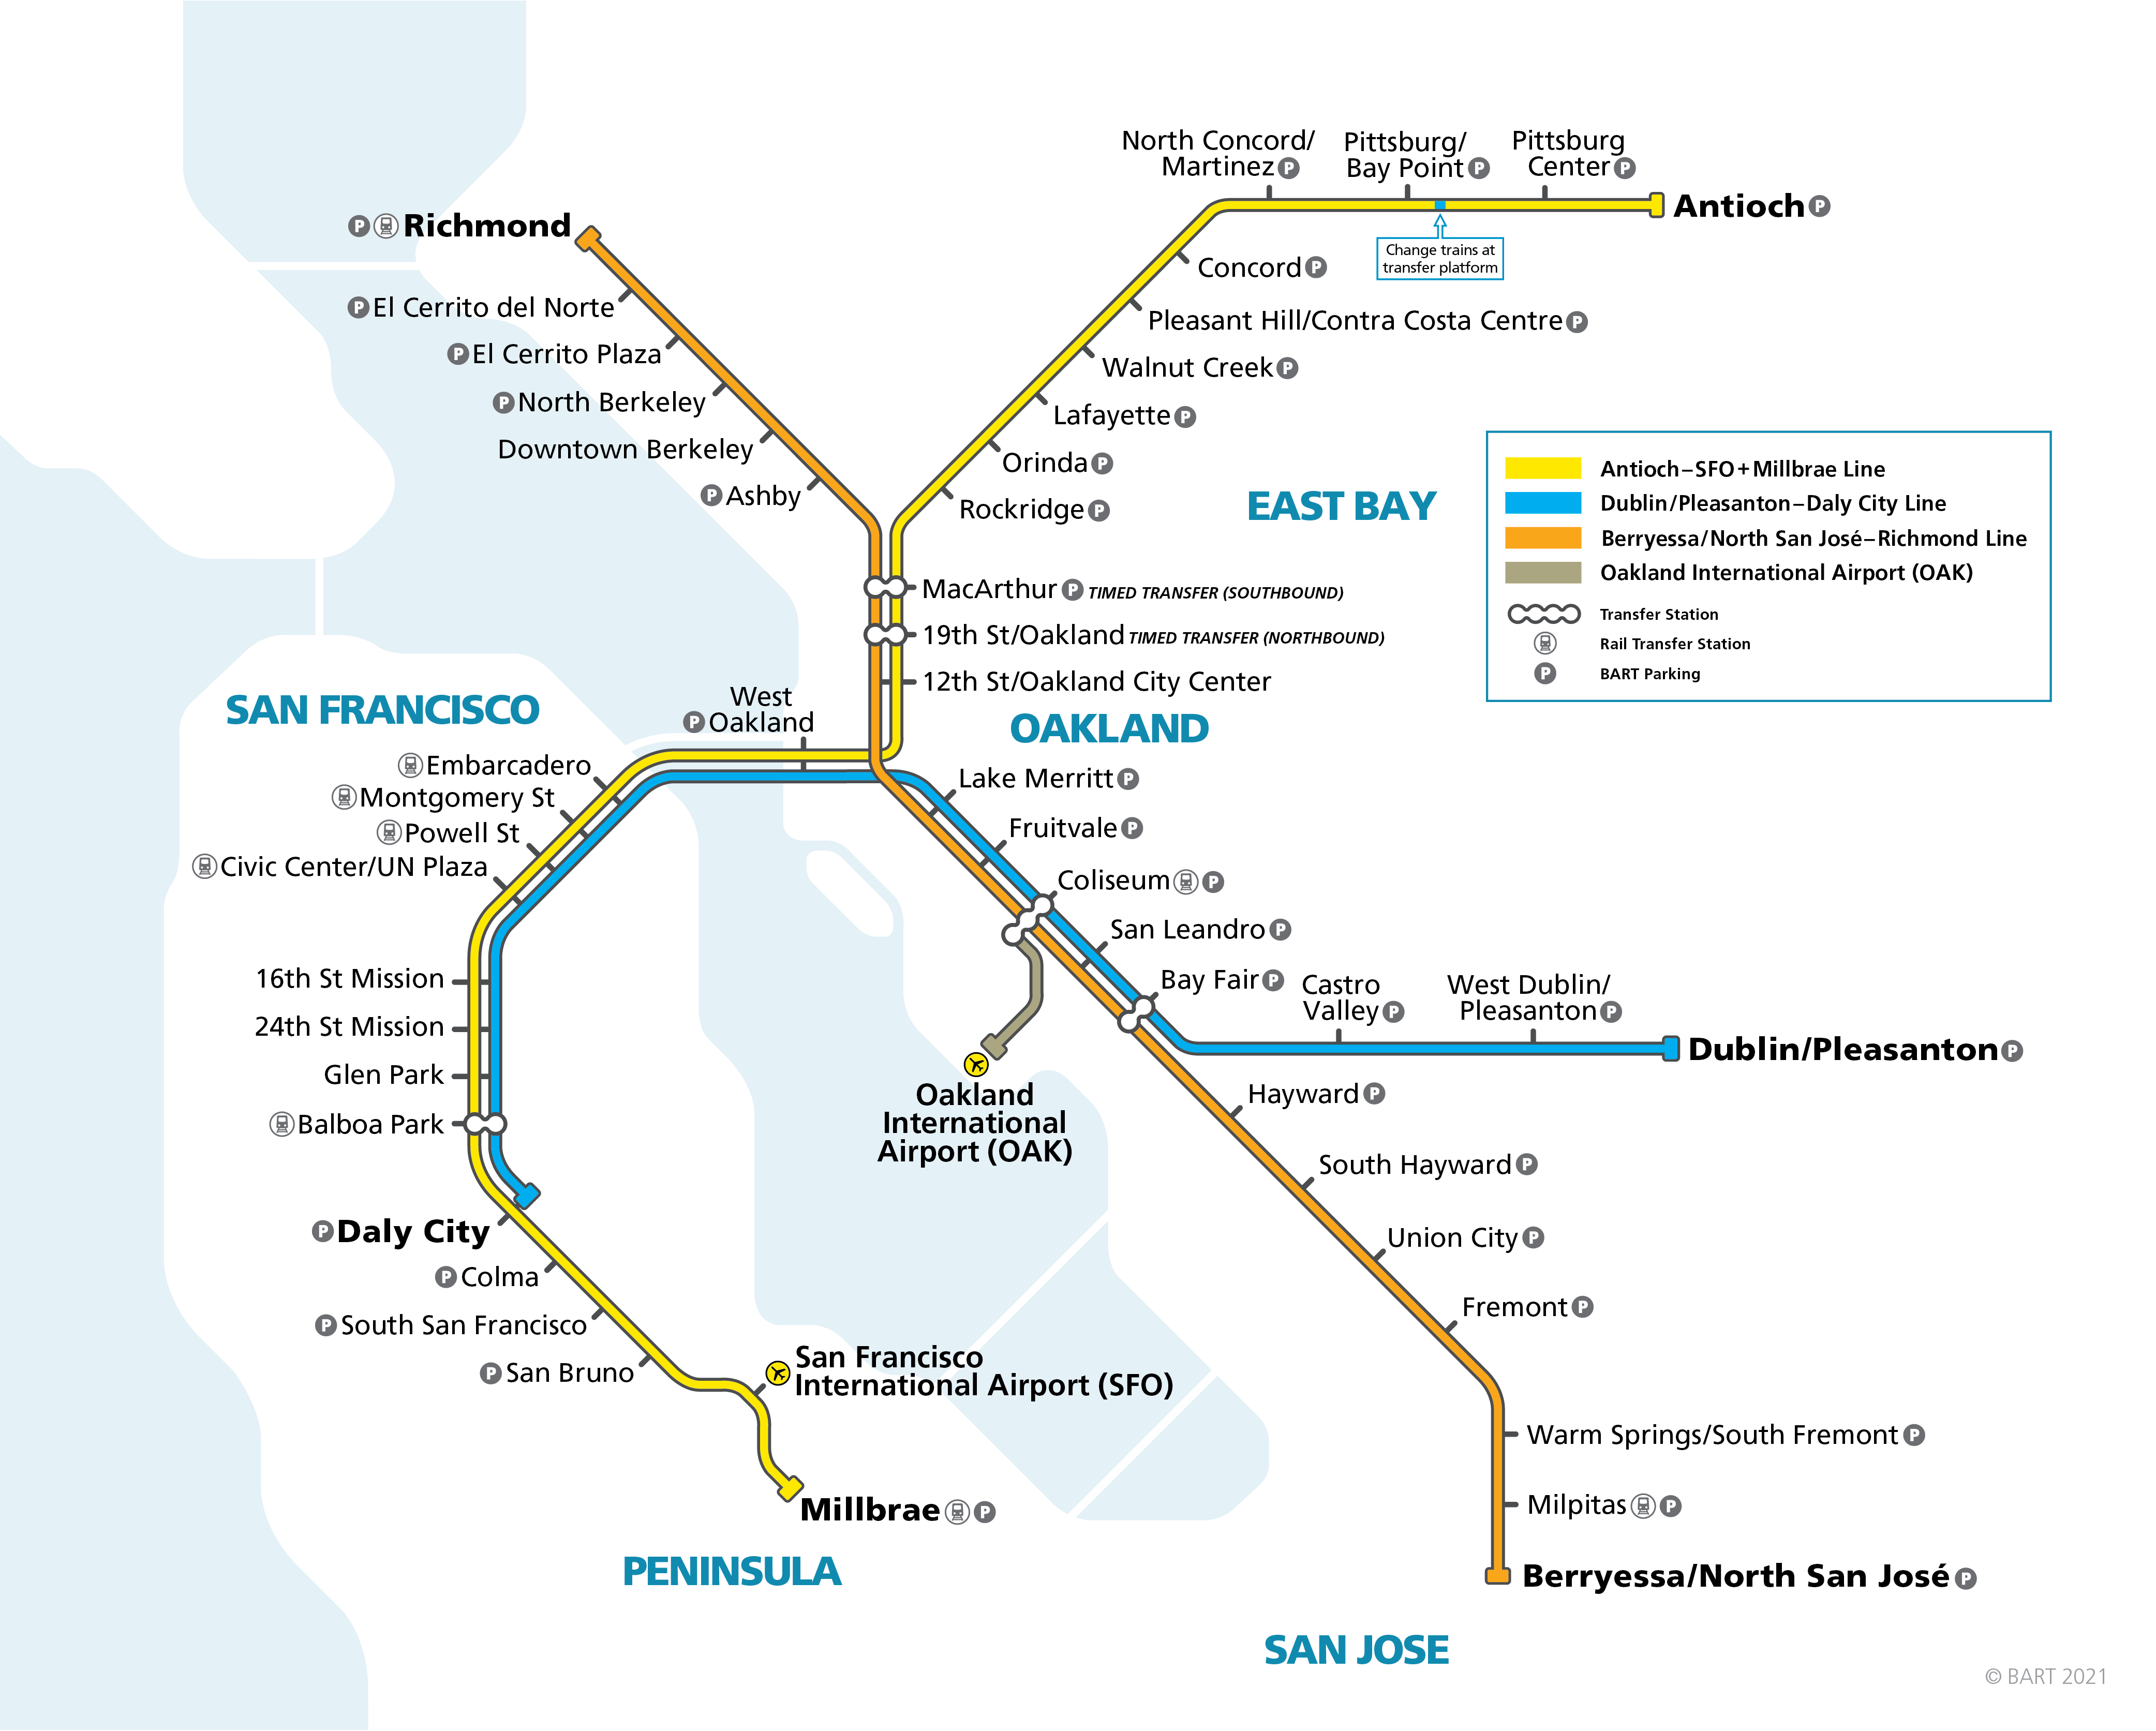
Roadmap
How does peer review at a journal work?
How does peer review on a grant study section work?
Ways to respond
Peer reviews
Study section critiques

Slide 3
Disclosures
Funding from AHRQ, PCORI, FDA (via UCSF/Stanford Center for Evaluation and Regulatory Sciences)
Royalties: Up to Date
Advisor: Pear Therapeutics
Founder (no funding): ADviCE Health

Slide 5
Peer review at a journal
Review by administrative editor (for submission problems)
Review by ‘triage’ editor (can be managing editor, associate editor) for initial check for rigor, fit, etc.
Decline without review can happen here

Slide 6
Peer review at a journal
Send for peer review
1-4 peer reviews generally the goal
5-10 invitations to reach required number
On return from review:
Triaging/managing editor makes judgment (reject vs. request revision) and adds clarifying/summarizing feedback to letter
Editor and Editorial Board discussion can also add thoughts or refine reviews

Slide 7
Nuances of journal peer review
Review happens asynchronously
Reviewers do not get to reconsider reviews after discussion with each other
More divergent, but also more likely to be ‘your market’
Not ‘scored’
Reject, major revision, minor revision are the common ‘big buckets’ but the process can be very gestalt-ish
Role of the Editor can be large
Add or overrule comments
Direct you to particularly important issues in cover letter

Slide 8
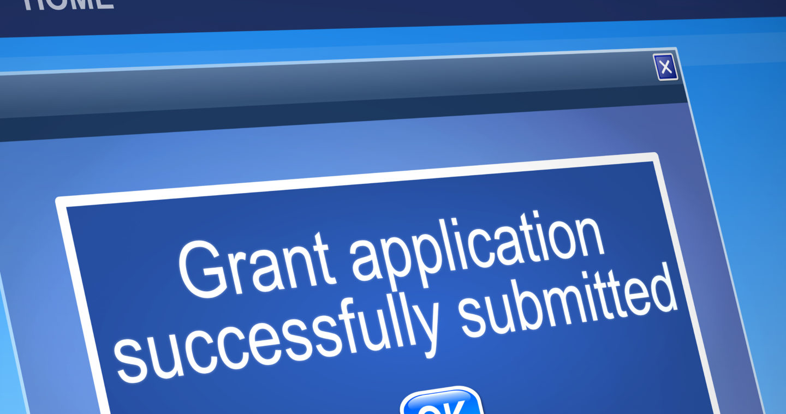

Slide 9
Reviews
Scores
Summary score
Percentile
Funding decision

Slide 10
Study sections
Study Section
Composed of individuals knowledgeable in the field, funding mechanism, who represent key groups (e.g. patients)
Study Section Chair
Oversees meeting, moderates discussion, ensures consensus on scores.
Reviewers
Read your proposal beforehand, score, then discuss in the meeting
First reviewer is the ‘primary’ reviewer, and others secondary.
Scores (NIH):
1-9 scores, with lower scores = better

Slide 11
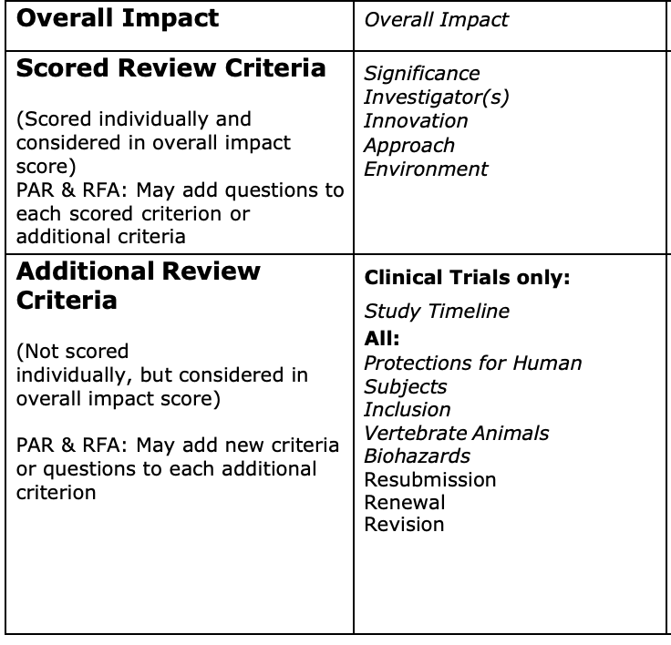
Research Grants

Slide 12
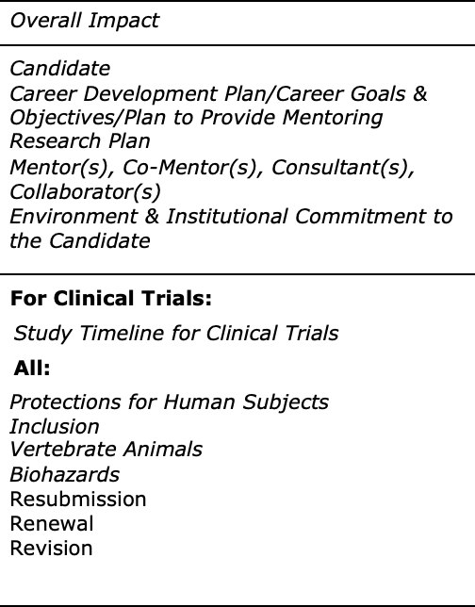
Career Development Grants

Slide 14
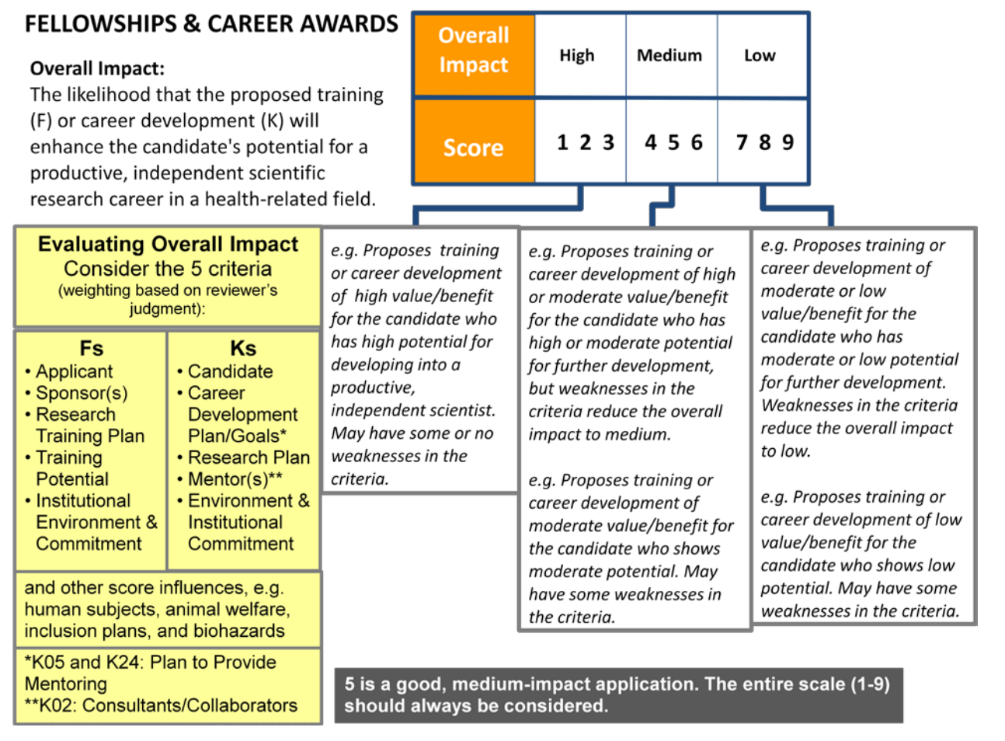

Slide 15
Scores, ctd
Scores are revised after discussion but what you see is their final call
Overall impact score (the score that matters) is determined by calculating the mean score from all eligible members' final scores, and multiplying the average by 10
Percentile is the percentage of applications that got a better impact score
Payline
Based on availability of funds and/or institute policy

Slide 16
Reviews
Scores
Summary score
Percentile
Funding decision

Slide 19
REF: M20-1929 Dear Dr. Auerbach:
Thank you for submitting your manuscript, ”Responding to peer reviews” to Annals. The editors, and 4 external reviewers read the manuscript. In addition, the editorial team discussed it at our weekly manuscript meeting.
We are potentially interested in publishing….

Slide 20
…. a substantially revised version of your manuscript. Before we can consider it further, you must prepare a revision that satisfactorily addresses the issues outlined in this letter and in the accompanying external reviews.

Slide 21
Really? Four reviewers? Really?

Slide 22
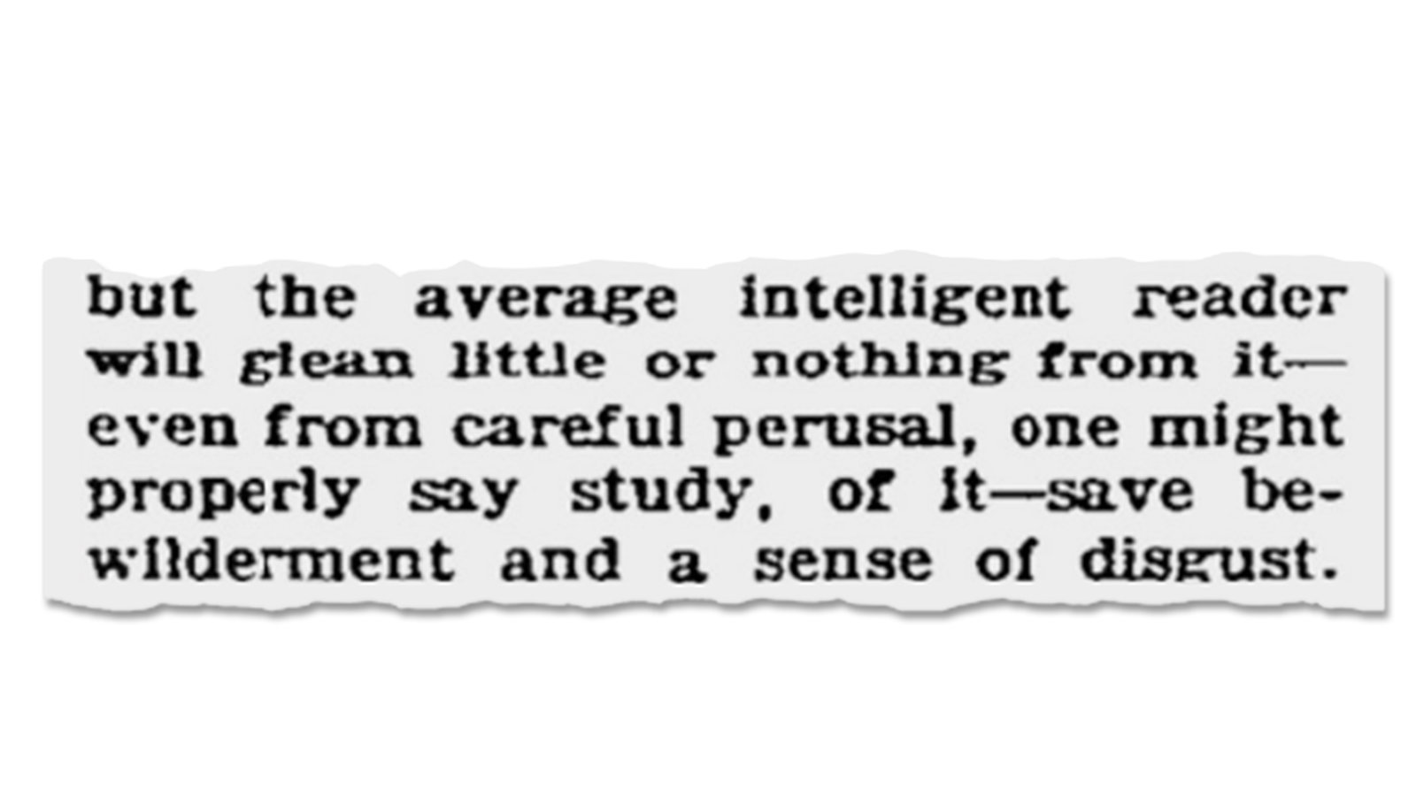

Slide 26
Responding to peer reviews from Journals
Stop, take a deep breath
Do not let it sit. I recommend no more than 5 days
Schedule a time to synthesize your response letter

Slide 27
Copy/Paste all comments into an MS word document

Slide 28
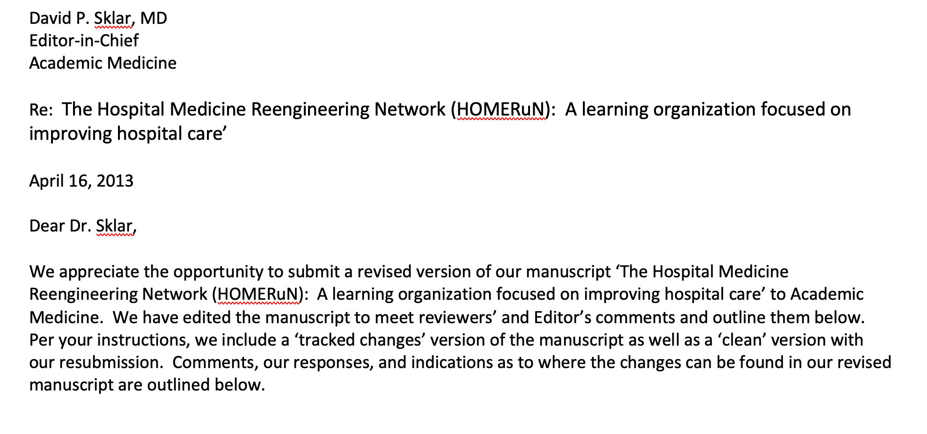
What’s missing here?

Slide 29
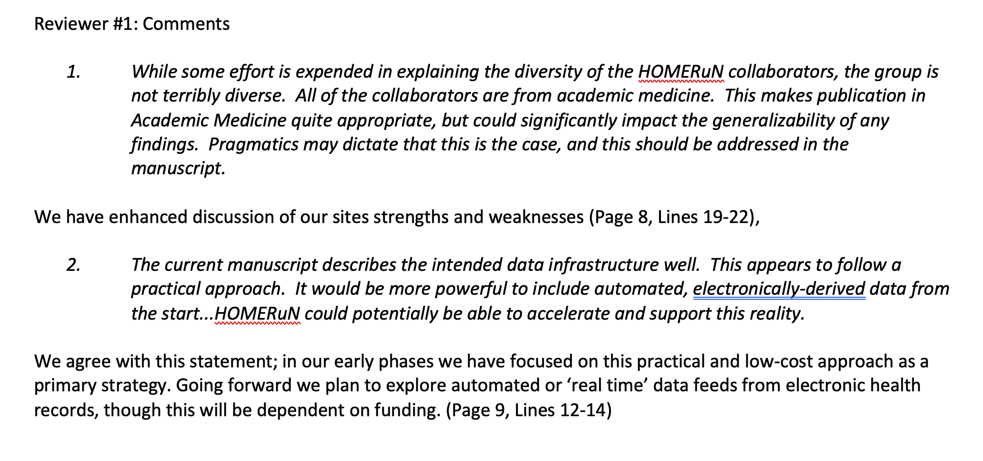
Create a bulleted list of reviewers’ comments
Format your responses so they are easily tracked (with line/page eventually)
Plan to respond to every… single….one
Add these last

Slide 30
Consider your responses
If the Editor gives you guidance or has specific feedback, focus on those issues primarily
Can also be used to break ties or deal with reviewer inconsistencies
Look for themes in reviewers’ comments, consolidate your responses where feasible
Work from top to bottom, OK to refer back to earlier responses if mentioned later

Slide 31
Critique phenotypes
Unclear or confusing items (reviewer misinterprets or misunderstands something)
Editorial work to clarify methods, add discussion points, etc
Analytic requests that might enhance findings or address limitations
Just do the analyses
Items you know can’t be fixed/Requests to do a study you didn’t to
Acknowledge kindly, add to Limitations
?e-mail Editor
Editorial or other somewhat orthogonal comments
Acknowledge kindly, add to discussion or intro if helpful framing

Slide 32
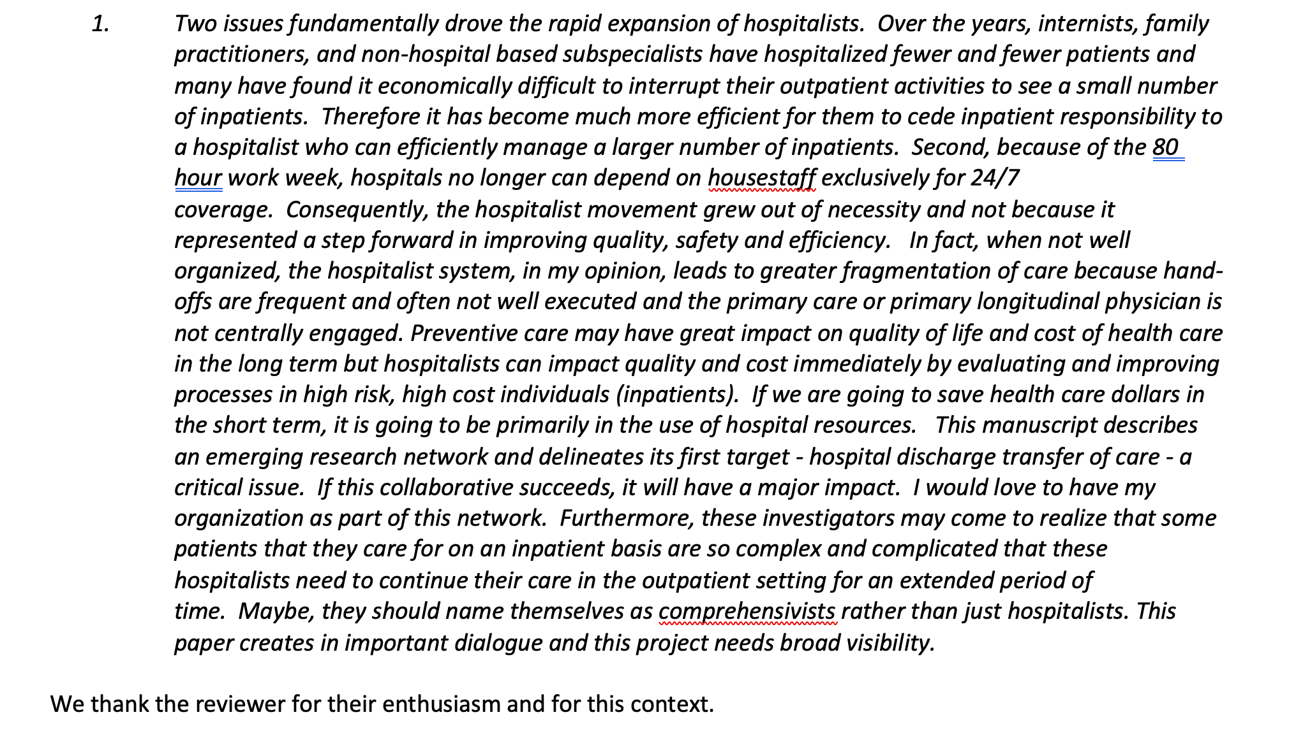
The editorial comment review

Slide 33
Consider your responses
If reviewers’ comments are in conflict or inconsistent
Option 1 (safer): Respond to the one which asks for feasible/most aligned with Aims changes, thank the other
Option 2: Ask Editor for guidance.
If reviewers’ comments are unclear, confusing, or vague
Option 1: Acknowledge in letter with rationale for your change, and make the edits you think helpful.
Option 2: Same, but point to place in paper you think addresses concern already

Slide 34
Response letter and revision
How long can your response letter be?
As long as it takes
It is not unheard of for a revision from a top tier journal will be as long as the original paper
Unsolicited Tables/analyses you put in your letter (but not manuscript) can be double edged sword… use carefully

Slide 35
Response letter and revision
Proofread everything before you send
Your revision:
Can include page/line numbers (most journals are OK with this)
Generally good form to submit tracked-changes version and clean version
Don’t forget to remove comments and tracked changes

Slide 36
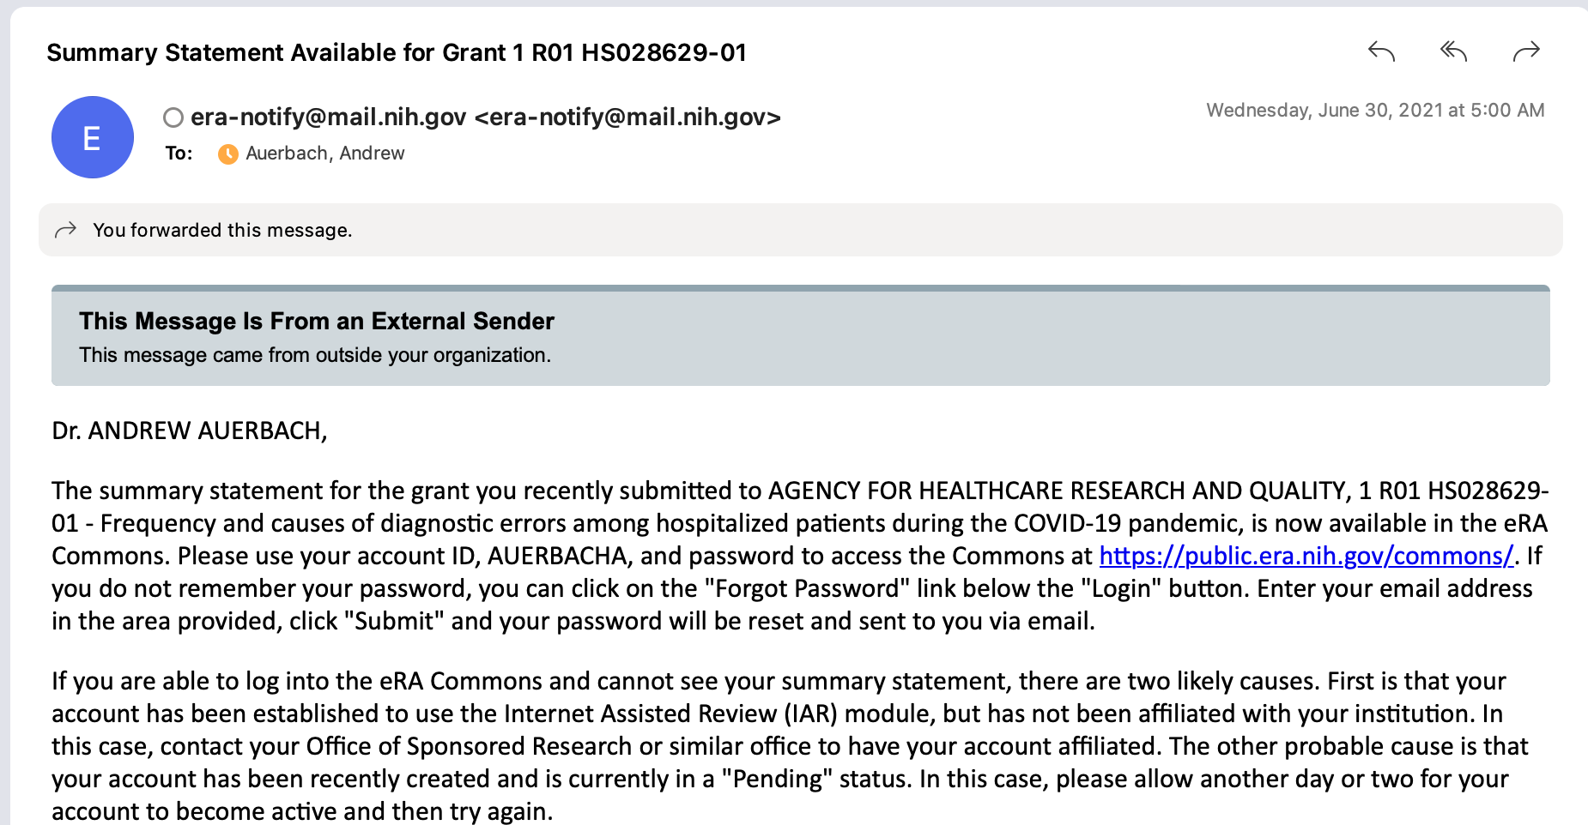

Slide 37
Grant revisions (NIH)
Rule 1: You have just one opportunity to resubmit.
Rule 2: You must apply within 37 months of the original application's receipt date.
Rule 3: You must create a one-page introduction that addresses all your reviewers' issues that are stated in your summary statement.

Slide 38
Before you get to writing…
Check your original funding opportunity announcement (FOA)
If the announcement has been reissued or updated, make sure you're aware of new deadlines, eligibility criteria, forms, and instructions.
If you applied to a program announcement (PA), program announcement with set-aside funds (PAS), or program announcement with special review considerations (PAR), you may resubmit to the same or a different PA, PAS, or PAR. But you'll still want to check your new FOA for the information.

Slide 39
Draft your revision strategy
Your primary way to identify priority areas is the summary statement
The first (e.g. primary) reviewer is the next priority area
Sometimes reviewers’ scores can help identify consistent areas
Copy and paste comments into a single document
Look for groupings of issues/comments
Call the program officer when you have completed your initial survey
Develop a plan for all comments/critiques, including PO’s feedback

Slide 40
Comment | To-do’s | Writing tasks
R1: Limited access to priority populations R2: More details about outreach to unhoused patients | Reach out to community partners Preliminary data on admissions among Double check human subjects files to be sure correct | Add to intro page Prelim data Methods

Slide 41
Draft your revision strategy
Emphasize strongest parts of your strategy, and discard parts that reviewers felt were weakest
Add new findings, data, or partnerships to Preliminary Studies
For K and training grants particularly – review all letters of support and redraft to address strengths and fill gaps
Do the to-do’s and represent them with the writing tasks throughout
https://www.niaid.nih.gov/grants-contracts/revise-resubmit-application

Slide 42
The revision process
Unlike a journal article:
No highlighting, underlining/italicizing is permitted
Some lack of clarity around bracketing/indents (but these use space)
Refer to sections (e.g. A.1. Aims).
This does mean you need to keep your document outline format straight
Smaller subheadings can make it easier for reviewers to find revisions, but can also be daunting to read
A.1
A.1.a
A.1.a.ii
A.1.a.ii.⍺

Slide 43
Formulate your 1 page introduction
Overview paragraph
Summarize the summary statement, the themes you identified, and an overview of give an overview of key steps you’ve taken
Priority revision sections (2-3 sentences each)
Give more detailed information about approaches to specific areas in (include section locations and/or tables/figures)
Work from most problematic areas to least.
Space is limited
Fit as much in as you can. Relate major additions, deletions, and modifications not mentioned above
A good introduction can take as much time and energy to draft, hone, and finalize as the entire grant

Slide 44
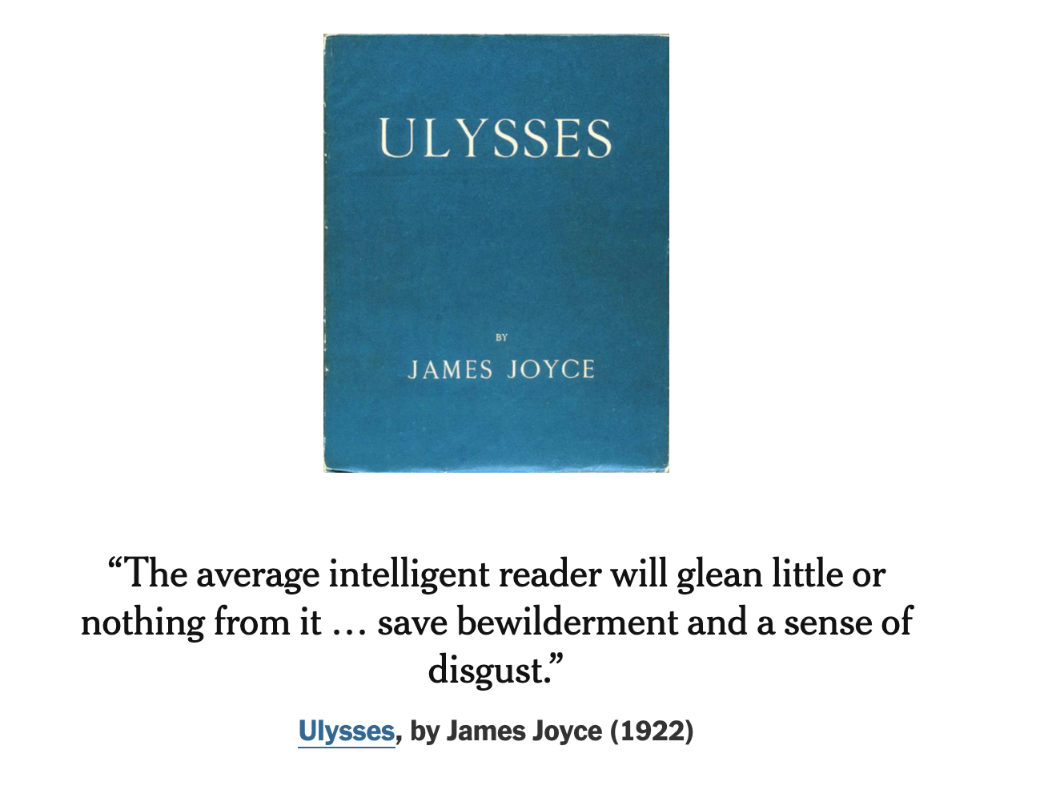

Slide 47
Responding to peer review
Understand the process that got you the feedback you did
Accept the feedback as positively as possible
But don’t let it sit
Have a system for prioritizing and addressing reviews
Take advantage of the idiosyncrasies of journals and grant reviews to craft an effective resubmission
Andrew.Auerbach@ucsf.edu | @ADAuerbachMD

Slide 48
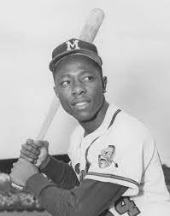
Non-success
Most of your papers, project proposals, grants will not be successful on the first try
Average acceptance rate at medical journals <30%
Average grant funding rate < 15%
A large proportion of your projects will be duds
.300 lifetime batting average
64% Failure
70% failure
All time home run leader

