Slide 1
Innovations in
Clinical Trial Design
Timothy D Girard, MD, MSCI
Associate Professor of Critical Care Medicine
CRISMA Center, Department of Critical Care Medicine
University of Pittsburgh and UPMC Health System

Slide 2
Disclosures
Federal funding: National Institutes of Health
Industry relationships: Ceribell, Lungpacer
Academic investment: Clinical trialist

Slide 3
Why do we need RCTs?
How do RCTs work?
How can RCTs innovate?
What’s
ahead

Slide 4
1
Why do we need RCTs?

Slide 5
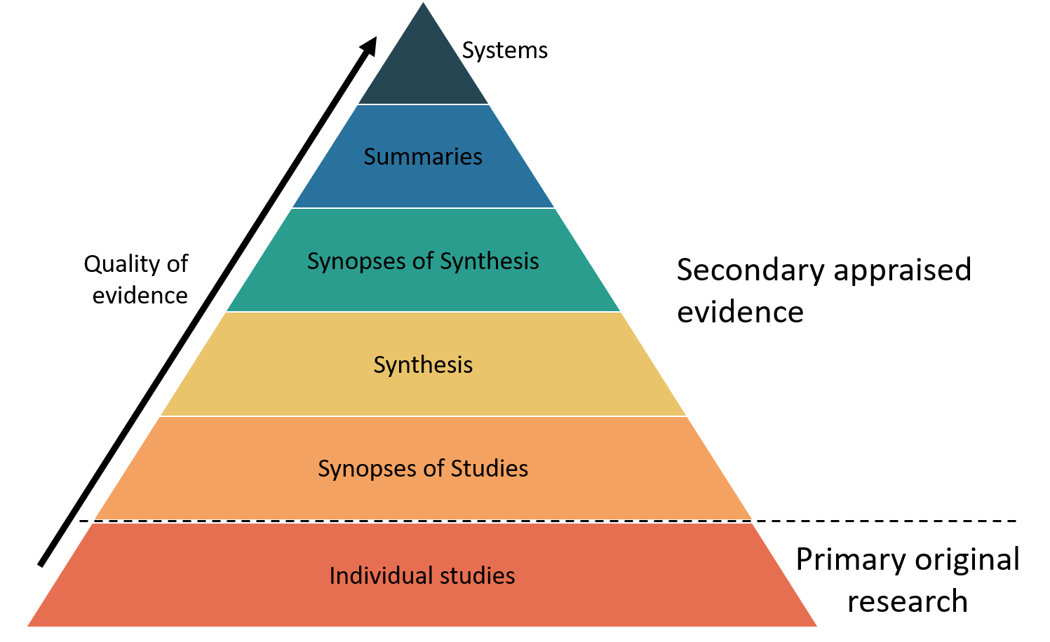
Levels of evidence

Slide 6
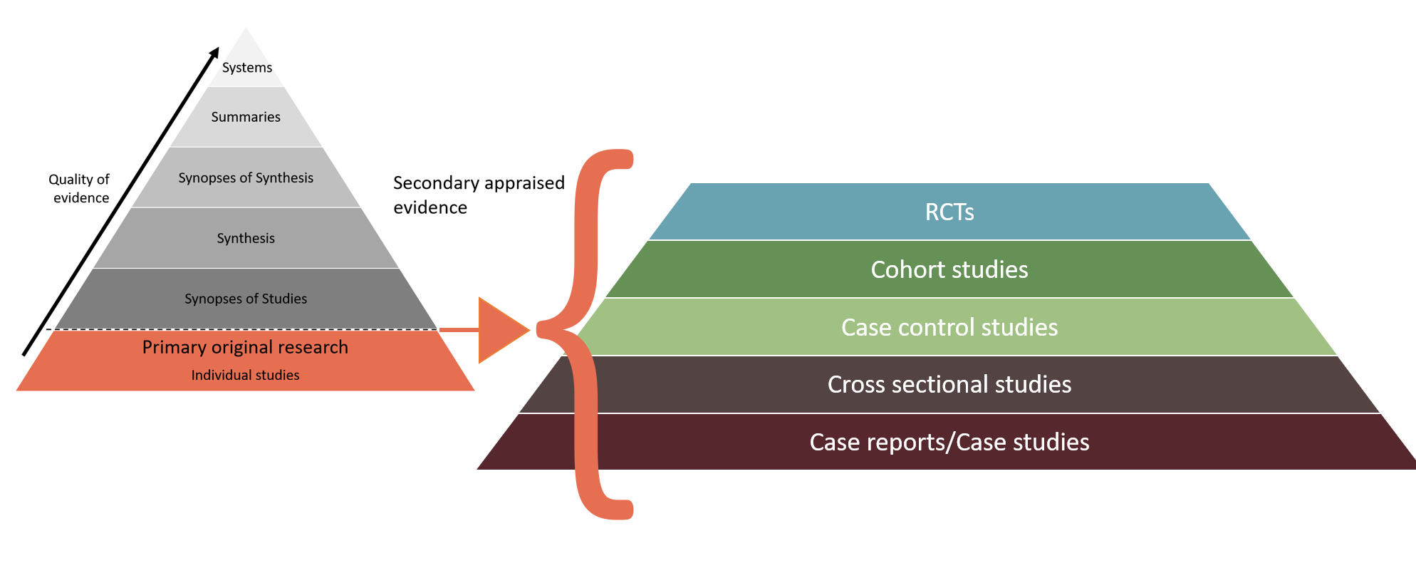
Levels of Primary Original Research

Slide 7
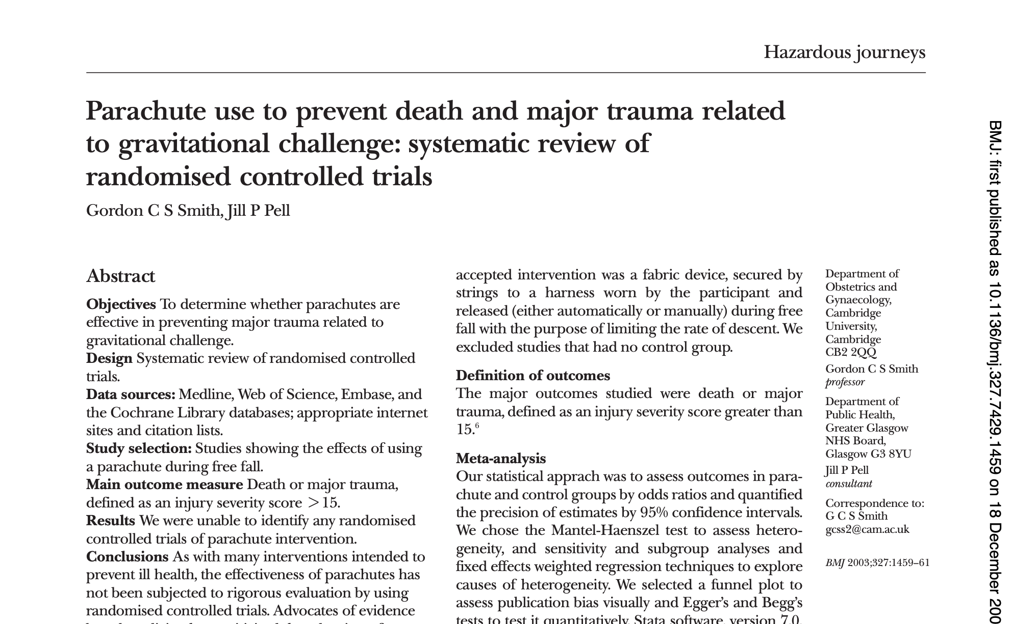

Slide 8

“This virus has a cure - it is called hydroxychloroquine, I have treated over 350 patients and not had one death.”

Slide 9
Bias
“Systematic error introduced into sampling or testing by selecting or encouraging one outcome or answer over others” – Merrian-Webster

Slide 10
Selection Bias
Group of participants analyzed/observed (sample) is not representative of the population intended to be studied
Types
  Observer bias
  Volunteer bias
  Allocation bias
  Sampling bias

Slide 11
Information Bias
Arises from measurement error
Types
  Misclassification bias
  Observer bias
  Recall bias
  Reporting bias

Slide 12
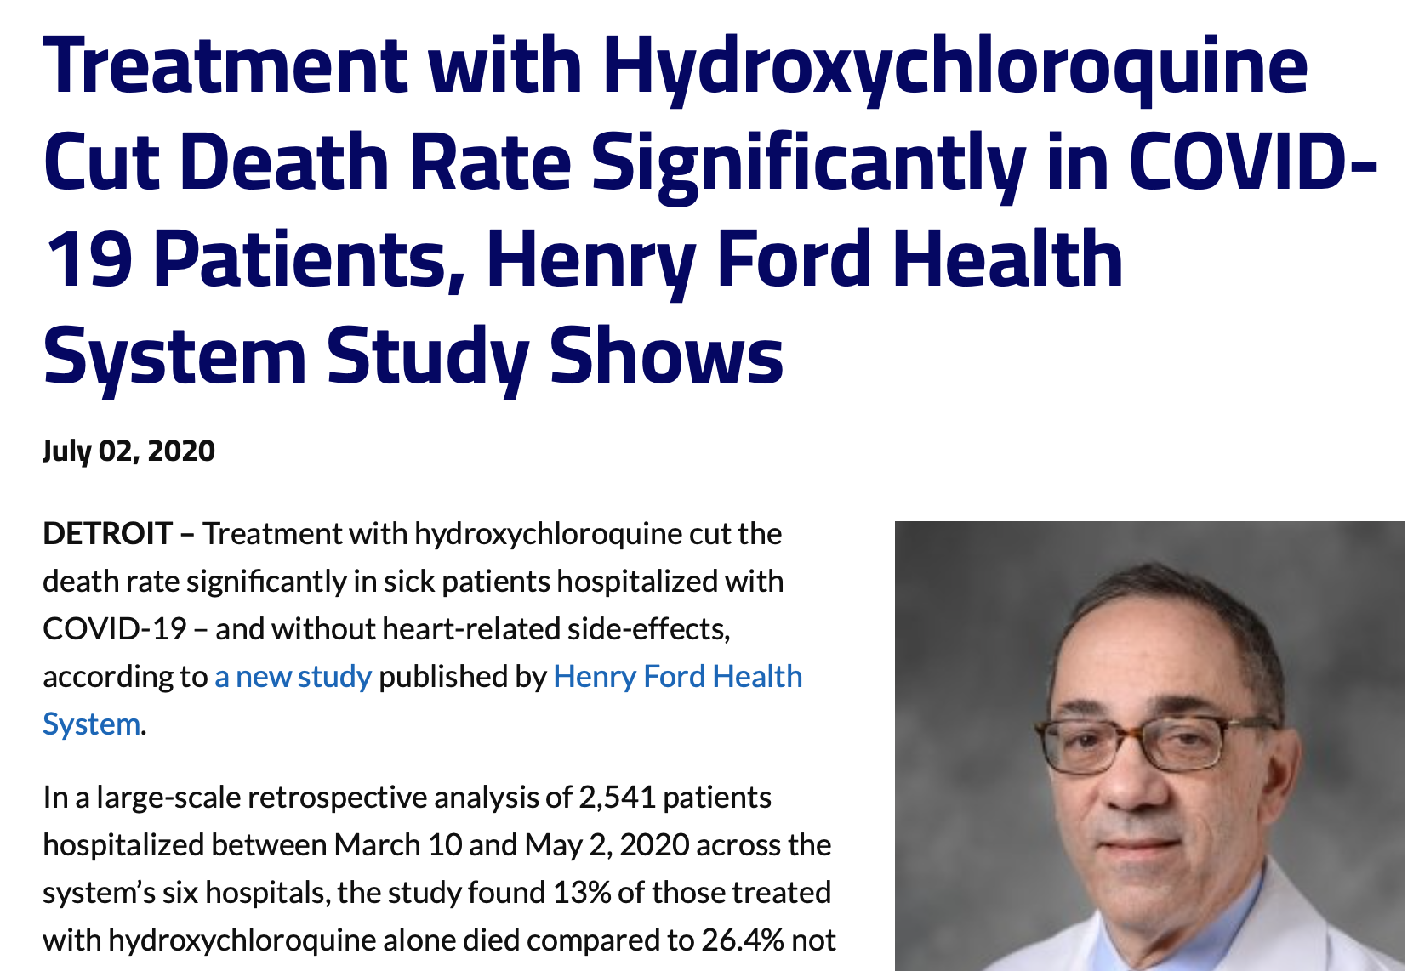

Slide 13
2
How do RCTs work?

Slide 14
Randomization in Clinical Trials
Two processes
Randomization procedure – Assignment of participants to interventions is random
Allocation concealment – Intervention assignments of participants are not revealed prior to allocating them

Slide 15
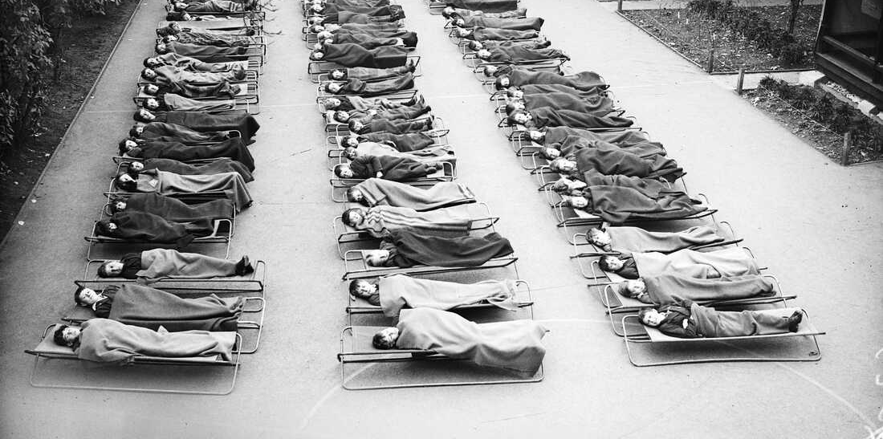

Slide 16
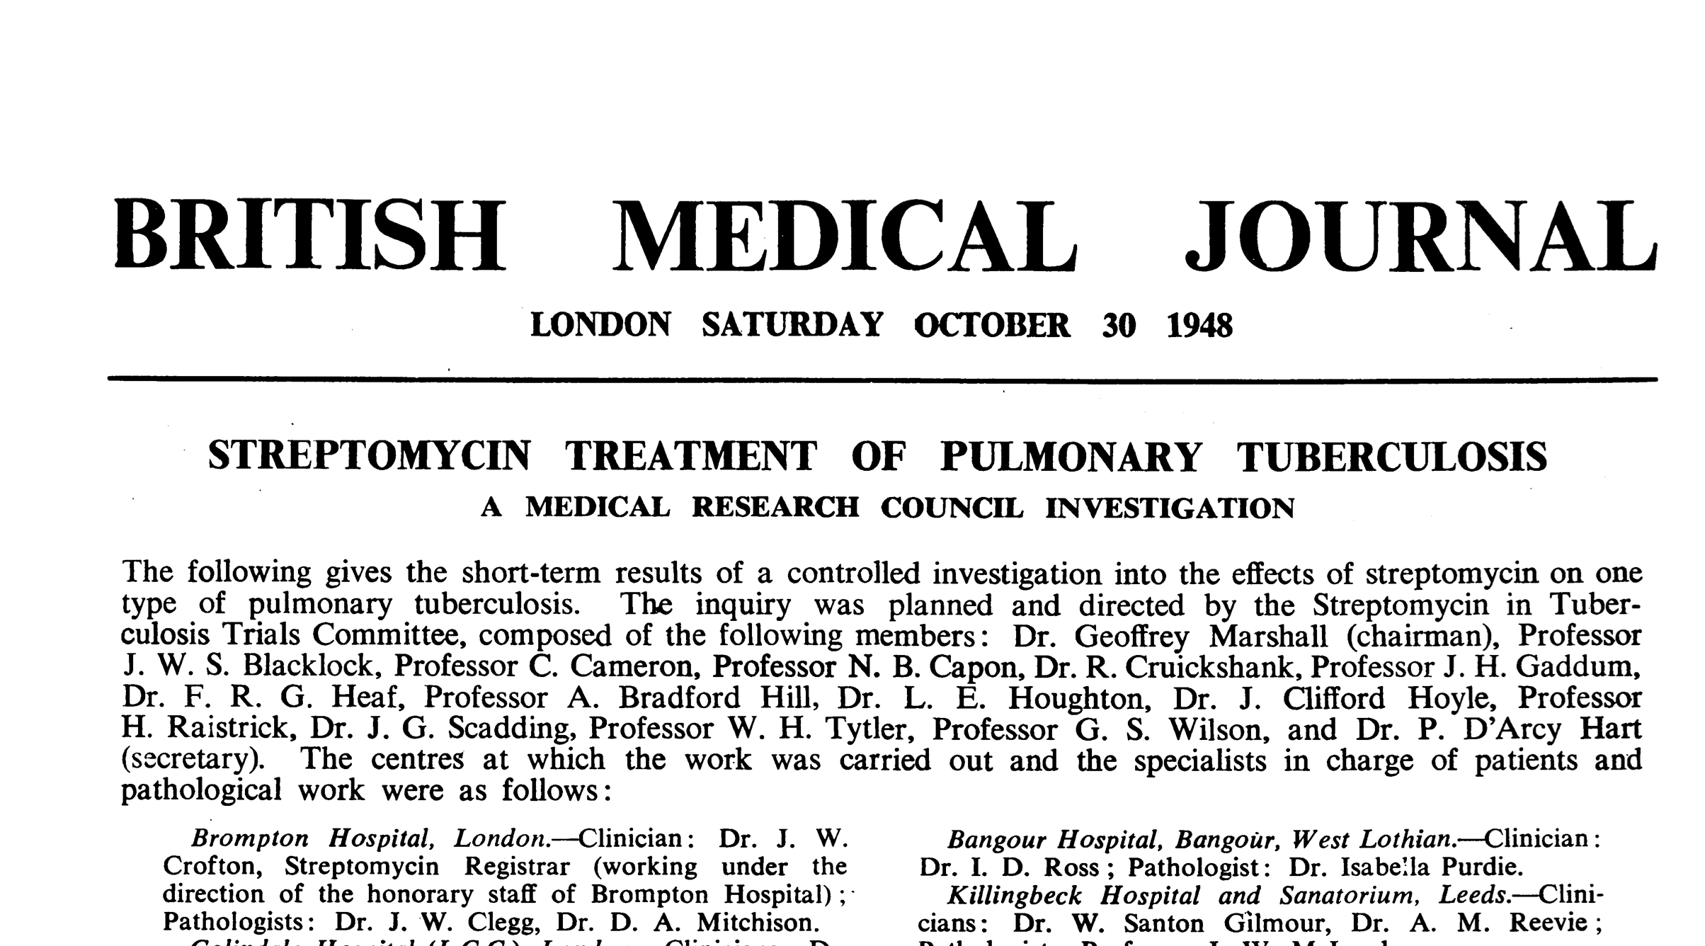

Slide 17
Benefits of Randomization
Eliminates selection bias
Facilitates blinding (masking)
  Reduces measurement error
  Prevents confirmation bias
Permits the use of probability theory when analyzing results

Slide 18
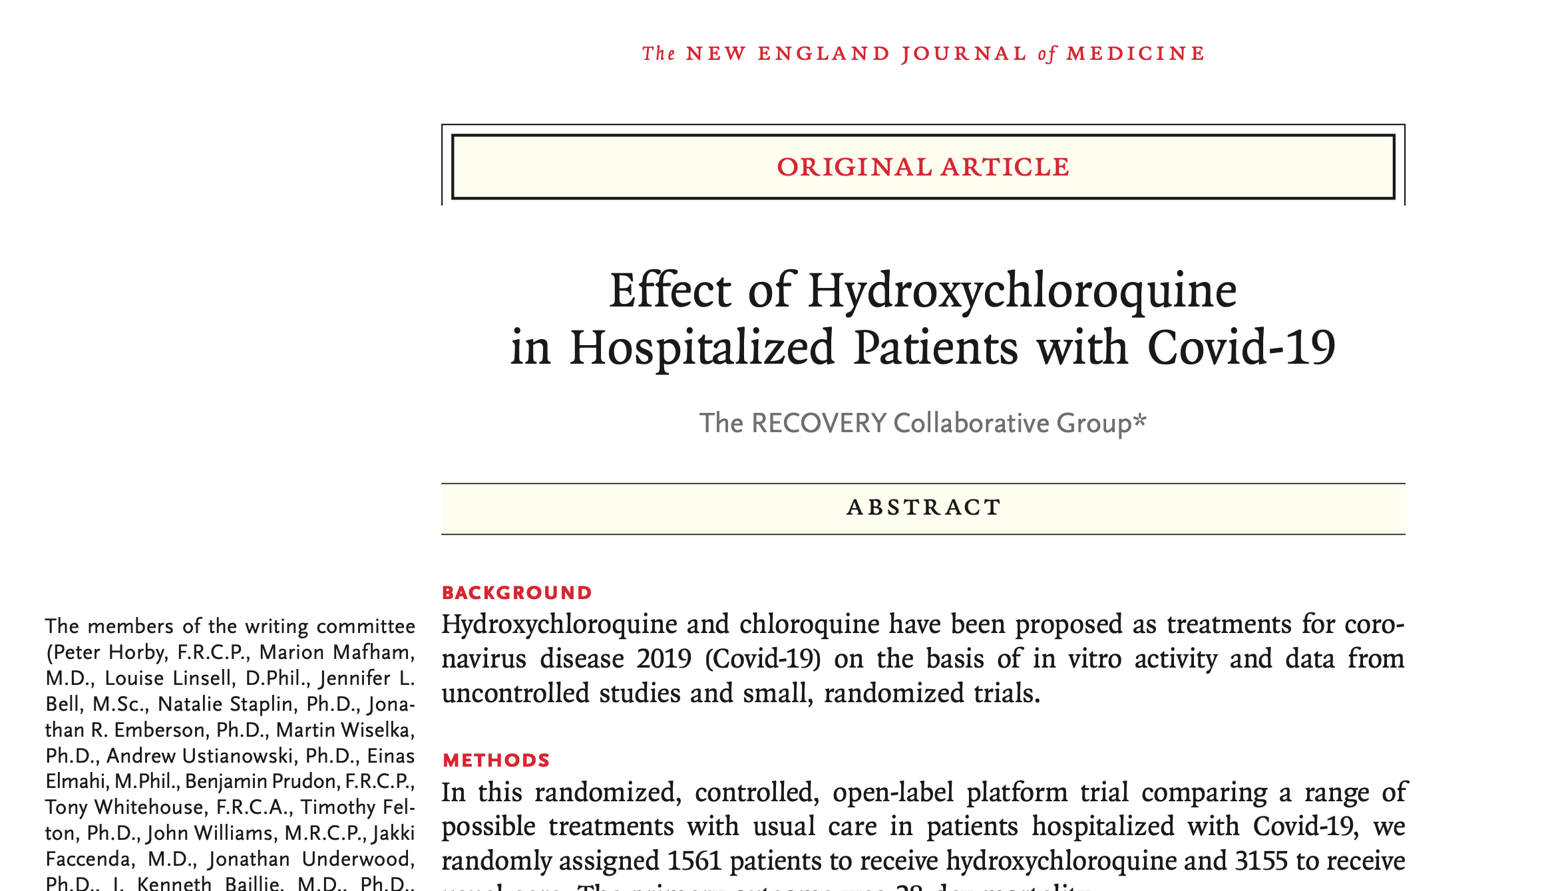

Slide 19
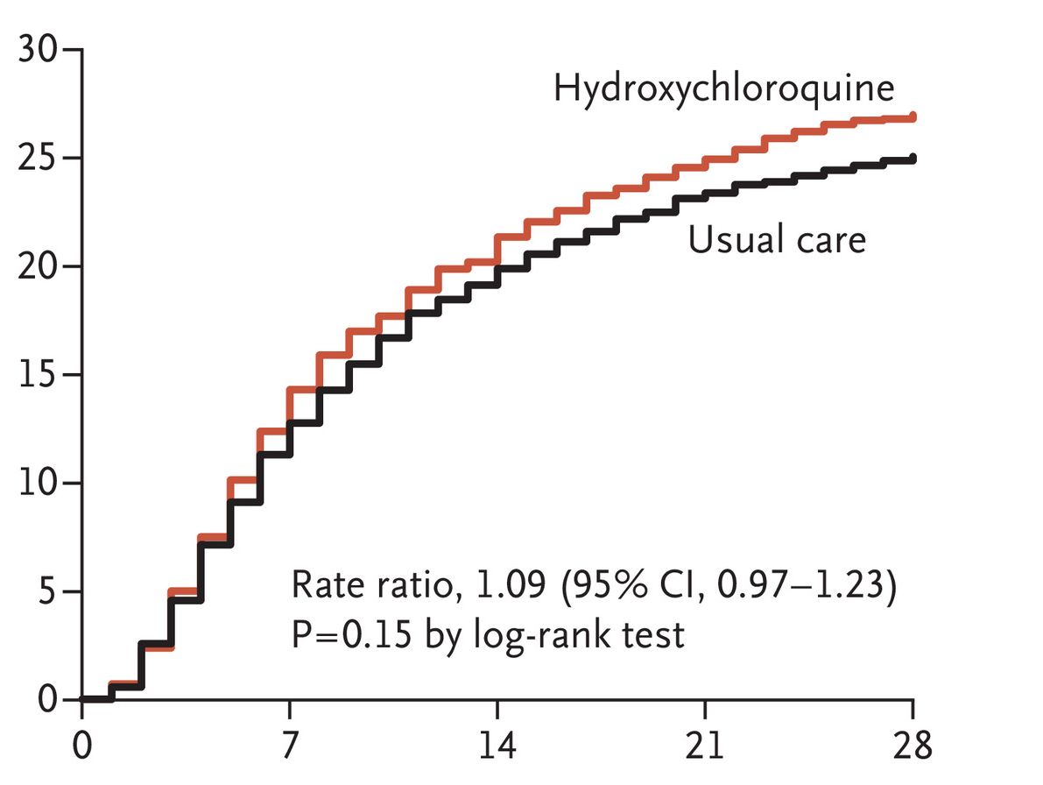
Effect of Hydroxychloroquine
Mortality (%)
Days since Randomization
RECOVERY Collaborative Group. N Engl J Med 2020

Slide 20
Patient/Participant Experience
Feature | Case Series | Non-randomized trial | Randomized trial
Access to novel treatments | – | ++ | +++
Increased chance of receiving most effective treatment | – | – | +
Independent oversight (FDA, IRB, DSMB) | – | + | +++
Enhanced, systematic safety monitoring | – | ++ | +++
Contribution to care of future patients | +/– | + | +++

Slide 21
3
How can RCTs innovate?

Slide 22
Major Challenges in RCTs
Randomization is very uncomfortable
  Physician feels responsible for patient outcomes, consequences are immediate
  Physician feels less responsible for research, consequences are remote
RCTs are very cumbersome
  Slow to start
  Intrusive to execute
Little coordination in the clinical research enterprise
  >100 RCTs registered for HCQ; few likely to be completed
  AMCs bombarded with 100s of requests to participate in trials; no national or global prioritization

Slide 23
Solutions
Make randomization more comfortable
  Multiple arms, only one is control
  Adaptive randomization, preferentially assign to best therapy over time
Make entry into clinical trials ‘1-stop shopping’
  Simplify interface between clinical practice and clinical research
  Use master protocols with standard entry criteria, outcomes, etc.
  Essentially, combine trials/study questions
Sacrifice ‘sacred cows’ of research
  Don’t let perfection be the enemy of the good
  E.g., placebo probably overrated in a pandemic; added rigor not worth the burden

Slide 24
REMAP-CAP Executive Summary
A global adaptive platform trial
Designed to determine best treatment for severe pneumonia
  Randomizes multiple interventions simultaneously, nested within domains
  Uses a multifactorial Bayesian inference model
  Uses response-adaptive randomization
Assesses both interpandemic AND pandemic forms of pneumonia
  Pre-set rules to switch into pandemic mode
Entered pandemic mode (termed ‘REMAP-COVID’) in February 2020

Slide 25
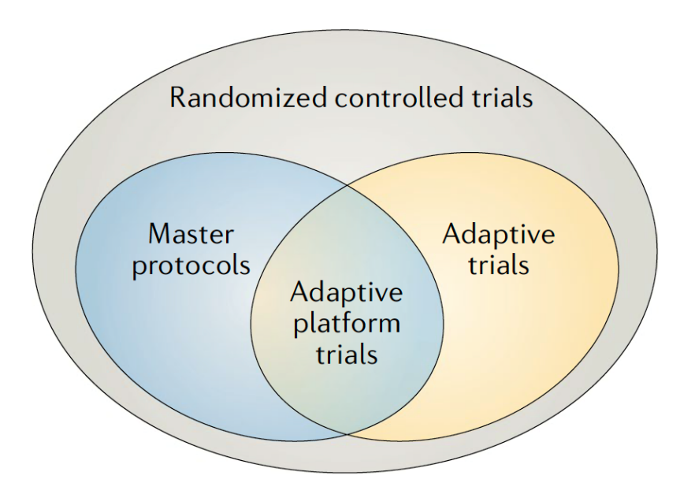
Adaptive Platform Trials
Typically, have focused on pre-approval space
  Emphasis on efficiency with (very) small sample sizes
  Different therapies ‘graduate’ to next phase while trial continues
Woodcock and Lavange. NEJM 2017
Adaptive Platform Trials Coalition. Nature Drug Discovery 2019

Slide 26
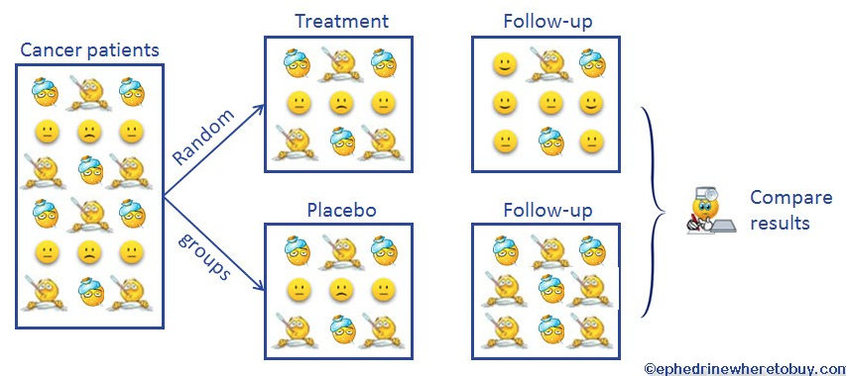

Traditional RCT
Patients with disease X
Treatment – ‘A’
At the start,
50% chance
that A > B
Placebo – ‘B’

Slide 27
Traditional RCT
Patients with disease X
At the end, >99% sure that A > B
What about in the middle?

Slide 28
A planned trial of A vs. B in 400 patients
After 40 enrolled …
40
Dead
# of
patients
20
Alive
A
B
The probability that A > B = 78%
Start randomizing MORE patients to A than B …

Slide 29
After 80 patients …
40
Dead
# of
patients
20
Alive
A
B
Now, the probability that A > B = 99.9%
Stop the trial!

Slide 30
Caveats
If the ‘second’ 40 was flat or opposite direction …
  Trial continues and the next ‘bet’ swings back closer to 50:50
When 2 groups, power driven by the smaller group
So, NOT very helpful if …
  Single homogenous cohort
  Two arms
But, becomes VERY interesting when …
  Multiple arms
  Multiple subgroups

Slide 31




Response-Adaptive Randomization
A
B
C
Randomization rule
Statistical model

Slide 32
Response-Adaptive Randomization
Odds weighted towards best RX
A
B
C
Randomization rule
Statistical model

Slide 33
Response-Adaptive Randomization
New arms activated
A
B
C
D
Randomization rule
Statistical model

Slide 34
Response-Adaptive Randomization
Or dropped
A
B
D
Randomization rule
Statistical model

Slide 35
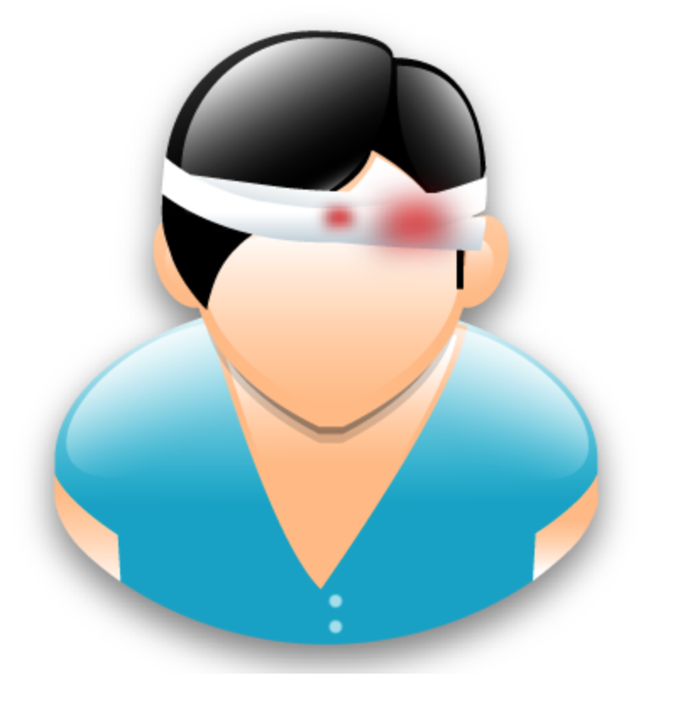
Response-Adaptive Randomization
Different weights for different patient groups
A
B
C
Randomization rule
Statistical model

Slide 36

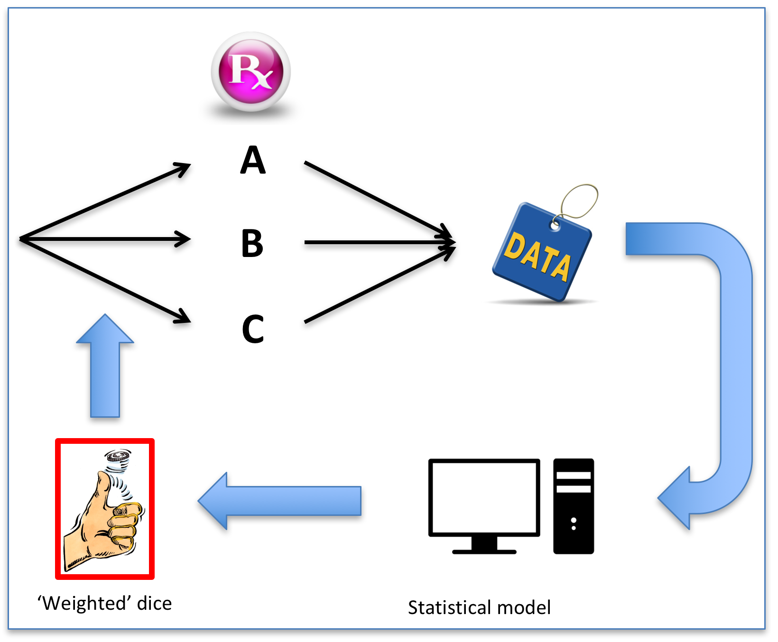

Slide 37
RANDOMIZED
Allow CAUSAL inference
EMBEDDED
Align with care; leverage the EHR
= R E M A P
MULTIFACTORIAL
Multiple treatments and subgroups
ADAPTIVE
Match odds of success to odds of assignment
PLATFORM
Perpetual enrollment; continuous learning
Angus DC. JAMA 2015

Slide 38
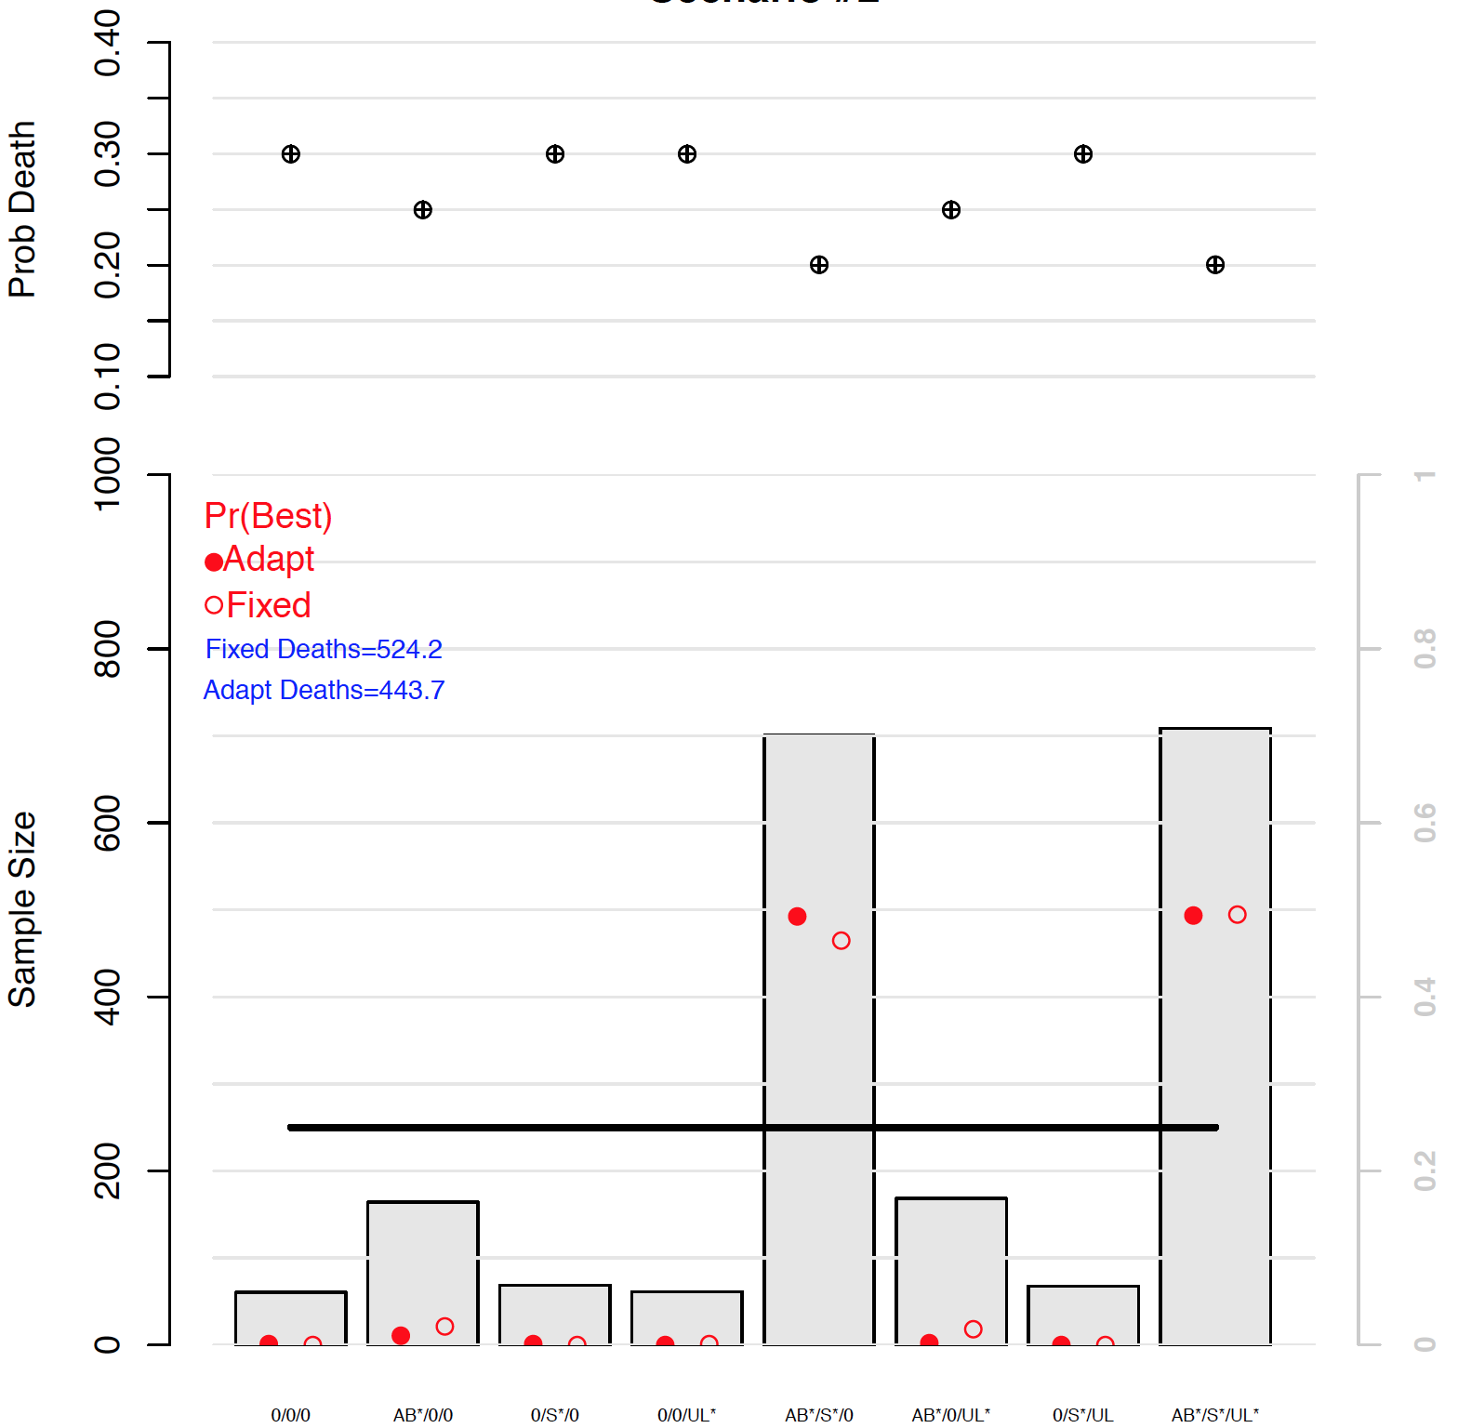
Scenario: 2 of 8 regimens are best
‘True’
mortality
80 fewer deaths; higher power
Average results
from 1,000s of
simulations

Slide 39
Scenario: 2 of 8 regimens are best
‘True’
mortality
For a 2,000 patient trial …
Similar power but 80 fewer deaths
Average results
from 1,000s of
simulations
250 patients per arm under ‘fixed’ design

Slide 40
REMAP designs …
Smart
  Consider many different treatment options
  Vary the options depending on the patient
Safe
  Probably ‘play’ what is probably the ‘winner’
  On average, safer ‘in’ the trial than out of it …

Slide 41
REMAP elements
Domain – an area where a question is asked …
  Domain #1 – choice of antibiotic
  Domain #2 – whether to give steroids or not
  Domain #4 – choice of ventilator strategy
  Etc. ….
Intervention
  Any option within a domain …
Regimen
  Unique combination of interventions within a domain …
Stratum
  Baseline subgroup
  E.g., Moderate vs. Severe COVID19 at presentation

Slide 42
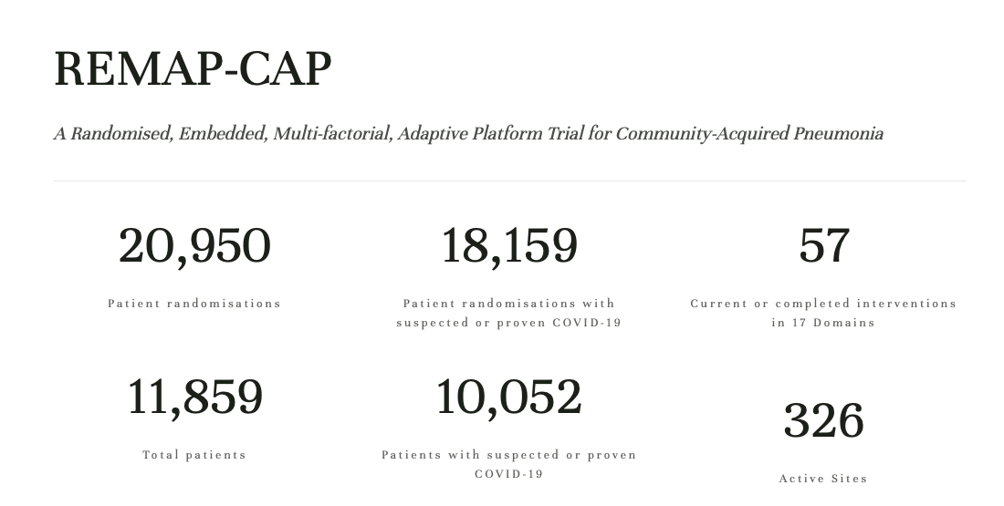

Slide 43
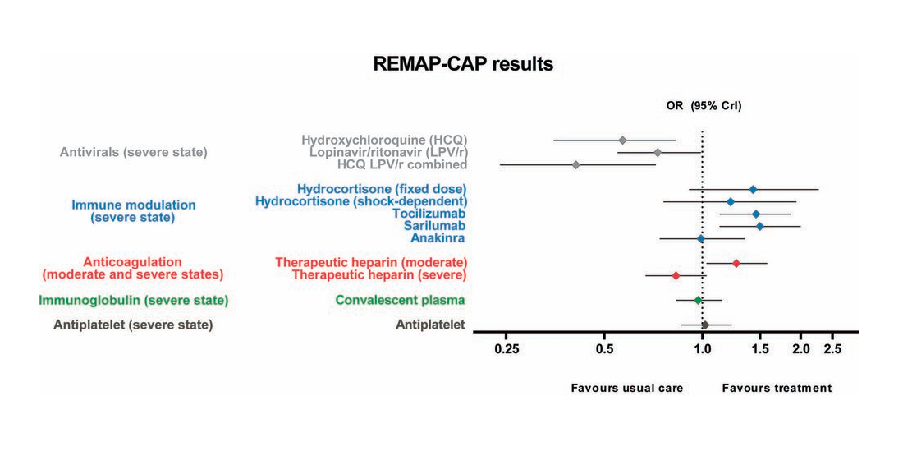

Slide 44
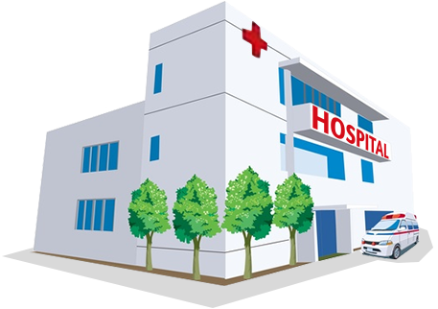







Clinical Care
A
B
New Drugs & Devices
Results
Too Narrow
Too Broad
Too Expensive
Too Long
Overestimate benefit
Underestimate harm
A
Research
Existing Therapies
B

Slide 45


Pragmatic Trials
Some feature of the trial is embedded within usual care
  Enrollment, Randomization, Data collection
Real world setting
  Physicians, Nurses, Patients
Big subgroups, personalized results
Mechanisms in place to translate to practice
Ideal for comparative effectiveness research
A
B

Slide 46
Pragmatic Trials
 | Explanatory Trial | Pragmatic Trial
Question | “Can the intervention work under ideal conditions?” | “Does the intervention work in practice?”
Setting | Resource-intensive ideal setting | Real-world clinical setting
Population | Highly selected, homogenous | Heterogeneous, limited exclusions
Providers | Highly trained | Representative of usual practice
Intervention | Strictly standardized & enforced | Flexibly applied

Slide 47

Pragmatic Patient-Level Randomized Trial
Advantages
A vs B
Allocation concealed
  Balances unknown covariates
Parallel management

Slide 48
Pragmatic Patient-Level Randomized Trial
Research question
Community or institution level questions
Contamination
For interventions related to education or protocols, the ‘control’ may drift toward intervention
Logistics
Simultaneous initiation impractical
Equipoise
For some trials there are practical or ethical barriers to a traditional control group

Slide 49
Cluster Randomized Trial
Randomize groups of individuals
  Hospital, ward, provider team
Intervention
  Group or Individual
Outcomes
  Group or Individual
A
B
A

Slide 50
Cluster Randomized Trial
Rationale
Challenges
Inherently communal
Prevent ‘contamination’
Community effect targeted
Logistical convenience
Balancing patient & provider characteristics
Post-randomization selection bias
Accounting for clusters

Slide 51
Cluster Randomized Trial
Fundamental Challenge
Intra-cluster correlation: Patients are more similar to other patients in their cluster
A
Cluster sample size = RCT sample size x 1+(m-1)ρ
B
Patient-level RCT → 1,000 patients
Clusters of 4 patients → 1,150 patients
Clusters of 200 patients → 9,950 patients
YOU WANT A LOT OF LITTLE CLUSTERS!
A

Slide 52
Stepped-Wedge Cluster Randomized Trial
Period 1
Period 2
Period 3
Period 4
A
B
B
B
A
A
B
B
A
A
A
B

Slide 53
Stepped-Wedge Cluster Randomized Trial
Challenges:
Time
  Long enough periods to see effect of intervention
  Attrition and contamination
Effective sample size
Analysis
  Clustering
  Intervention*time interaction

Slide 54
Why do we need RCTs?
How do RCTs work?
How can RCTs innovate?
Looking back

