Slide 1




Reclaiming What COVID Took using Humanism & Science
E. Wesley Ely, MD, MPH
Professor of Medicine and Critical Care
CIBS Center, Vanderbilt and Nashville VA GRECC
@WesElyMD

Slide 2

NIH and VA Funding
I have explicit written permission to share patients’ pictures & stories
COVID: Unpaid trial design w/ Eli Lilly & Pfizer honoraria for CME
I do not own stocks or have paid consulting arrangements with any pharmaceutical or medical companies
Disclosures

Slide 3



Slide 4
First 50 Years of Modern Critical Care
1st 25 years of Critical Care
1970-1995
Construction
Building, Adding, Complicating
2nd 25 years of Critical Care
1995-2020
Deconstruction
Removing, Unearthing, Excavating

Slide 5
First 50 Years of Modern Critical Care
1st 25 years of Critical Care
1970-1995
Construction
Building, Adding, Complicating
2nd 25 years of Critical Care
1995-2020
Deconstruction
Removing, Unearthing, Excavating
I’m going to tell you the story of the second 25 years
Discuss what happened in COVID
Offer some thoughts on a way forward

Slide 6
What if I told you we knew how to…
I believe we are called to an encounter…
Notes:
What if I told you we knew how to improve survival, reduce LOS, cut costs…and we just weren’t doing it. Or worse, we had been and we stopped.
I believe we are called to an encounter with our patients and colleagues, and that we are missing it. It’s hurting us and them. And the answer is the same thing we’re not doing in my statement above. It’s a way to incorporate robust science into humanism to find the person in the patient…

Slide 7
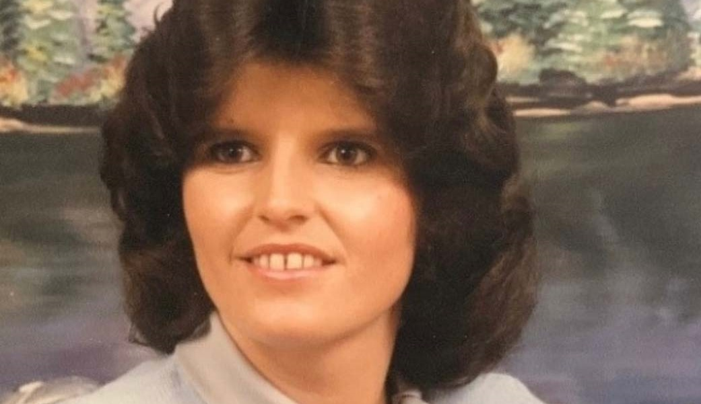

Slide 8

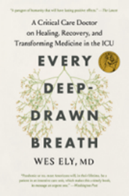
She was paralyzed in a coma, receiving over 125 mg a day of both benzodiazepines and morphine
…Malignant normality
Every Deep-Drawn Breath, p. 131

Slide 9
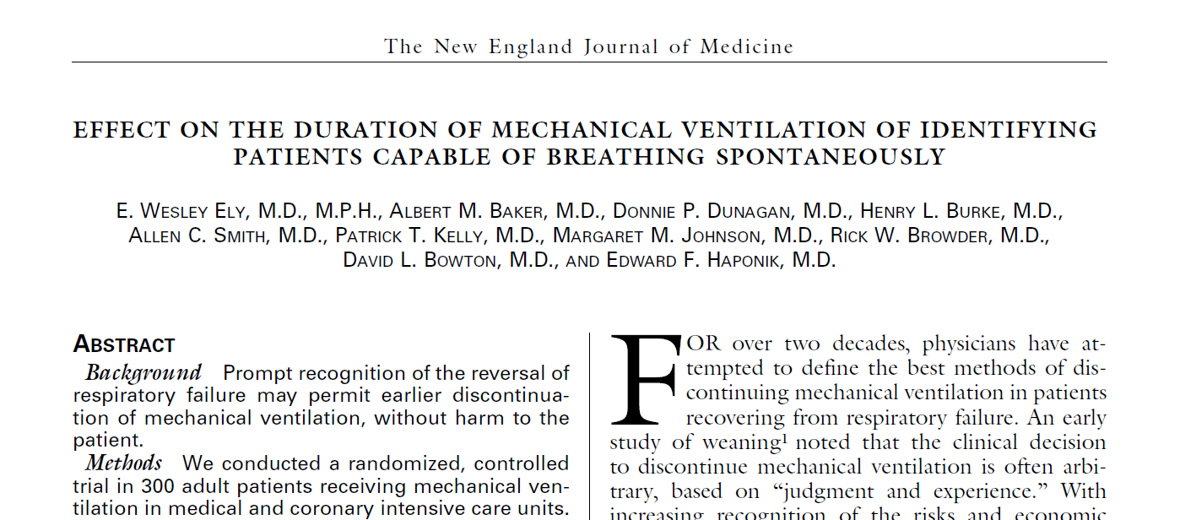
Ely EW, SBT NEJM 1996;335:1865-69

Slide 10
…in science: Never be so focused on what you are looking for that you overlook the thing you actually find.
Ann Patchett – 2011, State of Wonder

Slide 11

Ely EW, Ann Intern Med 1999;131:96-104
Ely EW, Ann Intern Med 2002;136:25-36

Slide 12
>75 y/o
<75 y/o
Ely EW, Ann Intern Med 1999;131:96-104
Ely EW, Ann Intern Med 2002;136:25-36

Slide 13
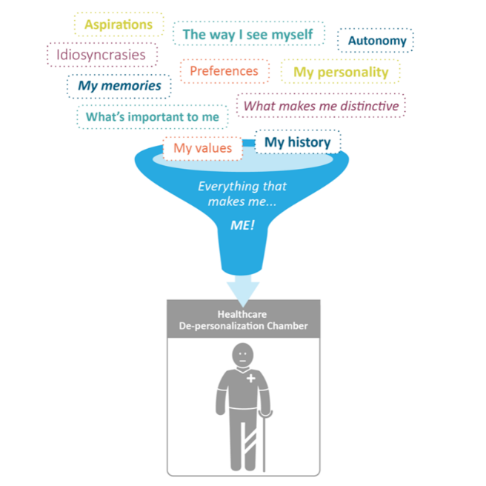
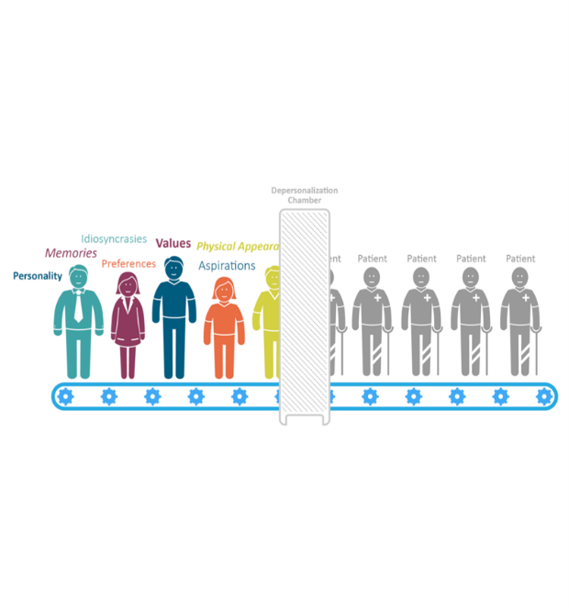
@TomMorrowMD

Slide 14


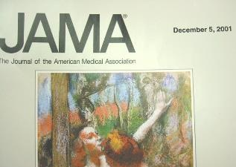
Pooled Test Characteristics:
Sensitivity 80%
Specificity 96%
κ > 0.91
Ely, Inouye, Bernard, Dittus. JAMA 2001;286:2703-10

Slide 15
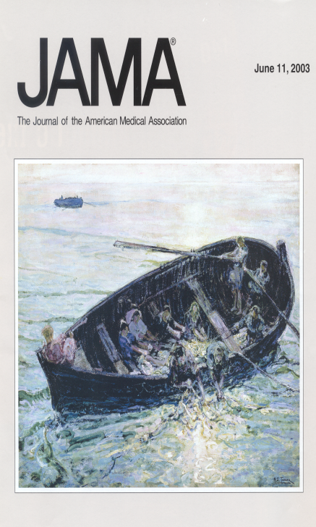
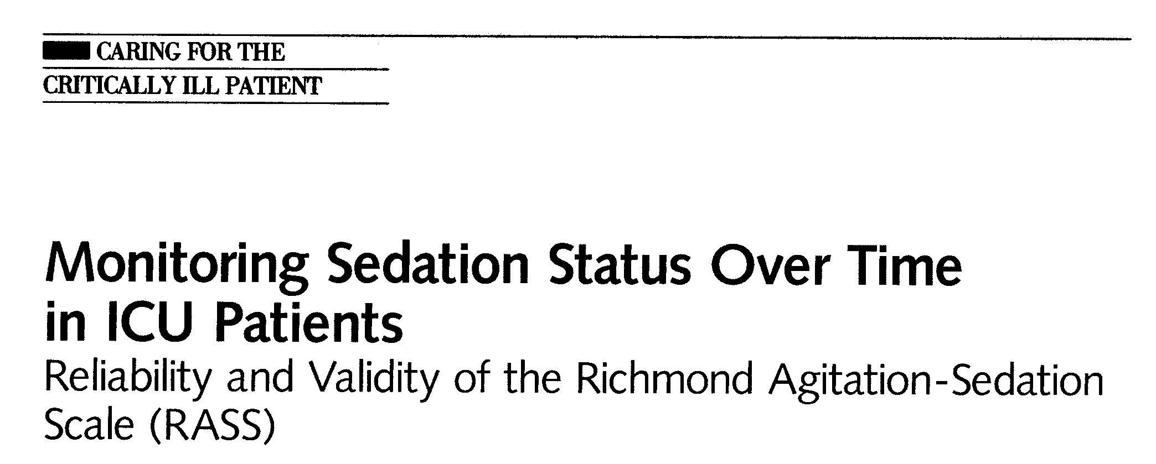
Inter-rater reliability: κ >0.90
Excellent criterion, construct & face validity
Ely, Pun, Sessler, Dittus, Bernard. JAMA 2003;289:2983-91

Slide 16
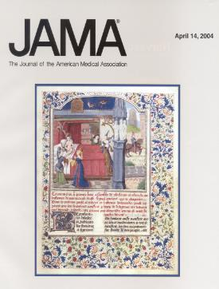
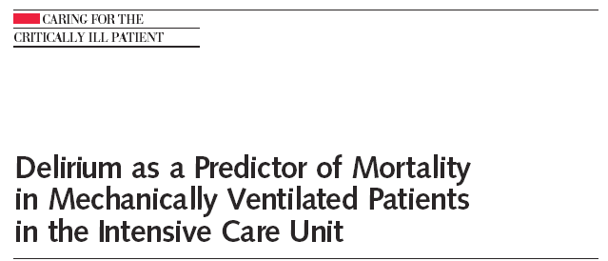
Delirium | Never Delirium | Ever Delirium | RR (CI)
6-mo mortality | 15% | 34% | 3.2 (1.4-7.7)
LOS in ICU | 5.0 (4-6) | 8.0 (7-9) | 2.0 (1.4-3.0)
LOS on Floor | 4.5 (3-6) | 8.0 (6-11) | 1.8 (1.1-2.3)
Ely, Shintani, Pun, Harrell, Inouye, Bernard, Dittus. JAMA 2004;291:1753-62

Slide 17
6 Month Mortality
100
80
60
Survival (%)
40
Normal (n=17)
Delirium
Mild (n=68)
Moderate (n=69)
20
Severe (n=70)
0
0
1
2
3
4
5
6
Time (Months)
JAMA 2004;291:1753-62

Slide 18
Young and Unsure…
“Wes, this focus on delirium doesn’t belong in the field of critical care.”
Many professors told me there was no hope for academic success, funding, or making a difference with further research into delirium. Even though I was counseled not to take this personally, I did.”

Slide 19
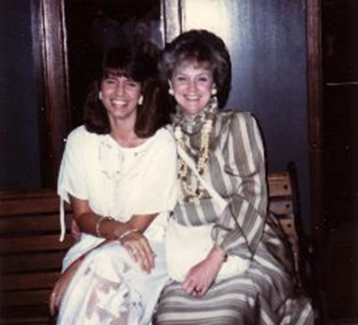

Donna Hilley…a CEO on Music Row
“After she developed delirium, we couldn’t get her mental clouding cleared for months…
Every Deep-Drawn Breath, P. 111-12

Slide 20
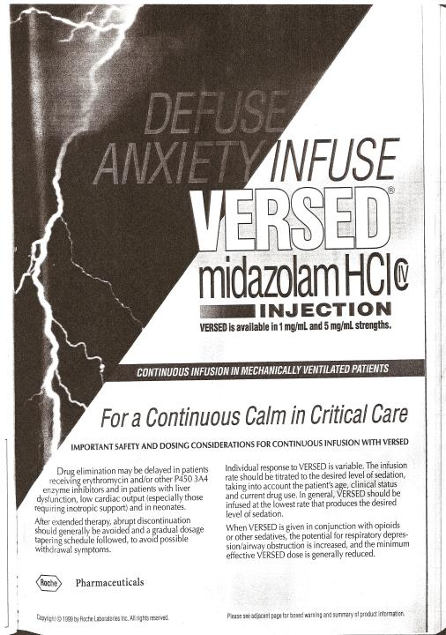
Notes:
GABA-Ergics

Slide 21
A long habit of not thinking a thing wrong, gives it a superficial appearance of being right…"
Thomas Paine

Slide 22

Cliff and Normy, Cheers

Slide 23
Buffalos to Beer to Brain Cells
Cliff the mailman and philosopher
Cliff:
“Well you see, Norm, it's like this . . A herd of buffalo can only move as fast as the slowest buffalo. And when the herd is hunted, it is the slowest and weakest ones at the back that are killed first. This natural selection is good for the herd as a whole, because the general speed and health of the whole group keeps improving by the regular killing of the weakest members.”
sitcom CHEERS

Slide 24
Buffalos to Beer to Brain Cells
Cliff the mailman and philosopher
“In much the same way, Norm, the human brain can only operate as fast as the slowest brain cells. Now, as we know, excessive intake of alcohol (GABA-ergics/benzodiazepines) kills brain cells. But naturally, it attacks the slowest and weakest brain cells first. In this way, regular consumption of beer eliminates the weaker cells, making the brain a faster and more efficient machine. And that, Norm, is why you always feel smarter after a few beers.”
sitcom CHEERS

Slide 25
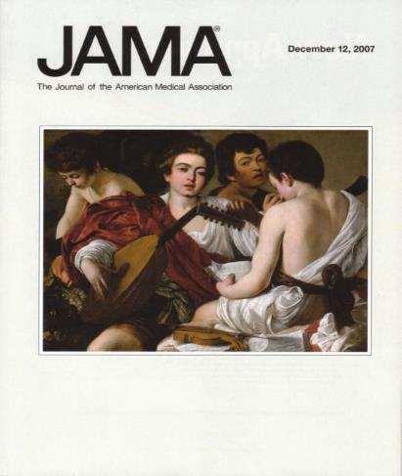
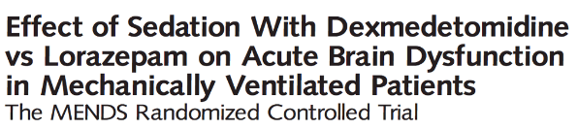
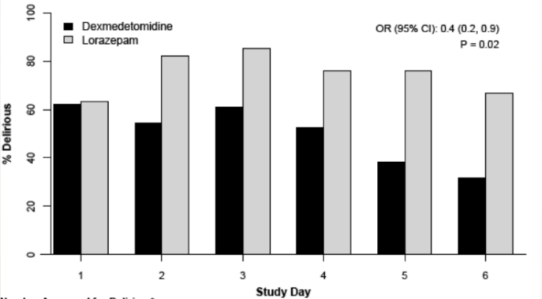
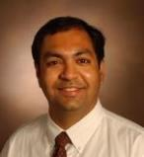
Pandharipande, …., Dittus, Bernard, Ely JAMA 2007;298:2644-53

Slide 26
Less delirium and coma, sure…
But could changing sedation paradigms save lives?
Pandharipande, …., Dittus, Bernard, Ely JAMA 2007;298:2644-53

Slide 27

Mid 2000’s:
What did we know and what to do?
ICU Delirium independently increased mortality
The more the delirium, the higher the mortality
Benzodiazepines, as sedatives for ventilation, increased delirium
Need to reduce the incidence and duration of delirium
Goal: get people off the ventilator as soon as possible

Slide 28

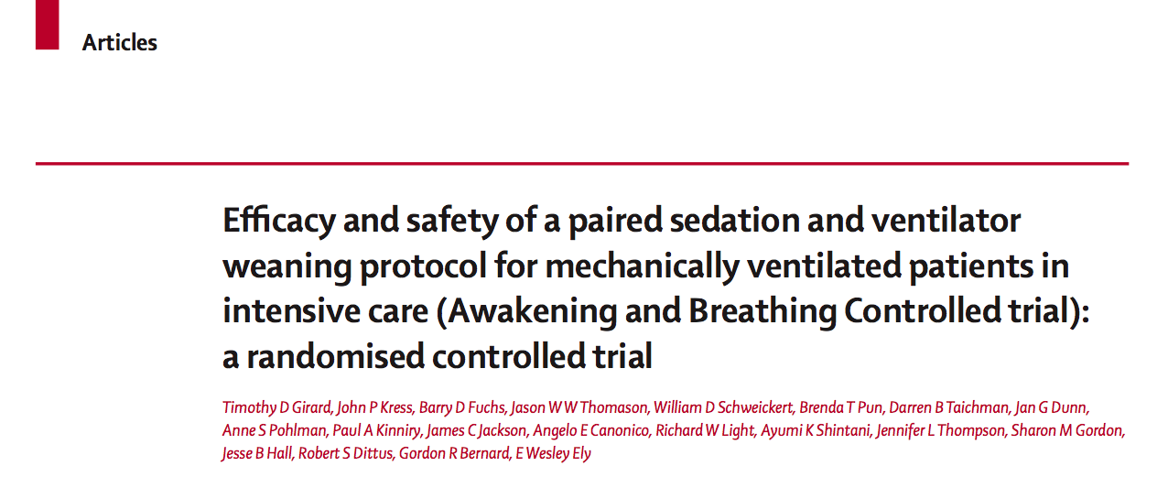
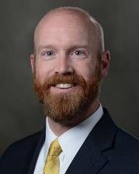

Girard, …, Dittus, Bernard, Ely. Lancet 2008;371:126-34

Slide 29
ABC Trial: One-Year Survival
100
32% reduction in mortality at any instant in first year
80
ABC approach (n=167)
60
Patients Alive (%)
NNT=7
40
Control (n=168)
20
p=.01
0
0
60
120
180
240
300
360
Days
Girard, …, Dittus, Bernard, Ely. Lancet 2008;371:126-34

Slide 30
ICU Length of Stay
100
reduced ICU stay by 4 days
80
SAT+SBT (n=167)
60
p=.01
% Patients Discharged from the ICU
40
SBT (n=168)
20
0
0
7
14
21
28
Days
Girard, …, Dittus, Bernard, Ely. Lancet 2008;371:126-34

Slide 31
Hospital Length of Stay
100
reduced hospital stay by 4 days
80
60
SAT+SBT
% Patients Discharged from the Hospital
p=.04
40
SBT
20
0
0
7
14
21
28
Days
Girard TD, et al. Lancet 2008;371:126-34

Slide 32
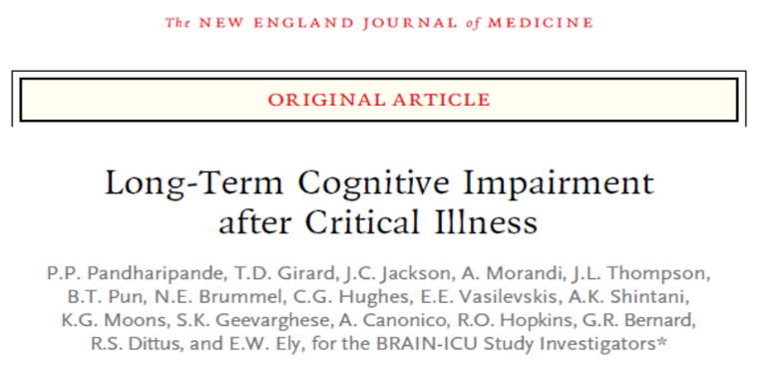
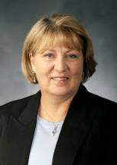

Mona Hopkins Jim Jackson
821 pts; academic & community hospitals
34% have equivalent of moderate traumatic brain injury
24% have equivalent of mild Alzheimer’s disease
Longer duration of delirium was associated with worse global cognition and worse executive function
Pandharipande,…, Dittus, Ely. NEJM 2013;369:1306-16

Slide 33
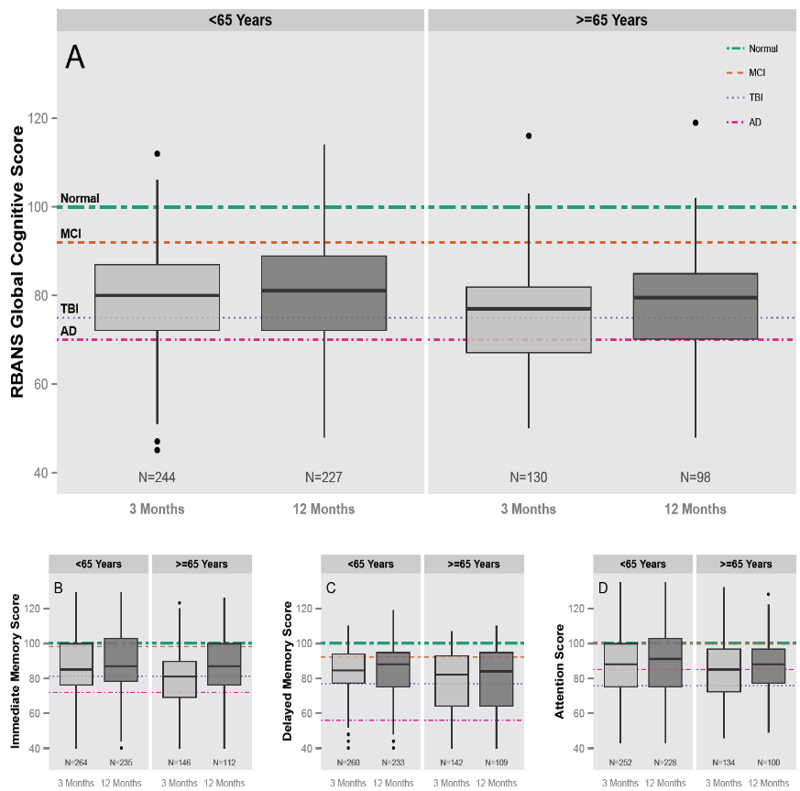
The Picture of Dementia Following ICU Care

Slide 34
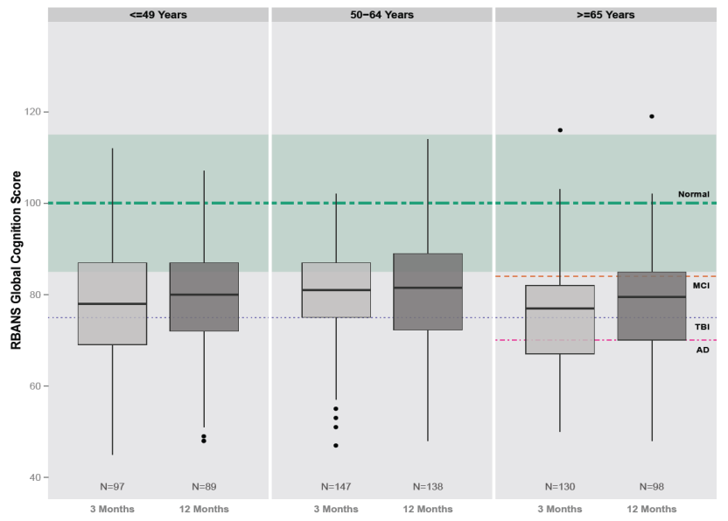
Global Cognitive Scores by Age
NEJM 2013;369:1306-16

Slide 35
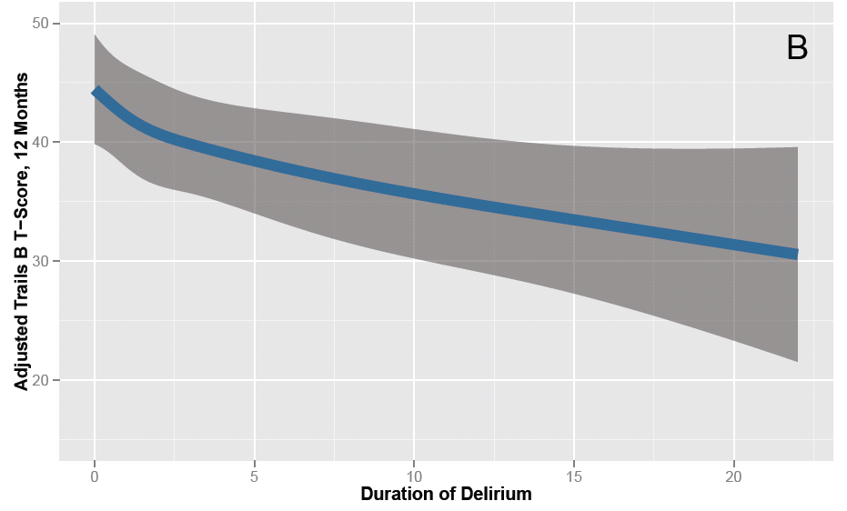
Delirium and Executive Function
NEJM 2013;369:1306-16

Slide 36
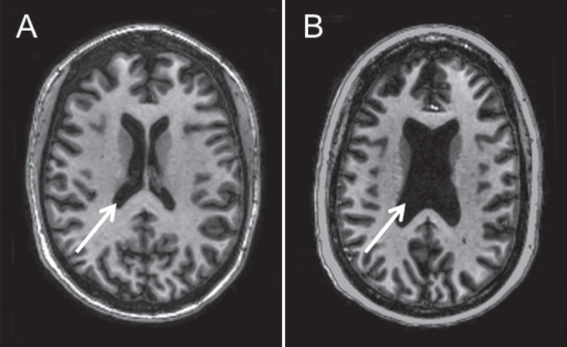
Delirium and Brain Atrophy
(A) 46 year old, no delirium (B) 42 year old, 12 days of delirium
Gunther M et al. CCM 2012;40:2022-32
Notes:
Figure 2. Representative example of lateral ventricle size in 46-yr-old female and 42-yr-old female intensive care unit (ICU) survivors with no preexisting cognitive impairment: Axial T¹-weighted brain images in two ICU survivors. A, Relatively normal ventricular volume (see arrow) in a 46-yr-old female who did not experience delirium in the ICU. Patient had a history of respiratory and heart failure. She was admitted to a medical ICU due to acute respiratory distress syndrome and was subsequently intubated and managed through the ICU without ever developing delirium. B, Enlarged ventricles (see arrow) in a 42-yr-old female who did develop delirium in the ICU. Patient was admitted to the hospital after reporting fever and dyspnea with a chest radiograph and other laboratory data confirming community acquired pneumonia and acute respiratory distress syndrome. The patient was admitted to the ICU and mechanically ventilated, experiencing 12 days of delirium and then resolution. There was no preexisting history of neurological impairment, and surrogate questioning for preexisting cognitive impairment was also negative.

Slide 37

When I returned to work, the work I did before seemed foreign and unfamiliar. I became isolated and excluded from everyone. No one wanted to be around me. My wife of more than 36 years told me that I was just “feeling sorry” for myself, and I just needed to get on with my life. I nearly ended my life a few times. Then after five years of this hell, Oct. 2, 2013 CBS News ran a report about people just like me. From that report I found your website. I cried for long time; it has changed my wife’s opinion about me. For the first time in the past five years, I think believe I have a future.
ICUDelirium.org/Testimonials
Photo © Travis Smith via Flickr
Notes:
“The time I spent seems like it was in a huge, empty gray space, sort of like a monstrous underground parking garage with no cars, only me, floating or seeming to float, on something. Every once in a while I would get to an edge of something horrible and once I remember I thought, "if I just let go, then this horror will be over.””

Slide 38
Confirmed: Delirium Risk Factor for
Long-Term Cognitive Impairment after ICU Stay
1,101 survivors of critical illness, 37% with delirium
Studied only survivors and used self report
Multivariable analysis with adjustment for gender, admission dx, severity of illness (both APACHE IV and cumulative SOFA)
Delirium independent predictor of LTCI at 1 year:
  mild: OR = 2.41 (1.57-3.69)
  severe: OR = 3.1 (1.1-8.74)
Wolters AE, Crit Care 2014;18:R125
Notes:
Limitations:
Only survivors so mortality analysis does not uproot ours
Biostats – dichotomous delirium ever/never, did use CAM-ICU twice daily but did NOT use duration of delirium (said was not possible)
LONG-TERM COGNITIVE IMPAIRMENT – no baseline incorporated so can’t tell is delirium was a causal factor or a marker of poor baseline.
Used self-report off of EQ-6D, which is a 3-level multiple choice question, which is “minimal compared to extensive neuropsychological testing.”
Adjustment with Cumulative SOFA interesting. They tested sensitivity analysis and it didn’t change things.
Findings nicely supportive of NEJM BRAIN-ICU and also actually supportive of Lancet RM (negative with delirium not predicting HRQOL)

Slide 39
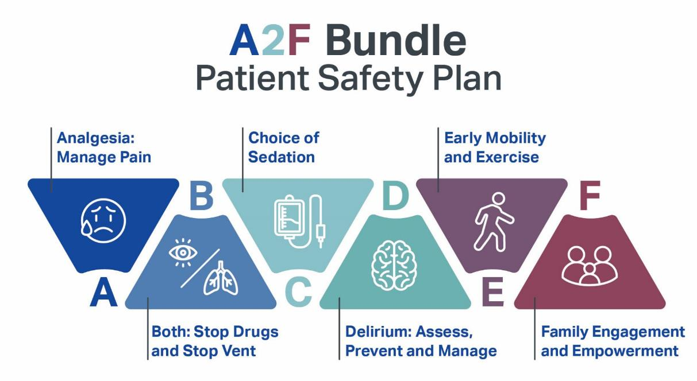
Notes:
Tool of Mercy…diving into the chaos of another person and providing lifting and healing
Vs. false mercy

Slide 40
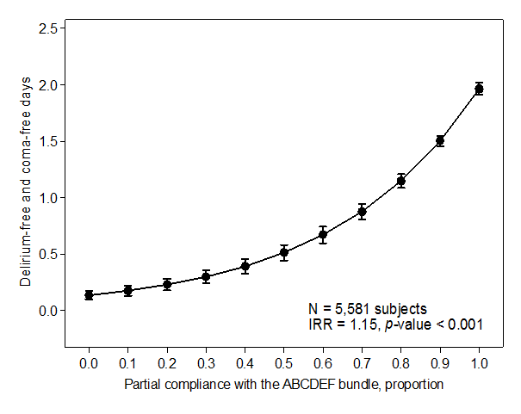
Survival and Delirium-Coma Freedom
Implementing ABCDEF Bundle in >6,000 patients
Mortality Improvement
Delirium and Coma Freedom
NOTE: Adjusted for age, APACHE III, and mechanical ventilation
7 California Hospitals, Interprofessional QI Implementation project
Barnes-Daly MA, CCM 2017;45:171-8

Slide 41
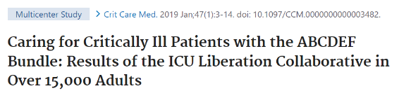
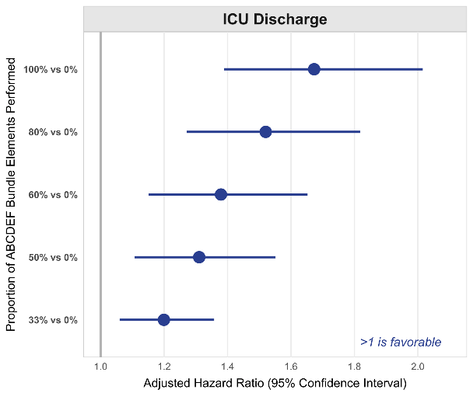
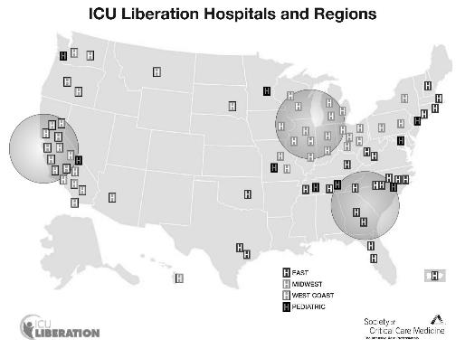
ABCDEF bundle performance… improves ICU discharge
Pun, …. Ely. Crit Care Med. 2019;47:3-14
Sponsored by the SCCM via The Moore Foundation
Notes:
Compliance = SAT screen was done but patient failed the safety screen.
Performance = SAT was actually done.
Each panel shows the hazard ratios and 95% confidence intervals for the specified outcome, comparing patients with a given proportion of eligible ABCDEF bundle elements performed on a given day to patients with none of the bundle performed that day. The gray line at 1.0 indicates no association. Hazard ratios are adjusted for baseline and ICU admission characteristics as well as daily covariates, measured the same day as bundle performance. For example, assuming all other covariates are equal, a patient who had 60% of the ABCDEF bundle elements for which s/he was eligible has, on average, about 1.4 times the likelihood of being discharged from the ICU on a given day as a patient with none of the bundle elements performed. All three outcomes were significant with P value < 0.0001. The covariates adjusted for include demographic variables (age, sex, race, ethnicity, body mass index, residency prior to admission, mobility restriction prior to admission); admission features (diagnosis, hospital type [community vs. teaching], and ICU type); and daily ICU characteristics on the day of bundle exposure (receipt of medications including benzodiazepines, opioids, propofol, dexmedetomidine, typical/atypical antipsychotics; comfort care order; mechanical ventilation; coma.

Slide 42
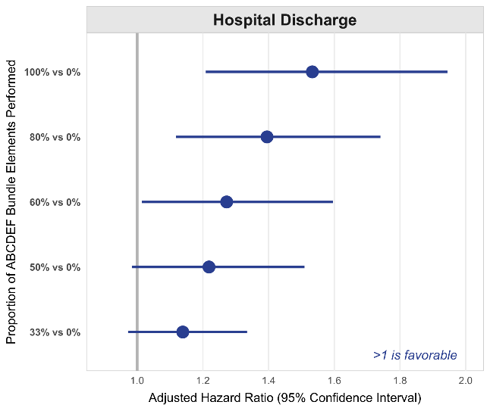
ABCDEF bundle performance… improves ICU discharge
Pun, …. Ely. Crit Care Med. 2019;47:3-14
Sponsored by the SCCM via The Moore Foundation
Notes:
Compliance = SAT screen was done but patient failed the safety screen.
Performance = SAT was actually done.
Each panel shows the hazard ratios and 95% confidence intervals for the specified outcome, comparing patients with a given proportion of eligible ABCDEF bundle elements performed on a given day to patients with none of the bundle performed that day. The gray line at 1.0 indicates no association. Hazard ratios are adjusted for baseline and ICU admission characteristics as well as daily covariates, measured the same day as bundle performance. For example, assuming all other covariates are equal, a patient who had 60% of the ABCDEF bundle elements for which s/he was eligible has, on average, about 1.4 times the likelihood of being discharged from the ICU on a given day as a patient with none of the bundle elements performed. All three outcomes were significant with P value < 0.0001. The covariates adjusted for include demographic variables (age, sex, race, ethnicity, body mass index, residency prior to admission, mobility restriction prior to admission); admission features (diagnosis, hospital type [community vs. teaching], and ICU type); and daily ICU characteristics on the day of bundle exposure (receipt of medications including benzodiazepines, opioids, propofol, dexmedetomidine, typical/atypical antipsychotics; comfort care order; mechanical ventilation; coma.

Slide 43
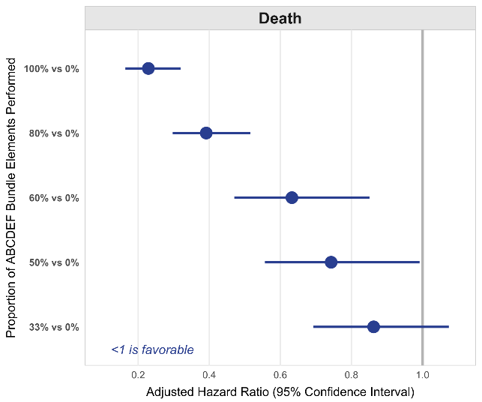
ABCDEF bundle performance… improves ICU discharge
Pun, …. Ely. Crit Care Med. 2019;47:3-14
Sponsored by the SCCM via The Moore Foundation
Notes:
Compliance = SAT screen was done but patient failed the safety screen.
Performance = SAT was actually done.
Each panel shows the hazard ratios and 95% confidence intervals for the specified outcome, comparing patients with a given proportion of eligible ABCDEF bundle elements performed on a given day to patients with none of the bundle performed that day. The gray line at 1.0 indicates no association. Hazard ratios are adjusted for baseline and ICU admission characteristics as well as daily covariates, measured the same day as bundle performance. For example, assuming all other covariates are equal, a patient who had 60% of the ABCDEF bundle elements for which s/he was eligible has, on average, about 1.4 times the likelihood of being discharged from the ICU on a given day as a patient with none of the bundle elements performed. All three outcomes were significant with P value < 0.0001. The covariates adjusted for include demographic variables (age, sex, race, ethnicity, body mass index, residency prior to admission, mobility restriction prior to admission); admission features (diagnosis, hospital type [community vs. teaching], and ICU type); and daily ICU characteristics on the day of bundle exposure (receipt of medications including benzodiazepines, opioids, propofol, dexmedetomidine, typical/atypical antipsychotics; comfort care order; mechanical ventilation; coma.

Slide 44
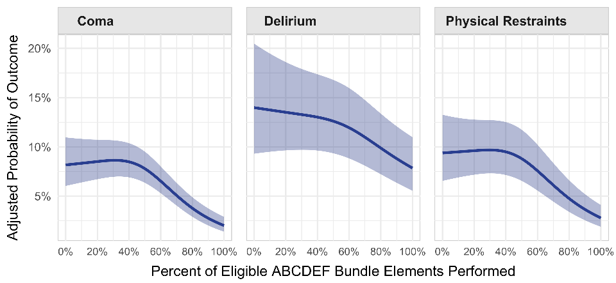
Performance improves… coma, delirium, restraints
Notes:
These data represent the relationship between the proportion of eligible ABCDEF bundle elements performed on a given day and the probability of a daily clinical outcome the following day. For example, in Panel D the upper left-hand panel represents the relationship between proportion of eligible elements performed on a given day and the probability that the patient would be on mechanical ventilation the following day.

Slide 45
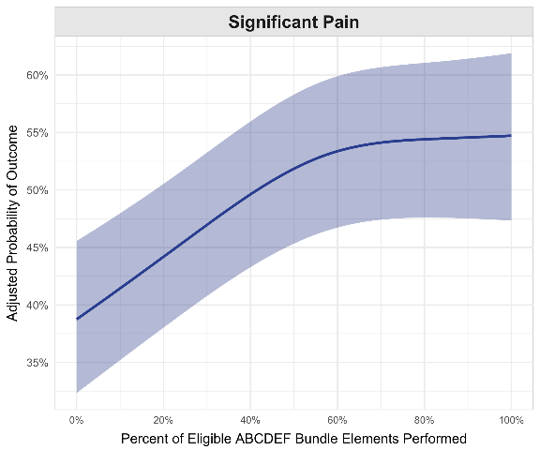
Performance increases reported pain
Notes:
These data represent the relationship between the proportion of eligible ABCDEF bundle elements performed on a given day and the probability of a daily clinical outcome the following day. For example, in Panel D the upper left-hand panel represents the relationship between proportion of eligible elements performed on a given day and the probability that the patient would be on mechanical ventilation the following day.

Slide 46
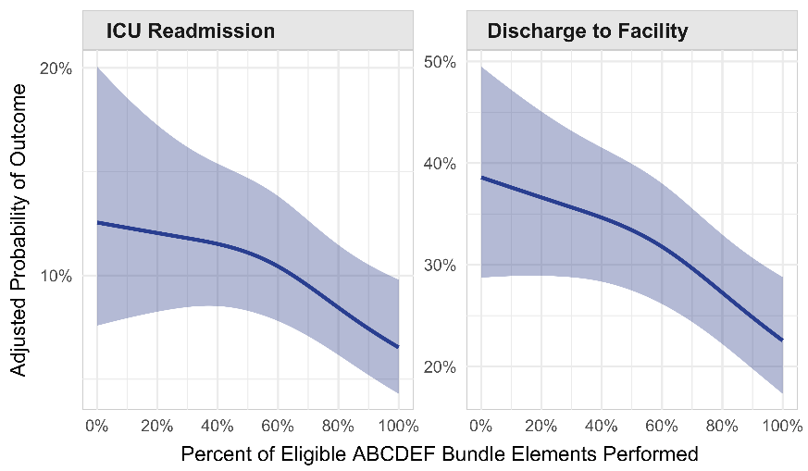
Performance reduces… ICU readmission and NH transfers

Slide 47
Scientific Foundation for
ICU Liberation and the ABCDEF Bundle
B
C
Both SATs and SBTs
Ely EW. NEJM. 1996;335:1864-69
Kress J. NEJM. 2000;342:1471-77
Girard TD. Lancet. 2008;371:126-34
Mehta G. JAMA. 2012;308:1985-92
Girard TD. Lancet RM. 2018;6:213-22
Thille AW. NEJM 2022; Oct 26 epub
Choice of Sedation and Analgesia
Pandharipande PP JAMA. 2007;298:2644-53
Riker R. JAMA. 2009;301:489-99
Strom T. Lancet. 2010;375:475-80
Jakob S. JAMA. 2012;307:1151-60
Reade M JAMA. 2016;315:1460-68
Su X. Lancet. 2016;388:1893-1902
Shehabi Y. NEJM. 2019;380:2506-17
Hughes CG. NEJM. 2021;384:1424-36

Slide 48
Scientific Foundation for
ICU Liberation and the ABCDEF Bundle
D
E
Delirium
Ely EW. JAMA. 2001;286:2703-10
Ely EW. JAMA. 2003;289:2983-91
Ely EW. JAMA. 2004;291:1753-62
Schweickert W. Lancet. 2009;373:1874-82
Girard TD. NEJM. 2018;379:2506-16
Pun BT. Lancet RM. 2021;9:239-50
Andersen NC. NEJM 2022; Oct 26 epub
Early Mobility
Herridge M. NEJM. 2003;348:683-93
Levine S. NEJM 2008;358:1327-35
Puthucheray Z. JAMA. 2013;310:1591-1600
Kress JP. NEJM. 2014;370:1626-35
Morris P. JAMA. 2016;315:2694-2702
Hodgson CL. NEJM 2022; Oct 26 epub

Slide 49
Scientific Foundation for
ICU Liberation and the ABCDEF Bundle
F
PICS
Family Engagement
Schneiderman L. JAMA. 2003;290:1166-72
Lautrette A. NEJM. 2007;356:469-78
Jabre P. NEJM. 2016;374:1831-41
Post-Intensive Care Syndrome
Iwashyna TJ. JAMA. 2010;304:1787-94
Ehlenbach W. JAMA. 2010;303:763-70
Herridge MS. NEJM. 2011;364:1293-1304
Pandharipande PP. NEJM. 2013;369:1306-16

Slide 50
ABCDEF Bundle References
A2F Bundle: the sum is greater than its individual parts.” Jack Iwashyna, Johns Hopkins
Individually “proven” steps must be tested together to call them a “Bundle.” Don Berwick, IHI
Pandharipande P, Crit Care, 2010;14:157-59
Vasilevskis EE, Chest, 2010;138:1224-33
Morandi A, Curr Opin Crit Care, 2011;17:43-49
Balas MC, Crit Care Nurse, 2012;32:40-47
Carrothers KM, CCM, 2013;41:S128-35
Trogrlić Z, Crit Care, 2015;19:157
Balas MC, Semin Respir CCM, 2016;37:119-35
Boehm LM, Am J Crit Care, 2017;26:e18-28
Boehm LM, Am J Crit Care, 2017;26:e38-47
Barnes-Daly MA, CCM, 2017;45:171-78
Ely EW, CCM, 2017;45:321-30
Marra A, Crit Care Clin, 2017;33:225-43
Morandi A, CCM, 2017;45:e1111-22
Barnes MA, World EB Nurs, 2018;15:206-16
Pun BT, CCM 2018;47:3-14
Pun BT. Lancet RM. 2021;9:239-50
Nakamura LK. Front Med. 2021;8:7358-60
Liu K. Crit Care Explor. 2021;3:e0353

Slide 51
A2F Bundle: Philosophy of Care
A2F Bundle : Unlocking Success
  Inter-professional ICU collaboration (de-silo)
  Change in care process (nurses, PA/NP, pharmD, RT/PT leaders)
  Additional measurement (e.g., delirium – canary in coal mine)
  Time and effort to liberate patients from ventilator
  Careful attention to sedative use (type and amount)
  Time and effort to mobilize and exercise patient
  Support of family engagement
  Overall ICU culture change to Humanism & Dignity + Science

Slide 52
A2F Bundle – Implementation and Liberation
Critical care nurses’ role in implementing the “ABCDE bundle” into practice
Improving Health Care for Critically Ill Patients Using an Evidence-Based Collaborative Approach to ABCDEF Bundle Dissemination and Implementation
Implementing the ABCDEF Bundle: Top 8 Questions Asked During the ICU Liberation ABCDEF Bundle Improvement Collaborative
Common Challenges to Effective ABCDEF Bundle Implementation: The ICU Liberation Campaign Experience
Effects of a National Quality Improvement Collaborative on ABCDEF Bundle Implementation

Slide 53
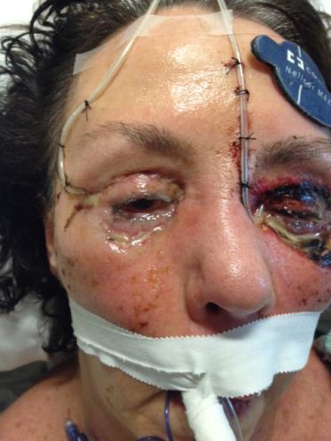
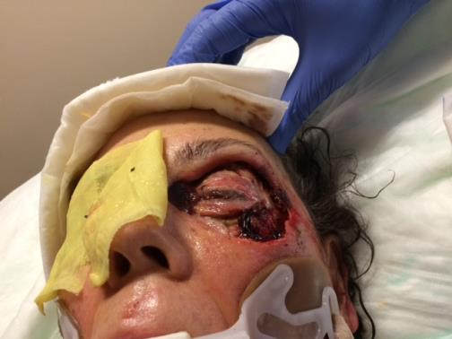
Liberated…?

Slide 54
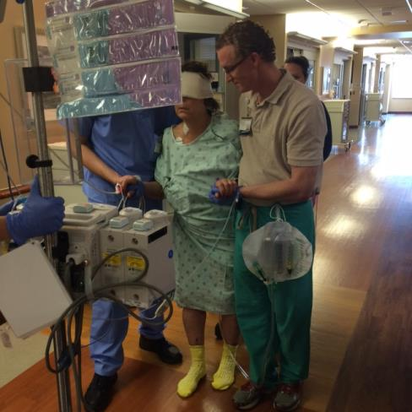
Liberated…

Slide 55

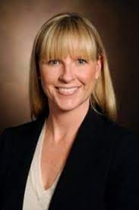
Liberated…
The ICU Recovery Center at Vanderbilt,
led by Dr. Carla Sevin (icudelirium.org)

Slide 56

COVID-19 Pandemic
Acute Covid
Long Covid

Slide 57
Helms J, NEJM 2020; 382:2268-70

Slide 58

Delirium & Coma in Critically Ill Patients
Historic Rates
2000-2014 delirium rates in ventilated ICU pts 70-80%
2015-2019 with ABCDEF Bundle, rates were 40-50%
Covid Rates (early reports)
Early reports of delirium in COVID-19 back to >80%
Benzo use in COVID-19 skyrocketed back to >80%
Ely EW, JAMA 2004; 291(14):1753-62
Pun BT, Crit Care Med 2019;47:3-14
Helms J, NEJM 2020;382:2268-2270
Helms J, Crit Care 2020;24:491-502

Slide 59
Pun BT, COVID-D. Lancet RM 2021;9:239-50
Notes:
International, multicenter, retrospective cohort study of >2000 adult ICU COVID-19 patients from 69 sites (14 countries)
Prospective delirium & coma assessments
Demographics, respiratory support, management strategies, & hospital course
We used multivariable regression to identify delirium risk factors and predictors of days alive without delirium or coma

Slide 60
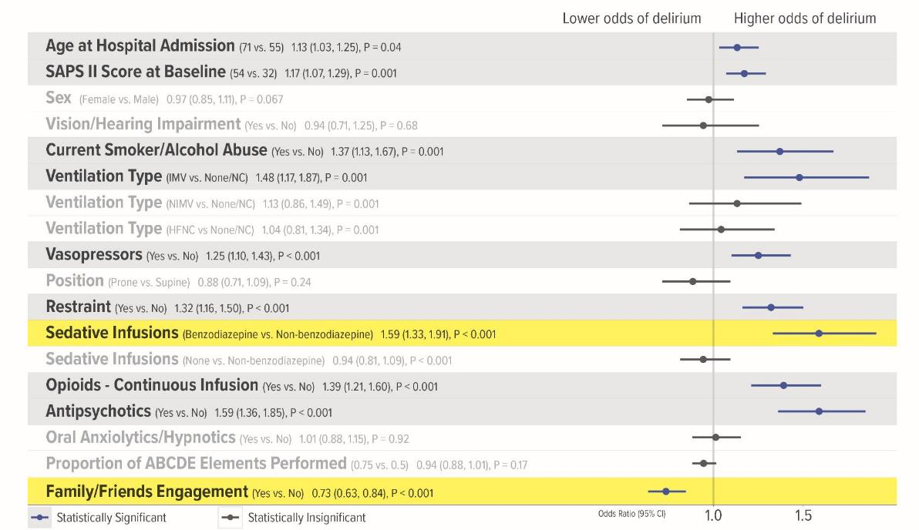
Risk Factors of Delirium

Slide 61
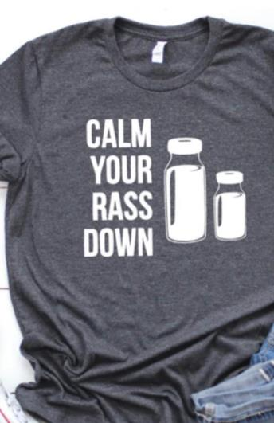
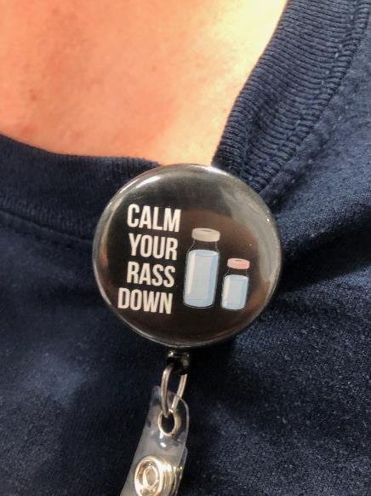
Girard TD. MIND-USA NEJM. 2018;379:2506-16
Hughes CG. MENDS-2 NEJM. 2021;384:1424-36
Shehabi Y. SPICE III. NEJM 2019; 380:2506-17
Andersen-Ranberg NC, ACT-ICU NEJM Oct 2022
Hodgson C, TEAM Study NEJM Oct 2022

Slide 62
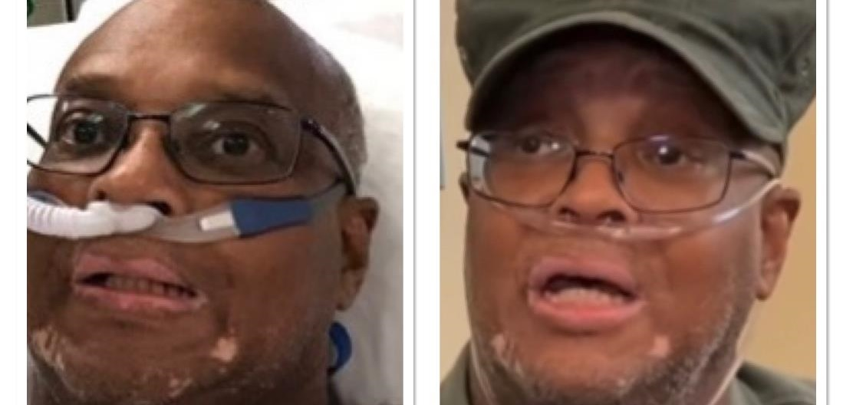

Slide 63


Slide 64
VIDEO

Slide 65
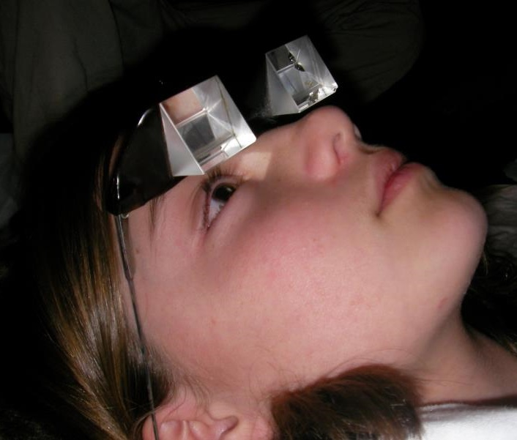
Now
What?

Slide 66
Healing Do’s and Don’ts
Do Don’t
Put touch before technology
Switch the Preposition
Take a spiritual history
Teach and practice compassion
Take a knee
Ask 4 ?s: food, music, pets, hobbies
Overuse equanimity
Separate loved ones
Be satisfied with benevolence
Allow malignant normality
Fear failure
Rob yourself of joy

Slide 67
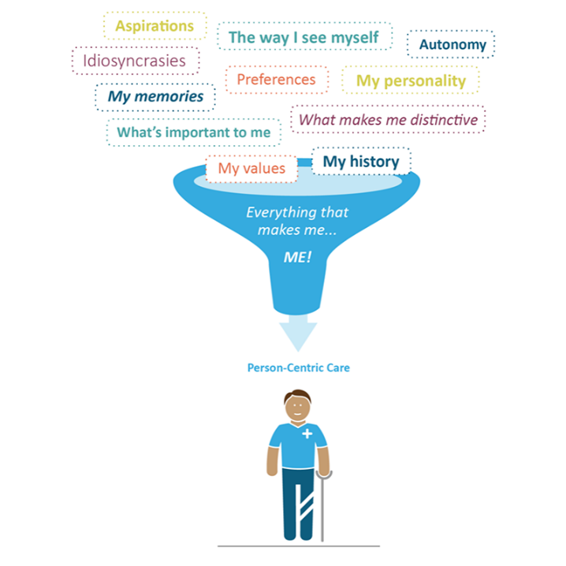
We must commit personally, and
as a community,
to create a repersonalization chamber…
an “I See You”
@TomMorrowMD

Slide 68
Cada persona es en mundo. Each person is a world.

Slide 69
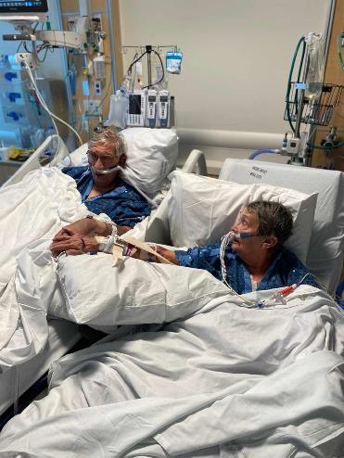
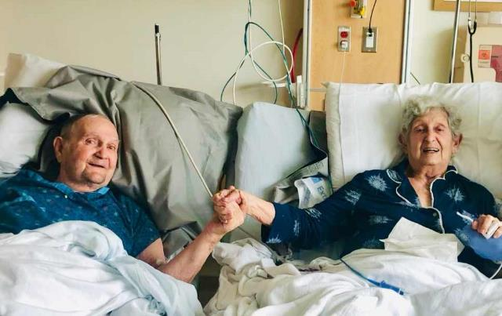
Figs
Every Deep-Drawn Breath, P. 237-38, 243-44
Notes:
“I have to find Virginia. Where did they take her?”
Mary looked over at her husband, her hand reaching out to touch his wrist, bruised from blood draws, as she repeated, “Phil, I’m here. I’m here.”

Slide 70
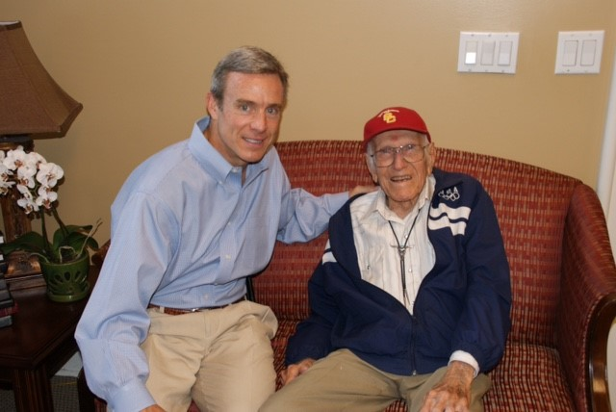

Dr. Wes, change is the most important word
Louis Zamperini

Slide 71



Slide 72
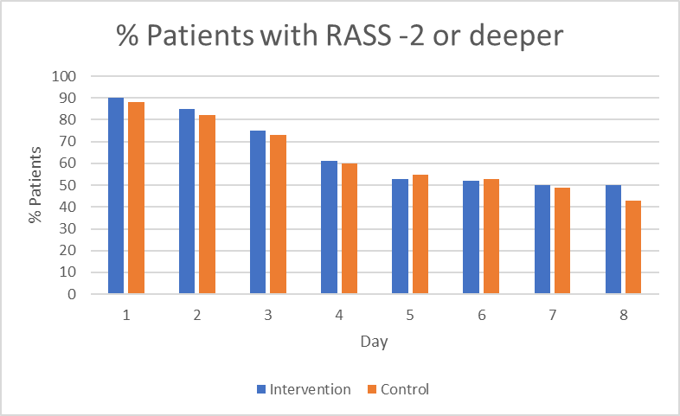
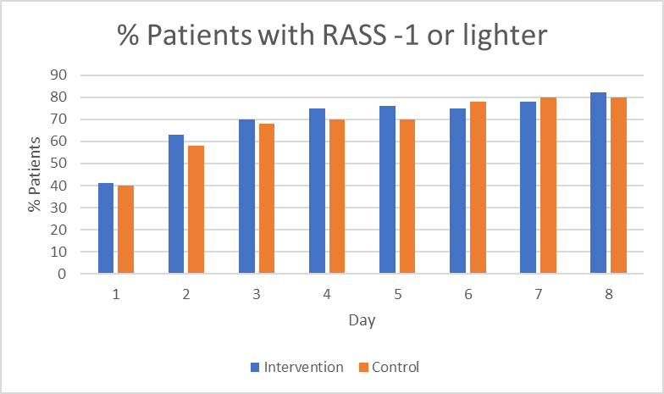

“Negative Trial” on Early Mobilization in ICU
It’s all about the sedation

Slide 73
Qi W & Ferrante LE. JICM 2022

Slide 74
N=2,164 pts, 13 studies, 47% lower risk of delirium and 1.8 days shorter duration
Nydahl P, Int CC Nurs 2022

