Slide 1




NIDUS Delirium Bootcamp 2022
Non-pharmacologic Interventions for Delirium:
Considerations and Priorities
Sharon K. Inouye, M.D., M.P.H.
Professor of Medicine
Harvard Medical School
Milton and Shirley F. Levy Family Chair
Director, Aging Brain Center
Hebrew SeniorLife

Slide 2

DSM5 CRITERIA FOR DELIRIUM
Disturbance in attention accompanied by reduced awareness of the environment
Disturbance develops acutely and tends to fluctuate
An additional disturbance in cognition, (e.g., memory deficit, language, visuoperceptual)
Evidence of an underlying organic etiology or multiple etiologies
Used with permission. American Psychiatric Association, 2013 (Rev 2022)
Notes:
The official diagnostic criteria for delirium can be found in the Diagnostic and Statistical Manual (Version 5) of the American Psychiatric Association, as outlined here.

Slide 3
Why should we care about delirium?
  Common problem
  Serious complications
  High healthcare expenditures
  Distressing to patients, families, and healthcare professionals
  Up to 50% cases preventable

Slide 4


In U.S. hospitals today
5 older adults become delirious every minute
2.6 million older adults develop delirium each year
U.S. Dept HHS, AoA Report, Profile of Older Americans 2011
4
Notes:
4

Slide 5
Delirium is common
Delirium Rates
Hospital:
Prevalence (on admission) 14-24%
Incidence (in hospital) 6-56%
Postoperative: 15-53%
Intensive care unit: 70-87%
Nursing home/post-acute care: 20-60%
Palliative care: up to 80%
Mortality
Hospital mortality: 22-76%
One-year mortality: 35-40%
Ref: Inouye SK, NEJM 2006;354:1157-65; Lancet 2014; 383:911-922; JAMA 2017; 318:1161-1174
5
Notes:
5

Slide 6

Delirium has serious complications
Delirium associated with:
  Increased morbidity and mortality
  Functional and cognitive decline
  Increased rates of dementia
  Institutionalization
  Increased length of stay and healthcare costs
  Post-traumatic stress disorder
  Caregiver burden
6
Notes:
6

Slide 7
Delirium is expensive
Hospital costs (>$8 billion/year)
Post-hospital costs (>$150 billion/year)
Rehospitalization
Institutionalization
Rehabilitation
Home care
Caregiver burden
Ref: Leslie DL, et al. Arch Intern Med 2008;168:27-32
7
Notes:
7

Slide 8

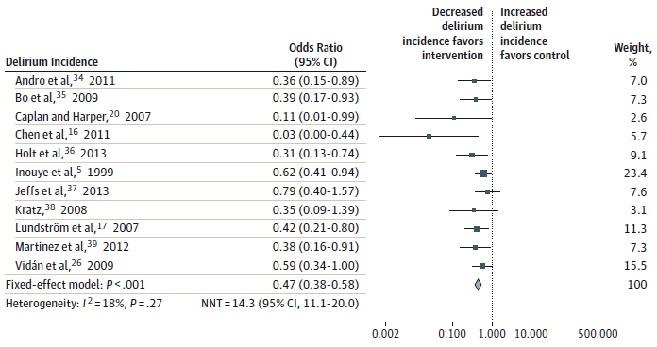
Delirium is preventable
(N=3,751)
Hshieh TT et al. JAMA IM. 2015; 175:512-520
Notes:
In a meta-analysis of 11 clinical trials of delirium involving 3751 patients, that odds of delirium were 53% lower in the intervention group compared with controls (OR 0.47, 95% CI 0.38-0.58).
The prevention programs were multicomponent targeted risk factor intervention strategies, based on the Hospital Elder Life Program (HELP)

Slide 9
Evidence on nonpharmacologic prevention for delirium
In hospital setting, meta-analysis from 2021¹ found:
  22 RCTs (N=5718), 43% reduction in delirium, RR=0.57 (95% CI 0.46-0.71)
  Most effective interventions: reorientation, cognitive stimulation, and sleep hygiene
In ICU setting, meta-analysis from 2022² found:
  29 RCTs (N=7005), 57% reduction in delirium, OR=0.43 (95% CI 0.22-0.84)
  Most effective interventions: early mobilization and family involvement
1. Burton JK. Cochrane Database of Systematic Revs 2021; 7:CD013307; 2. Chen TJ. Int J Nurs Stud 2022; 131:104239 (epub)

Slide 10
Nonpharmacologic approaches in delirium
Well-accepted for delirium prevention
  Included in all delirium guidelines to date
  The “gold standard” approach
  Doing it well—consistently, effectively—not often achieved
To date, effective delirium treatment has not been demonstrated consistently
  No consistently effective pharmacologic approach
  Nonpharmacologic approaches only modestly effective to date

Slide 11
What I learned from conducting the first-ever delirium prevention trial

Slide 12
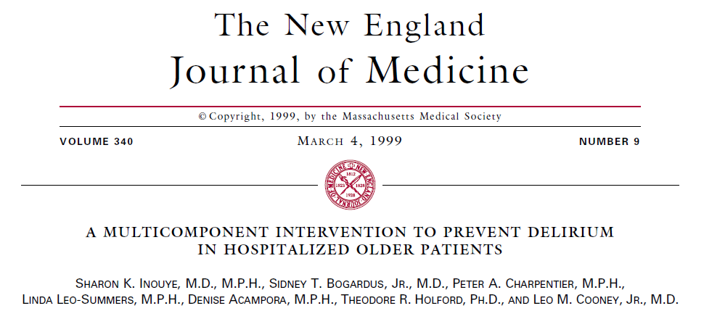

Slide 13
Key lessons learned
  Study design
  Selection of study population
  Control group considerations
  Potency of intervention
  Assuring and tracking adherence
  Blinding
  Contamination
Notes:
Lessons that I learned by “doing”. Great to learn these lessons in advance to enhance your work and avoid serious mistakes that will threaten the effectiveness and validity of your trial.

Slide 14
Study design
A randomized parallel-arm controlled trial is the gold standard, and preferred approach if at all possible
May not be possible (as was not in our study)—be aware that this is a huge compromise
  Consider other alternatives
    Acknowledge their strengths and limitations
    Be aware of potential for bias
  Pragmatic designs
  Involve your experts

Slide 15
Selection of study population
“at risk, but not too high”
Selection of your study population is key
Be sure there will be sufficient delirium
Moderate risk is best, to make sure you can intervene to make a difference
  High risk is harder to impact and make a difference
  Some delirium will not be readily amenable to interventions
Feasibility considerations: comparable control group available for RCT
Notes:
Risk stratification based on existing predictive models, or develop and test your own.

Slide 16
Control group considerations
Essential to determine effectiveness of your intervention
Different types to consider, seek expert input:
  Historical controls
  Concurrent controls (preferred)
    Usual care
    Active control (e.g., time or attention control)

Slide 17
Assuring potency of intervention
Must select intervention(s) such that you are assured there will be adequate effect to truly impact the outcome
With delirium and its complex multifactorial etiology, this may involve more than a single intervention
Also need to be assured that the intervention(s) chosen will impact on the targeted risk factor or causal pathway enough to make a difference
  EG: Vision: Just arranging an eye doctor visit unlikely to be a potent enough single intervention.

Slide 18
Importance of adherence
“intervention only works if it’s received”
Just as with a drug, adherence is extremely importance in a nonpharmacologic intervention
In a prior study, we demonstrated a dose-response effect of our HELP intervention
Delirium reduction correlated directly with the proportion and completeness of assigned protocols received.

Slide 19
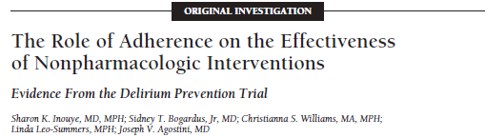
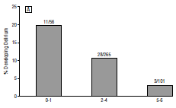
Arch Intern Med. 2003;163:958-64
Low Intermediate High
Adherence rate

Slide 20
Blinding
Blinding is an important tool in clinical trials to reduce bias
  Refers to keeping investigators, data collectors, and study participants blinded to their assigned intervention group
Often not feasible to keep patients and investigators blinded with a behavioral or unit-wide intervention
Important to keep data collectors/assessors blinded
Also recommend assessing effectiveness of blinding at end of trial

Slide 21
Minimizing contamination
Contamination occurs when the control group receives the intervention or co-interventions that may influence the intended outcome
This is very hard to avoid in a unit-wide behavioral intervention, where staff must be trained
Staff (even patients) move to control floors
  Staff become motivated to implement interventions
  Changes in practice occur over time

Slide 22
First steps first…
This talk is intended to be a brief overview
If you decide to pursue a clinical trial of nonpharmacologic intervention program, be sure you get the training and expertise you need.
  Detailed, in-depth understanding of each topic I’m presenting will be required
  Seek out an expert in RCT methods—design and analysis—as a key partner on this journey
Start with a clear, detailed research question that includes your aims, comparators, outcomes.

Slide 23
Delirium treatment: Designing a nonpharmacologic intervention
Approaches based on what we know about pathophysiology, vulnerability, and precipitating factors
Multi-component approach required
Balance effectiveness with feasibility

Slide 24
Designing the Ideal Intervention
What would it look like?
  Highly potent
  Good safety profile; minimal adverse effects
  Straightforward, standardizable, reproducible
  Acceptable to patients and staff
  Effective and cost-effective

Slide 25
Challenges for Treatment Trials
More complex, since treating delirium is more difficult once it occurs
Many different etiologies (vulnerability and precipitating factors) will need to be addressed
Multi-pronged approach will be required for potency
Select factors which are readily amenable to intervention

Slide 26
What approaches are likely to be effective?
Multi-component approach
Remove or treat underlying cause(s)
Restore cognitive and physical function
Manage delirium behaviors
Prevent or remediate complications
Caveat: not feasible to address all factors

Slide 27
Remove or treat underlying cause(s)
Development:
  Identify ~10 most common etiologies
  Develop standardized assessments/interventions for these (“menu”)
Personalized medicine:
  Customize approach in tailored approach
  Stepped or menu-driven approach for individualization
  Must be able to standardize protocols and monitor adherence

Slide 28
Restore cognitive and physical function
Rehabilitative approaches, targeted to maximizing functioning and independence.
Consider PT/OT options
Cognitive retraining
Family education and participation
Coordinated transitional care

Slide 29
Manage delirium behaviors
Agitation and inappropriate behaviors
Nonpharmacologic strategies 1st: behavioral interventions, family participation
Pharmacologic approaches reserved for severe agitation: beware of vicious cycles of medications and worsening delirium
Low-dose pharmacologic approach

Slide 30
Prevent or remediate potential complications
Oversedation/medication adverse effects
Immobility, functional decline, falls
Poor oral intake, dehydration/malnutrition
Aspiration risk
Sleep disturbance
Urinary incontinence
Pressure ulcers
DVT/pulmonary embolism

Slide 31
Principles of Implementation
Pilot test all protocols for feasibility and acceptability; effect on process measures
Design systematic approaches to assure that all interventions are received
Build in quality assurance procedures to track and maximize adherence and to minimize missing data

Slide 32
Implementation Issues
Multidisciplinary team likely needed for effectiveness:
  Physician: proactive consultation for causes
  Nursing: interventions
  Pharmacist: medications
  Rehabilitation therapists
  Trained volunteers
Develop standardized intervention protocols
Prioritize: avoid unfeasible number of interventions per patient

Slide 33
Choosing your study outcomes
Choose your endpoints carefully to define intervention effectiveness
Delirium: [do not overweight agitation]
  Shortening duration and/or severity
  Decrease delirium recurrence
Not delirium alone:
  Reduce adverse clinical outcomes (both short- and long-term): LOS, costs, readmission, NH placement, death
  Return to functional independence
NB: Large sample size may be needed

Slide 34
If we could shorten delirium…
The potential cost savings would be:
>$164 (US) billion per year in United States
>$182 billion (US) in 18 European countries
We have not a moment to lose

Slide 35
Treating delirium may offer the unprecedented opportunity to prevent or ameliorate future cognitive decline.
Notes:
The preponderance of evidence suggests that preventing delirium may offer us an unprecedented opportunity to prevent or ameliorate future cognitive decline (as already demonstrated with HELP!). To quote Dr. Ara Katchatarian, he states that this is "low hanging fruit" for the dementia world, and a call to action for all of us to consider delirium as an important preventable factors for dementia. And to add delirium prevention as a major treatment option for all our patients when they are admitted to the hospital or scheduled for surgery.
We already know how to prevent delirium, and it’s time we implement these strategies to improve outcomes for persons with dementia.

Slide 36

Join NIDUS to connect to Delirium Research!
What is NIDUS? Network for Investigation of Delirium: Unifying Scientists!
NIA-funded research network dedicated to advancing the study of delirium through collaborative studies, use of NIDUS research resources, career development opportunities, and dissemination of delirium science.
How to be involved:
Apply to attend the Delirium Boot Camp – 2.5-day workshop on delirium research
Apply for Pilot Grants and Collaboration Awards. Attend webinars.
  LOI Due December 7, 2022 https://deliriumnetwork.org/pilots/nidus-ii-pilots-loi/
Use our Research and Measurement Resources! Search the NIDUS bibliography!
Register for website deliriumnetwork.org to access our blog, resources and receive NIDUS newsletter and announcements.
Follow NIDUS online!
Twitter: @nidus_delirium Facebook: NIDUSDelirium Email: nidus@hsl.harvard.edu
@sharon_inouye

