Slide 1
Advice for Early Stage Investigators
Luci Roberts, Ph.D.
Program Director, National Institute on Aging,
National Institutes of Health

Slide 2
Financial Disclosures
Nothing to report

Slide 3
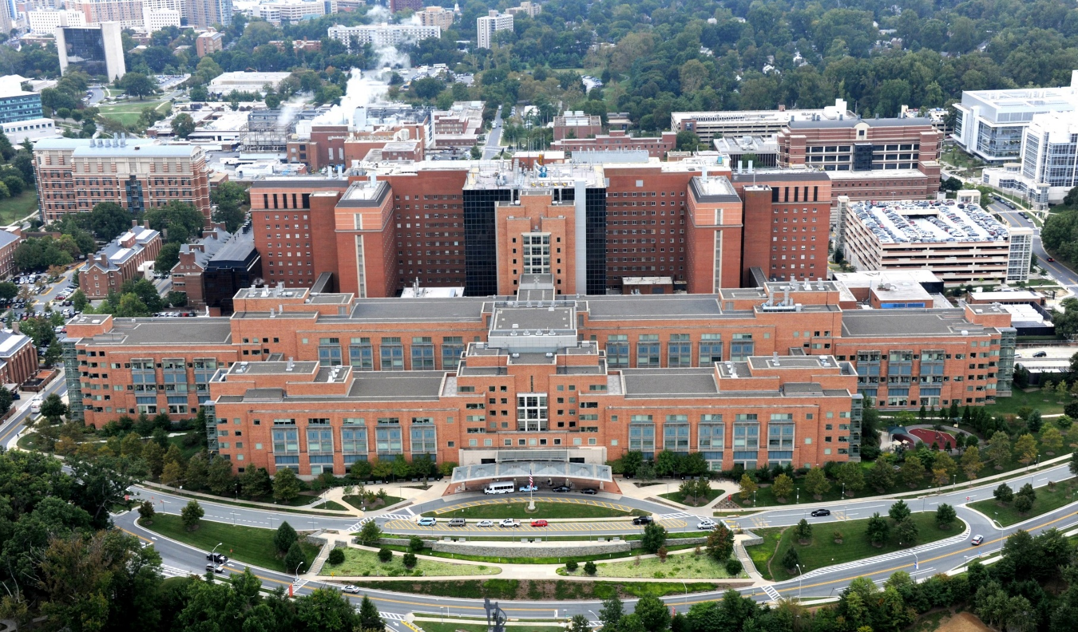
Who We Are
NIH/NIA Budget Update
$45 B for FY ‘22
Largest public funder of biomedical research in the world.
Clinical Center (Building 10), NIH Campus

Slide 4
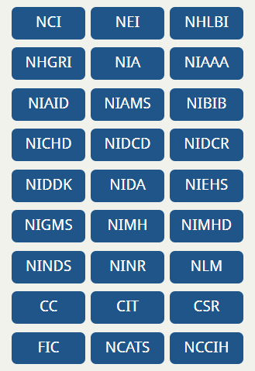
National Institutes of Health
27 Institutes and Centers (ICs)
Each IC has its own
mission,
priorities,
budget, and
funding strategy.

Slide 5
Proposed FY ’23:
$4.24 B
?

Slide 6
Outline
Getting started at NIH
Five points of advice for writing a successful grant application:
Know the purpose of the program and its review criteria
Tell Reviewers what they need to know to favorably evaluate your application
Use NIH’s data to better understand the scientific landscape around your application
Avoid applying for the R21 Activity Code – Look for “Signature Programs” for New and Early Stage Investigators
Build your Networks !!!
Then I will take questions.

Slide 7
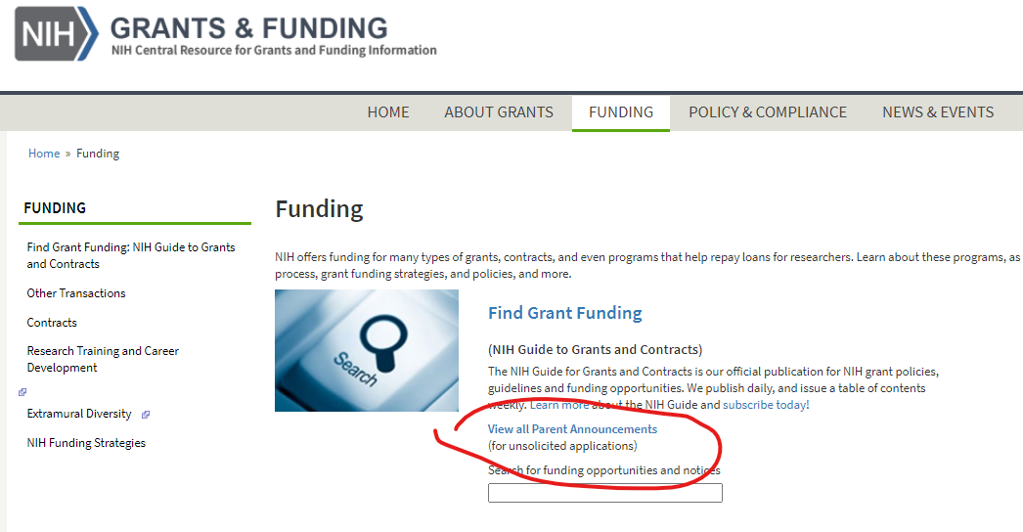
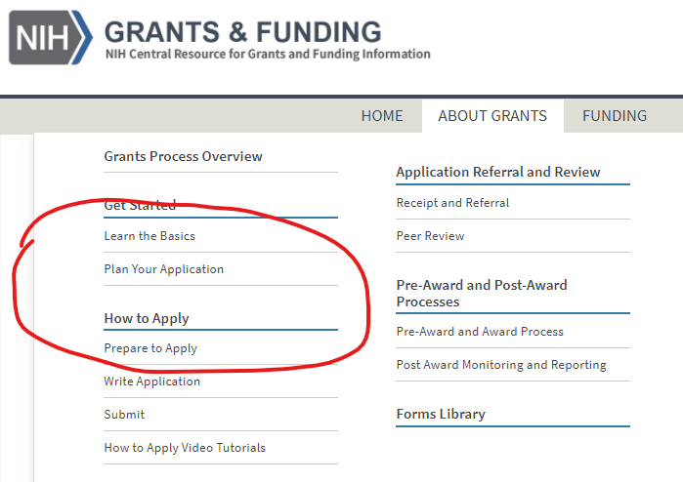
How to Apply? Grants.NIH.gov
NIH publishes funding opportunities (FOA) = a call for applications
Targeted FOA = targeted to a certain topic or group of investigators
Parent FOA = available for investigators to propose their own topic

Slide 8
Know the purpose of the program and its review criteria
“The purpose of the NIH Mentored Patient-Oriented Research Career Development Award (K23) is to support the career development of individuals with a clinical doctoral degree who have made a commitment to focus their research endeavors on patient-oriented research. ”
“The NIH Research Project Grant supports a discrete, specified, circumscribed project in areas representing the specific interests and competencies of the investigator(s). ”

Slide 9
Review Criteria - K23
Candidate
Career Development Plan/Career Goals and Objectives
Research Plan
Mentor(s), Co-Mentor(s), Consultant(s), Collaborator(s)
Environment & Institutional Commitment to the Candidate
State Long-term and Immediate Career Objectives
Explain how Career Development Plan, Research Plan, Mentors and Institution will help fulfill career objectives
Letters of support must express commitment to fulfilling candidate’s career objectives

Slide 10
Review Criteria – R01
Significance
Investigator(s)
Innovation
Approach
Environment
Focus of review criteria is the research project
Approach, Significance, Innovation
These three criteria are weighted most heavily
Other criteria assess how the research objectives are advanced.
Investigator(s), Environment

Slide 11
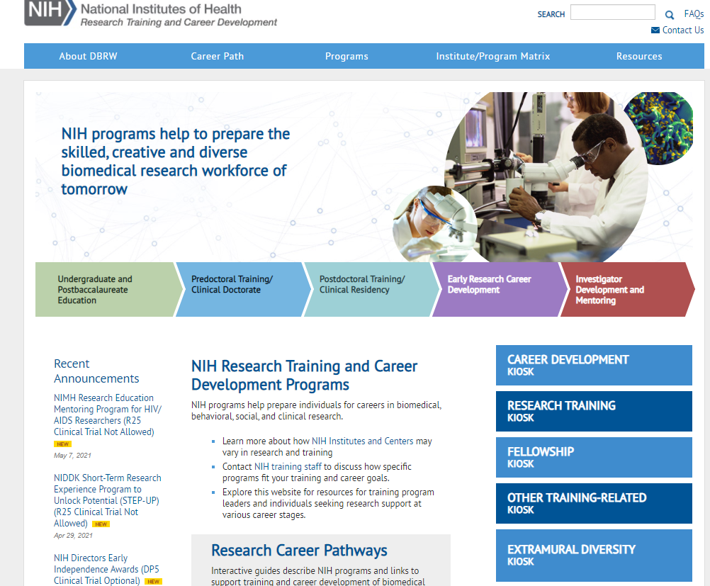
https://researchtraining.nih.gov/

Slide 12
Tell Reviewers what they need to know to favorably evaluate your application
Explain in the application:
How the project is significant and innovative
How the project fulfills the objectives of the program
If there are controversies or conflicting literature in the field, it must be discussed in the application (conceptual framework; background and significance) – explain how research informs the discussion.
Don’t ignore limitations in the application in hopes that reviewers don’t notice them.
It is better to make the argument for your chosen solution
Assures reviewers you have thought of (almost) everything

Slide 13
Use the NIH data to better understand the scientific landscape around your application
Look for funded grants similar to your own
“Futurecasting”
Talk to other successful applicants about their experiences and strategies
Use NIH tools to find study sections and information about the review loci for RFAs

Slide 14
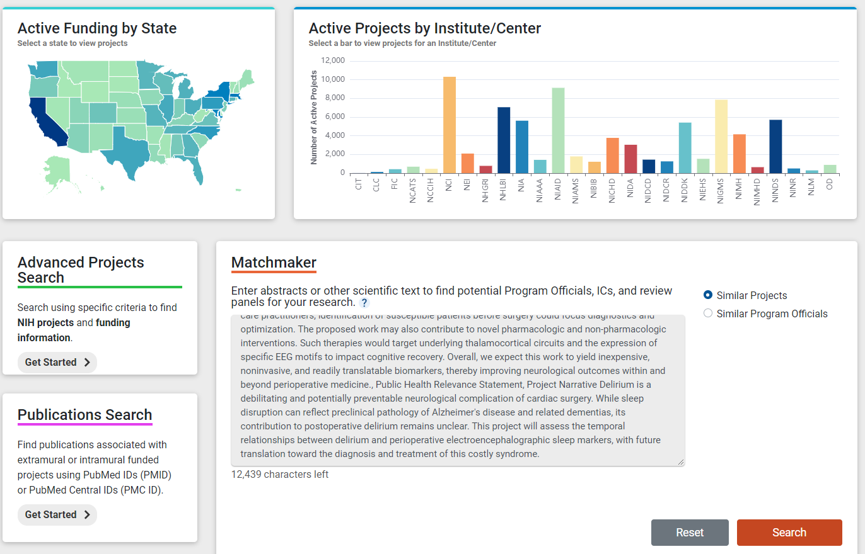
Finding Funded Grants…

Slide 15
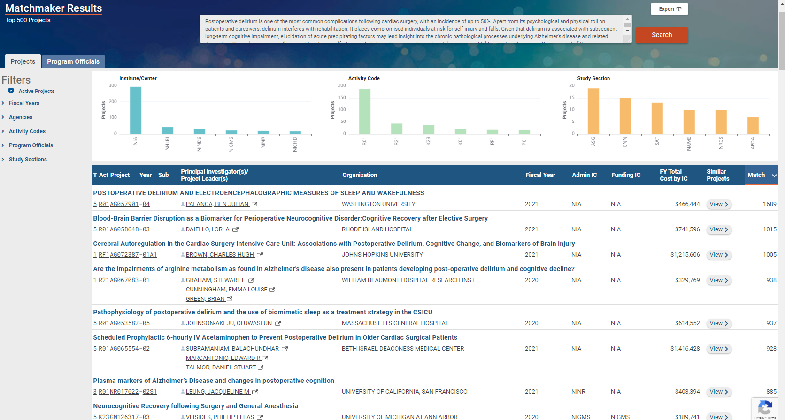

Slide 16
Avoid applying for the R21; Look for ESI/NI targeted opportunities instead
Why? Reviewers look for fit with purpose, e.g. the “high risk – high reward” aspects of the application
Look for the stated purpose from the parent announcement:
https://grants.nih.gov/grants/guide/pa-files/PA-20-195.html
“…providing support for the early and conceptual stages of these projects. These studies may involve considerable risk but may lead to a breakthrough in a particular area, ”
Reviewers look for evidence that approach is “feasible”; risk is “mitigated” in the hands of this investigator
Read: Preliminary data – not required but established investigators often provide it
Limited funds and time make challenges for inexperienced managers, reviewers know this
No benefit to Early Stage Investigators applying for the R21, so enlist established investigator to collaborate as a MPI
Instead, look for Signature Programs targeted to Early Stage (ESI) and New Investigators (NI)
Trans-NIH programs like the Katz award, New Innovator, and Diversity Supplements;
Most Institutes and Centers have targeted opportunities that address scientific priorities or workforce goals.

Slide 17
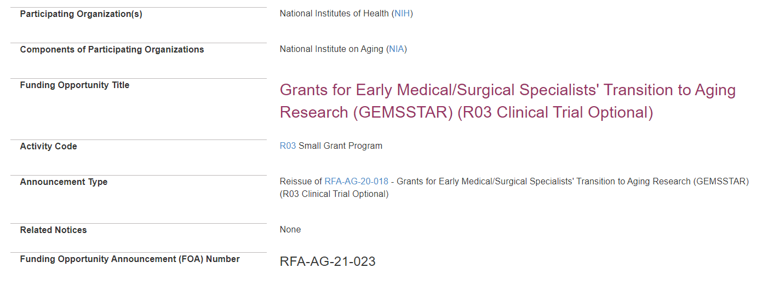
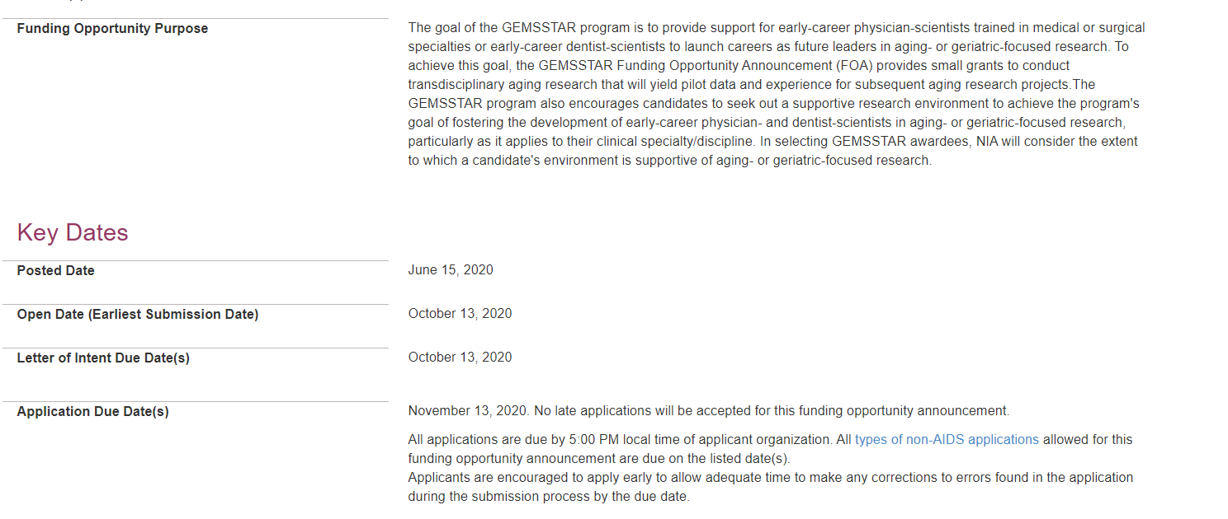
Also see PAS-19-391;
PAS-19-392; PAS-19-393;
Next Generation of Researchers in AD/ADRD Research: Existing Data Sets; Basic Science; Systems Biology
$100K/year for two years;
Standard Receipt Dates
$100K/year for two years
Targeted to clinicians;
Receipt Dates in October
Award rate in FY ‘21: 35% !!!

Slide 18
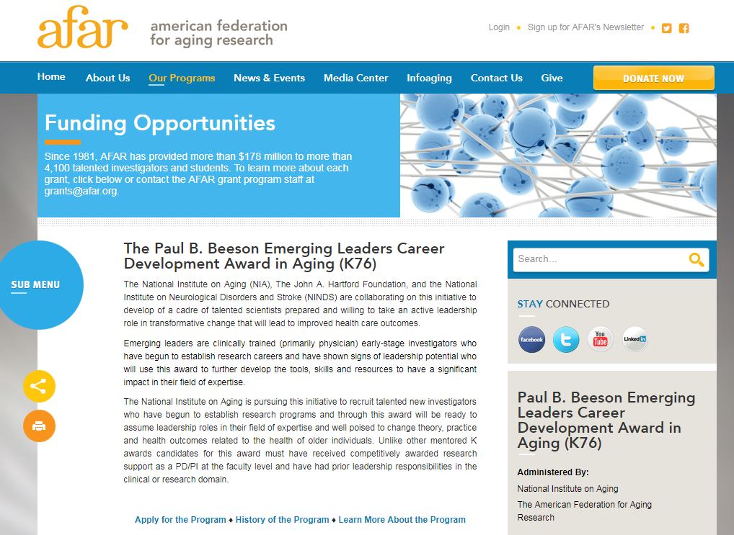
RFA-AG-21-020; RFA-AG-21-021
Receipt Dates:
October 22, 2021; October 21, 2022
7-10 Awards per year;
Budgets limited to $225,000
Per year direct costs
For ESIs who have successfully competed for a research grant, i.e., R03 or other non-R01 equivalent
Candidates must have a research or clinical doctoral degree, including, but not limited to PhD, MD, DO, DDS, DMD, OD, DC, PharmD, ND, and DVM.
Review criteria include evaluation of the candidate's background as an emerging leader

Slide 19
Stephen I. Katz Early Stage Investigator Research Project Grant
https://grants.nih.gov/sites/default/files/katz-esi-r01-award-program.pptx

Slide 20
Subscribe to NIA’s listserv to be notified about next year’s program at: https://www.nia.nih.gov/research/blog/about

Slide 21
Build your Networks !!!
Don’t try to be too self-reliant
Many will want to help you, so if the first person does not respond, keep asking until you find your partners
Don’t underestimate the value of casual acquaintances
https://snap.stanford.edu/class/cs224w-readings/granovetter73weakties.pdf
https://pubmed.ncbi.nlm.nih.gov/35332225/

Slide 22
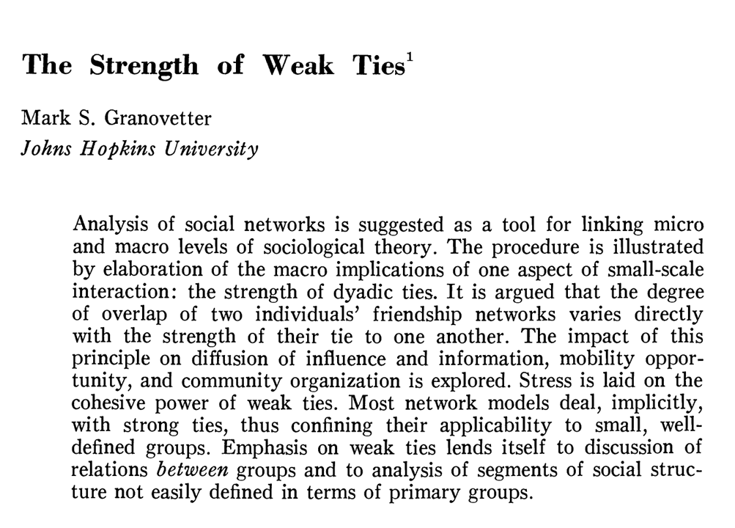
American Journal of Sociology (1973) 78 (6) 1360 – 1380.

Slide 23
The Strength of Weak Ties
The more frequently people interact, the stronger their sentiments of friendship are apt to be; these are strong ties, and they tend to exist within a social network
Weak ties are, conversely, ties between people who do not interact frequently
Strong ties transmit the majority of content, but usually within groups
Content is more likely to be transmitted across groups through weak ties
For a direct test of this theory using publications, see Fronczak, et al. Sci. Rep. (2022) doi: 10.1038/s41598-022-09118-8.

Slide 24
Build your Networks !!!
Don’t try to be too self-reliant
Many will want to help you, so if the first person does not respond, keep asking until you find your partners
Don’t underestimate the value of casual acquaintances
https://snap.stanford.edu/class/cs224w-readings/granovetter73weakties.pdf
https://pubmed.ncbi.nlm.nih.gov/35332225/
NIA Program Staff get much email, are often on travel, reading email on tiny screens. You may have to send a reminder email to get a response.
We do want to speak to you, it’s the fun part

Slide 25
Luci Roberts, Ph.D. Behavioral and Systems Neuroscience Branch Division of Neuroscience, National Institute on Aging roberlu@mail.nih.gov Susan Zieman, M.D., Ph.D. Division of Geriatrics and Clinical Gerontology National Institute on Aging susan.zieman@nih.gov

Slide 26
Research Challenges with Older Adult populations
Comorbidity
Controlling for many covariates affects power
Coordination challenges
Participants may no longer drive or be cognitively impaired, caregivers need to be included and/or home visits needed
Continuity
Attrition levels may be higher depending upon context
Demographics
Recruiting underrepresented populations and participants of average educational backgrounds is challenging
Pre-delirium Health and Cognitive Status
Need better information about participant condition prior to hospitalization

Slide 27
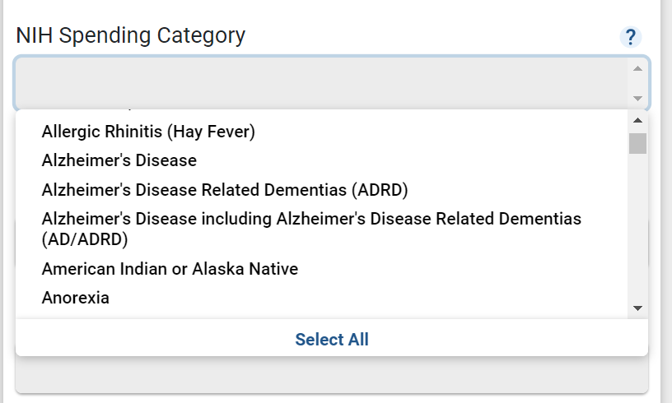
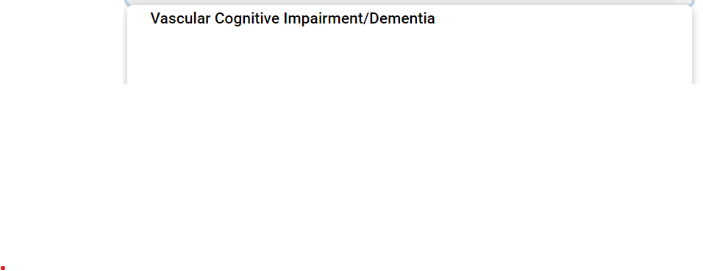
RCDC: NIH’s Text Mining Engine
Briefly explain the relevance of proposed work to dementia/ Alzheimer’s disease
Abstract
Public Health Relevance
Specific Aims
Use terms related to Alzheimer’s disease related dementia’s

Slide 28
NIA Strategic Directions for Research (2020—2025)
https://www.nia.nih.gov/about/aging-strategic-directions-research
Point of reference for NIA’s research priorities over the next five years
Encompasses these following broad goals:
To understand the dynamics of the aging process;
To improve the health, well-being, and independence of adults as they age;
To support the research enterprise
https://www.nia.nih.gov/about/bypass-budget-proposal-archive
Bypass Budget Proposal for Fiscal Year 2022 (PDF, 5.37M)
Fiscal Year 2022 Executive Summary (PDF, 371K)
Link to the Research Implementation Milestones Database
Link to the Report of 2019-2020 Scientific Advances for the Prevention, Treatment, and Care of Dementia
28

