Slide 1
NIDUS BOOT CAMP 2020 Family Caregivers Role in Delirium Tanya Mailhot, RN. PhD. Assistant Professor Faculty of Nursing Université de Montréal Dr. Deborah D’Avolio, PhD, BC-ACNP, ANP Nurse Coach (BC), Associate Professor Christine E. Lynn College of Nursing Florida Atlantic University

Slide 3
BACKGROUND & SIGNIFICANCE
U.S > 96% of older adults (OA) live in the community
Among those who need assistance 74% suffer from Alzheimer's disease and related dementias (ADRD) (National Academies of Sciences, Engineering, and Medicine, 2016).
older adults with dementia (ADRD) are at high risk for delirium
Often preventable, treatable, frequently misdiagnosed, not recognized by providers and family caregivers (Leslie & Inouye, 2011)

Slide 4
BACKGROUND & SIGNIFICANCE
43.5 million adults in the US have provided unpaid care in the prior 12 months.
8 out of 10 caregivers (84%) could use more information or help on caregiving topics.
Family caregivers-unsupported, marginalized, have limited time and are overextended (National Academies of Sciences, Engineering, and Medicine, 2016).
Purpose of the Study: Develop & implement a multi-component coaching intervention to provide caregivers with delirium knowledge & skills to assess for delirium

Slide 5
METHODS
Integrated mixed methods design
Survey data augmented with semi-structured interviews
Purposive sample of 20 FCGs of OAs with dementia (dyads)
Pre/post focus group and measurements
6 weeks of telephone coaching
FG daily assessments, FAM-CAM
Paired Sample t-test, Correlations and GLM investigate changes over time and relationships variables and outcomes
Semi-structured interview guide, pre and post focus groups, weekly telehealth coaching
Demographics, caregiving history, delirium knowledge, FAM-CAM, Modified Caregiver Strain Index, SF-36, Human Conn. Scale

Slide 6
INTERVENTION
Delirium education: what it is, predisposing factors, causes, signs and symptoms, prevention strategies, when to seek healthcare, differences-dementia and delirium
Weekly coaching focused on the caregivers’ needs, stress reduction/awareness exercises
Scripting for discussion of possible signs and symptoms with healthcare provider

Slide 7
RESULTS: Caregivers 58 – 89 YRS

Slide 8
RESULTS: Paired Sample t-test, Effect Sizes
Notes:
Statistically significant positive correlation between the Human Connection Scale and the SF-36 pretest domain of general health (r=.47, p=.04)
Statistically significant positive correlation between the Human Connection Scale and the SF-36 posttest domains-physical functioning (r=.54, p=.014) and general health (r=.76, p=_<.001)

Slide 9
RESULTS
Small, positive changes-mean scores on each domain between pre and post test on SF-36
Scores on the Modified Caregiver Strain Index were higher on the pretest (M=13.15) than on the post test (M=11.9)
Many changes indicated a moderate effect
> Social Engagement: friends, golfing, cruise, family, elder day care

Slide 10
RESULTS
Most impressive-FCG identification of delirium using FAM-CAM, No hospitalizations during study period
20 participants-no hx of delirium
6 of 20 (30%) reported at least one episode, tx at home by PCP, undiagnosed UTIs, new medications
Weekly coaching sessions beneficial and supportive

Slide 11
DISCUSSION
Coaching may have a meaningful impact on caregiver empowerment and delirium knowledge; prevention, assessment, and intervention
Telehealth Coaching support is uniquely suited to FCGS who have limited time, freedom and mobility
FCGs report heightened awareness
FCGS report rewarding experience
Data from this study of FCGs demonstrates the feasibility of using technological interventions for this population.

Slide 12
CONCLUSION
Telehealth coaching-empowers caregivers to prevent and assess (30% incidence)
>HRQOL, >support, >human connection <stress through awareness/stress reduction
Reported positive benefits of intervention
Enhanced understanding of delirium
Caregiver empowerment
Positive experiences and satisfaction of telehealth by family caregivers
Pilot Study- further research is needed

Slide 13
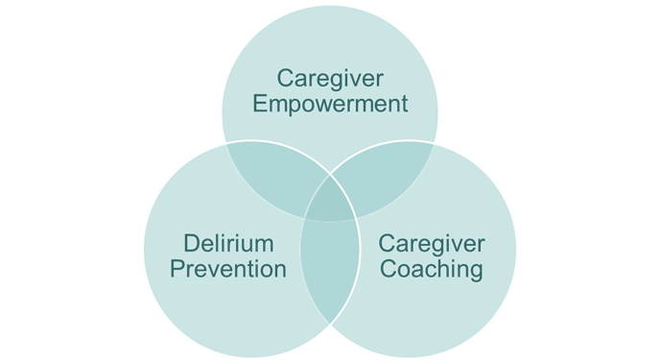
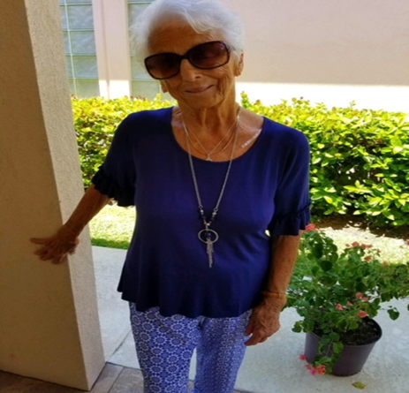
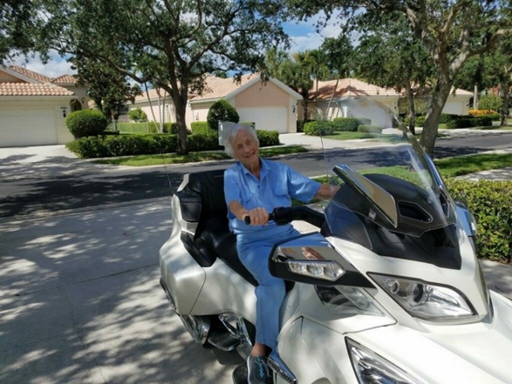
Acknowledgements
Funding-Network for the Investigation of Delirium Unifying Scientists, NIDUS Mentors
Guests %& Staff Greene Memory & Wellness Center Florida Atlantic University
Study Participants & Collaborators

Slide 14
NORTHEASTERN UNIVERSITY Tanya Mailhot, RN PhD, Chad Darling, MD, MSc, Jillian Ela, BS, Yelena Malyuta, BS, Sharon K. Inouye, MD, MPH, and Jane Saczynski, PhD
UNIVERSITÉ DE MONTRÉAL & MONTREAL HEART INSTITUTE Tanya Mailhot RN PhD, Sylvie Cossette RN PhD, José Côté RN PhD, Anne Bourbonnais RN PhD, Marie-Claude Côté MD, Yoan Lamarche MD MSC and André Denault MD PhD
Notes:
Tanya Mailhot, Sylvie Cossette, José Côté, Anne Bourbonnais, Marie-Claude Côté, Yoan Lamarche and André Denault

Slide 15
BACKGROUND & SIGNIFICANCE
Among older adults in acute and critical care:
Family caregivers are an untapped resource for aiding in the identification of delirium;
Family caregivers are the best sources of information on the acute onset;
Family caregivers have a critical knowledge of a patients’ baseline level of cognitive function.
Incorporating family caregivers’ observations, by use of a structured instrument, may help identify delirium
Incorporating family caregivers’ knowledge, may support management of delirium

Slide 16
FAMILY CAREGIVERS AND DELIRIUM
Families’ knowledge of the patient
Observation
Personalization
Detection of delirium in the ED
Management of delirium in cardiac ICU
FAMCAM
MENTOR_D INTERVENTION

Slide 17
PROJECTS – FAMCAM
AIM
Examine the performance of the Family-Confusion Assessment Method (FAM-CAM) in the ED compared to the Confusion Assessment Method (CAM) completed by trained interviewer, among patients with and without dementia.
Examine whether long-term outcomes (length of stay, ED readmission, hospital admission and mortality within six-month) differed by FAM-CAM result was also assessed.

Slide 18
PROJECTS – FAMCAM
METHODS
Study setting: A tertiary-care, academic ED in Central Massachusetts.
Sample: 108 patient and family caregiver dyads;
Eligible family caregivers were required to have regular interactions, in person or via phone conversations, with the patient at least once a week
Procedure: * The interviewer was blind to FAM-CAM responses when scoring the CAM and the caregivers were blind to the CAM when completing the FAM-CAM.
Measures: FAM-CAM, CAM, IQCODE, hospital length of stay, ED readmission, hospital admissions and mortality
Notes:
Study setting: A tertiary-care, academic ED in Central Massachusetts.
Sample:
108 patient and family caregiver dyads;
patients admitted to the ED at a large teaching hospital and their family caregivers;
Eligible family caregivers were required to have regular interactions, in person or via phone conversations, with the patient at least once a week
Procedure: * The interviewer was blind to FAM-CAM responses when scoring the CAM and the caregivers were blind to the CAM when completing the FAM-CAM.
Interviewer performed a cognitive screen, a delirium symptom assessment, and reference standard CAM rating
Caregiver completed the FAM-CAM independently.
Measures: FAM-CAM, CAM, Informant Questionnaire on Cognitive Decline in the Elderly (IQCODE), hospital length of stay, ED readmission, hospital admissions and mortality

Slide 19
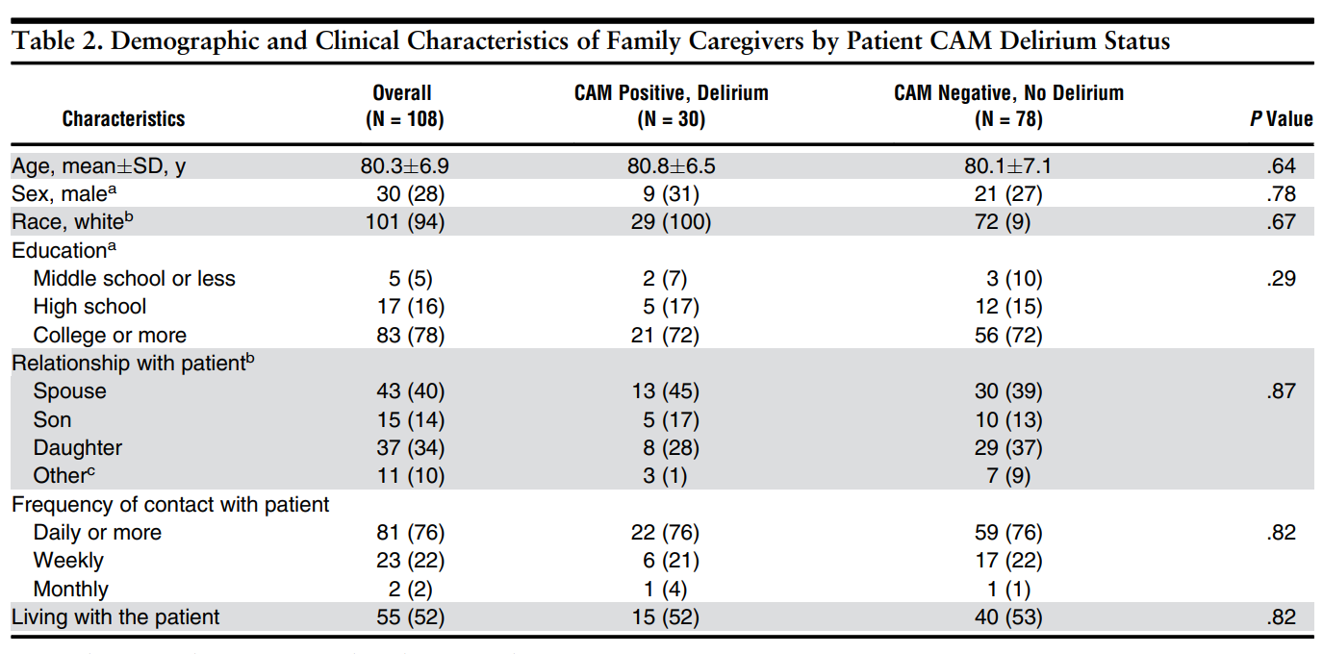
PROJECTS – FAMCAM
RESULTS
Notes:
Study setting: A tertiary-care, academic ED in Central Massachusetts.
Sample:
108 patient and family caregiver dyads;
patients admitted to the ED at a large teaching hospital and their family caregivers;
Eligible family caregivers were required to have regular interactions, in person or via phone conversations, with the patient at least once a week
Procedure: * The interviewer was blind to FAM-CAM responses when scoring the CAM and the caregivers were blind to the CAM when completing the FAM-CAM.
Interviewer performed a cognitive screen, a delirium symptom assessment, and reference standard CAM rating
Caregiver completed the FAM-CAM independently.
Measures: FAM-CAM, CAM, Informant Questionnaire on Cognitive Decline in the Elderly (IQCODE), hospital length of stay, ED readmission, hospital admissions and mortality

Slide 20
PROJECTS – FAMCAM
RESULTS
Notes:
Study setting: A tertiary-care, academic ED in Central Massachusetts.
Sample:
108 patient and family caregiver dyads;
patients admitted to the ED at a large teaching hospital and their family caregivers;
Eligible family caregivers were required to have regular interactions, in person or via phone conversations, with the patient at least once a week
Procedure: * The interviewer was blind to FAM-CAM responses when scoring the CAM and the caregivers were blind to the CAM when completing the FAM-CAM.
Interviewer performed a cognitive screen, a delirium symptom assessment, and reference standard CAM rating
Caregiver completed the FAM-CAM independently.
Measures: FAM-CAM, CAM, Informant Questionnaire on Cognitive Decline in the Elderly (IQCODE), hospital length of stay, ED readmission, hospital admissions and mortality

Slide 21
PROJECTS – FAMCAM
RESULTS
Notes:
Among patients with and without dementia, the FAM-CAM shows qualities that are important in the ED setting for identification of delirium. Using the FAM-CAM as part of a systematic screening strategy for the ED, in which familiesʼ assessments could supplement healthcare professionalsʼ assessments, is promising
Among the 108 patients, 30 (28%) were CAM positive for delirium and 58 (54%) presented with dementia. The FAM-CAM had a specificity of 83% and a negative predictive value of 83%. Most false negatives (n = 9 of 13, 69%) were due to caregivers not identifying the inattention criteria for delirium on the FAM-CAM. In patients with dementia, sensitivity was higher than in patients without (61% vs 43%). In adjusted models, a hospitalization in the following 6 months was more than three times as likely in FAM-CAM positive compared to negative patients (odds ratio = 3.4; 95% confidence interval = 1.2-9.3).

Slide 22
PROJECTS – FAMCAM
CONCLUSIONS
Among patients with and without dementia, the FAM-CAM shows qualities that are important in the ED setting for identification of delirium.
Using the FAM-CAM as part of a systematic screening strategy for the ED, in which familiesʼ assessments could supplement healthcare professionalsʼ assessments, is promising.

Slide 23
PROJECTS – MENTOR_D
AIM
To assess the feasibility, acceptability and preliminary efficacy of a nursing intervention involving family caregivers in delirium management following cardiac surgery

Slide 24
PROJECTS – MENTOR_D
METHODS
Randomized pilot study
Study setting: A tertiary-care, academic cardiac surgery ICU in Montreal.
Sample: 30 patient with delirium and family caregiver dyads;
Family caregivers: self identified as family member of the patient
As patients were required to present with delirium at study entry, recruitment was achieved through surrogate consent by the FC initially and then confirmed by the patient after delirium resolution.
Procedure: control : standard care and experimental: MENTOR_D intervention.
Measures: CAM-ICU, DI, TAPQ, STAIS, Self-effiacy
Notes:
Study setting: A tertiary-care, academic ED in Central Massachusetts.
Sample:
108 patient and family caregiver dyads;
patients admitted to the ED at a large teaching hospital and their family caregivers;
Eligible family caregivers were required to have regular interactions, in person or via phone conversations, with the patient at least once a week
Procedure: * The interviewer was blind to FAM-CAM responses when scoring the CAM and the caregivers were blind to the CAM when completing the FAM-CAM.
Interviewer performed a cognitive screen, a delirium symptom assessment, and reference standard CAM rating
Caregiver completed the FAM-CAM independently.
Measures: FAM-CAM, CAM, Informant Questionnaire on Cognitive Decline in the Elderly (IQCODE), hospital length of stay, ED readmission, hospital admissions and mortality

Slide 25
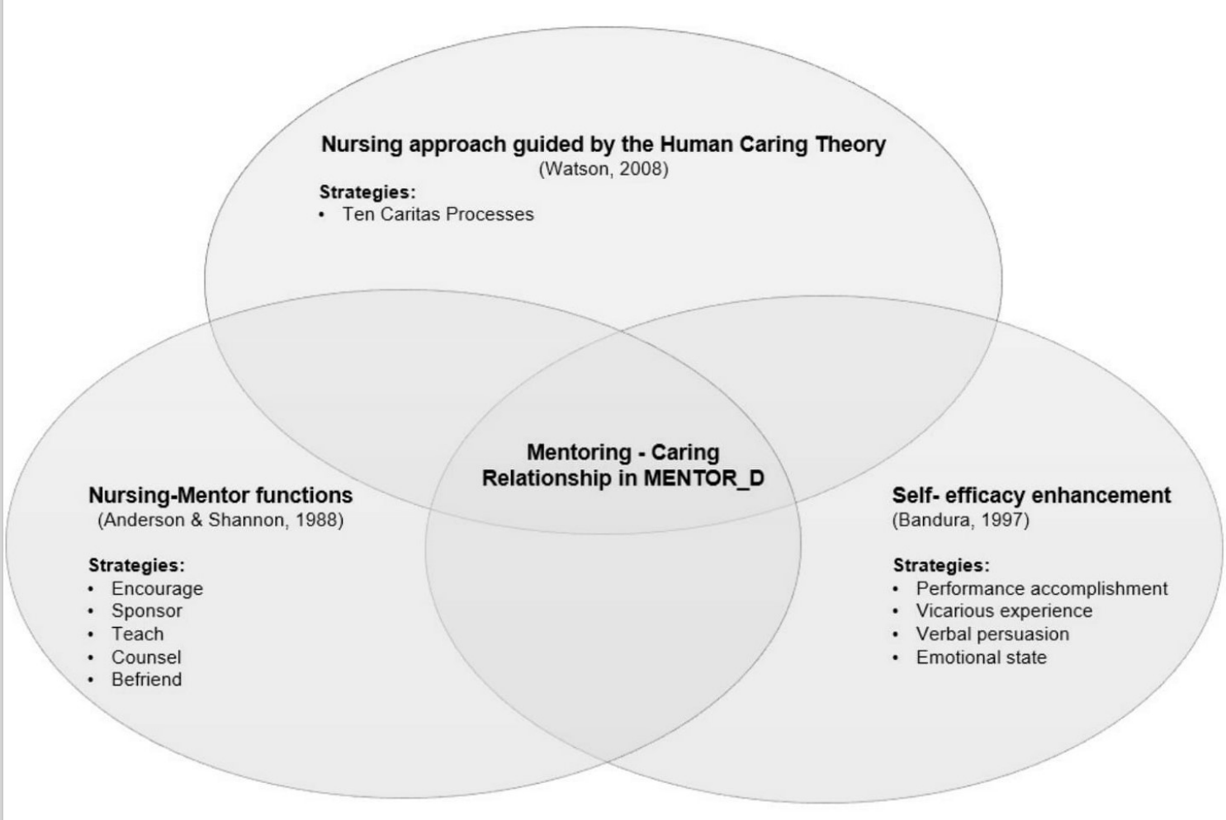
PROJECTS – MENTOR_D
INTERVENTION
Families encouraged to use delirium management interventions
Twice a day during three days following onset
Notes:
Study setting: A tertiary-care, academic ED in Central Massachusetts.
Sample:
108 patient and family caregiver dyads;
patients admitted to the ED at a large teaching hospital and their family caregivers;
Eligible family caregivers were required to have regular interactions, in person or via phone conversations, with the patient at least once a week
Procedure: * The interviewer was blind to FAM-CAM responses when scoring the CAM and the caregivers were blind to the CAM when completing the FAM-CAM.
Interviewer performed a cognitive screen, a delirium symptom assessment, and reference standard CAM rating
Caregiver completed the FAM-CAM independently.
Measures: FAM-CAM, CAM, Informant Questionnaire on Cognitive Decline in the Elderly (IQCODE), hospital length of stay, ED readmission, hospital admissions and mortality

Slide 26
PROJECTS – MENTOR_D
RESULTS
INTERVENTION:
ACCEPTABLE
FEASIBLE
DESIGN:
ACCEPTABLE
FEASIBLE
POTENTIAL OF THE INTERVENTION:
Patient outcomes
Family caregiver outcomes
Notes:
Study setting: A tertiary-care, academic ED in Central Massachusetts.
Sample:
108 patient and family caregiver dyads;
patients admitted to the ED at a large teaching hospital and their family caregivers;
Eligible family caregivers were required to have regular interactions, in person or via phone conversations, with the patient at least once a week
Procedure: * The interviewer was blind to FAM-CAM responses when scoring the CAM and the caregivers were blind to the CAM when completing the FAM-CAM.
Interviewer performed a cognitive screen, a delirium symptom assessment, and reference standard CAM rating
Caregiver completed the FAM-CAM independently.
Measures: FAM-CAM, CAM, Informant Questionnaire on Cognitive Decline in the Elderly (IQCODE), hospital length of stay, ED readmission, hospital admissions and mortality

Slide 27
PROJECTS – MENTOR_D
CONCLUSIONS
The mentoring intervention was acceptable and feasible and shows promising results in improving patients and FC outcomes.

Slide 28
Acknowledgements
Study Participants & Collaborators
Fonds de recherche du Québec – Santé
Montreal Heart Institute Foundation

Slide 29
Challenges
BURDEN OF FAMILIES
RECRUITMENT
TECHNOLOGY

Slide 30
OPPORTUNITIES
The aging of the population implies that an increased number of family caregivers and OA are going to need some form of care or assistance.
Caregiving poses a range of physical, emotional, and financial demands and often causes burden and stress for family members.
Multiple research opportunities to develop and implement supportive interventions for caregivers/care recipients
Thank you

